Slide 1
Terrestrial Planets
Winter 2020
Week 6
Professor Olivia Jensen
Earth and Planetary Sciences
FD Adams 131C

Slide 2
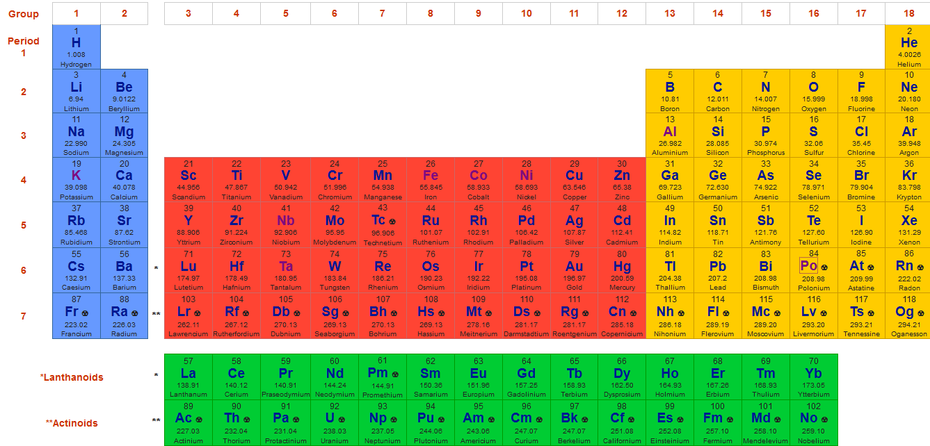
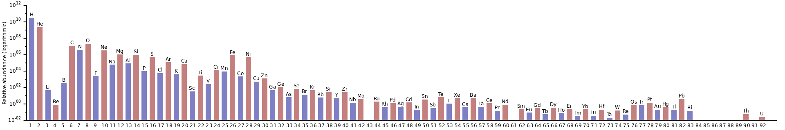
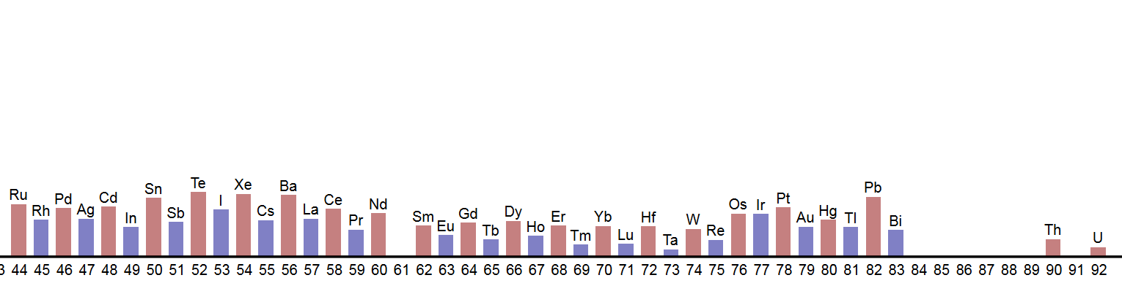
Solar system elemental abundances
By Swift - Own work, CC0: https://commons.wikimedia.org/w/index.php?curid=48991521

Slide 3
Elemental abundances in the Solar System
by atom-relative (to Si 10000)
Element | Atomic number | Atomic weight | Abundance (Urey 1950)
Hydrogen | 1 | 1 | 400000000
Helium | 2 | 4 | 31000000
Oxygen | 8 | 16 | 215000
Neon | 10 | 20 | 86000
Nitrogen | 7 | 14 | 66000
Carbon | 6 | 12 | 35000
Silicon | 14 | 28 | 10000
Magnesium | 12 | 24 | 9100
Iron | 26 | 56 | 6000
Sulfur | 16 | 32 | 3750
Argon | 18 | 40 | 1500

Slide 4
Elemental abundances in the Solar System
by atom-relative (to Si 10000)
Element | Atomic number | Atomic weight | Abundance (Urey 1950)
Aluminum | 13 | 27 | 950
Calcium | 20 | 40 | 490
Sodium | 11 | 23 | 440
Nickel | 28 | 59 | 270
Phosphorus | 15 | 31 | 100
Chlorine | 17 | 35 | 90
Chromium | 24 | 52 | 78
Manganese | 25 | 55 | 69
Potassium | 19 | 39 | 32
Titanium | 22 | 48 | 24
Cobalt | 27 | 59 | 18
Fluorine | 9 | 19 | 16

Slide 5
Accretion – planets, asteroids
Gravity assembles bodies from the materials of the nebula.
In the inner region of the Terrestrial Planets, the materials of the nebula are largely the refractory minerals: silicates and metal oxides.
The volatiles such as H, He, Ne, CH₄ and H₂0 are swept to greater distances in the solar system by the radiation pressure and winds issuing from the Sun. Beyond the “ice line” the Gas Giants (Jupiter and Saturn) and Water Giants (Uranus and Neptune) form.

Slide 6
What is Earth made of?
Our best model for Earth’s bulk chemical composition is based on that of carbonaceous chondrites such as the Tagish Lake Meteorite.
Element | Composition by mass
Fe | 32.0 %
O | 29.7
Si | 16.1
Mg | 15.4
Ca, Al, Na, S | 3.5
K | 160 ppm (0.0187 ⁴⁰K)
Th | 0.055
U | 0.015
McDonough, 2003

Slide 7
What is Earth made of?
Our best model for Earth’s bulk chemical composition is based on that of carbonaceous chondrites such as the Tagish Lake Meteorite.
In bulk, by mass, it is thought to be composed of Fe: 32%, O: 30%, Si: 16%, Mg: 15%, S: 2.9%, Ni: 1.8%, Ca: 1.5%, and Al: 1.4%; with the remaining 1.2% consisting of trace amounts of other elements.*
The proportions of the major 4 elements that comprise 93% of the total mass could be assembled into the mineral Olivine with chemical composition FeMgSiO₄

Slide 8
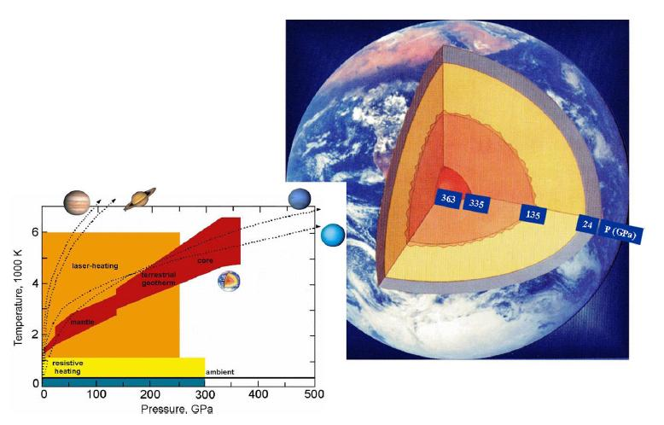
The outer and inner core
Temperature and pressure within Earth
The outer core is convecting vigourously; its temperature gradient must be very close to adiabatic. Still, we don't have good constraints on the thermal properties of the liquid outer core.
Temperature at the inner-core/outer-core boundary? Probably about 4500 K.
Assuming an essentially iron-nickel inner core and adiabatic equilibrium, the inner core's central temperature is estimated to be about 5500 K.
Mao and Hemley, 2007

Slide 9
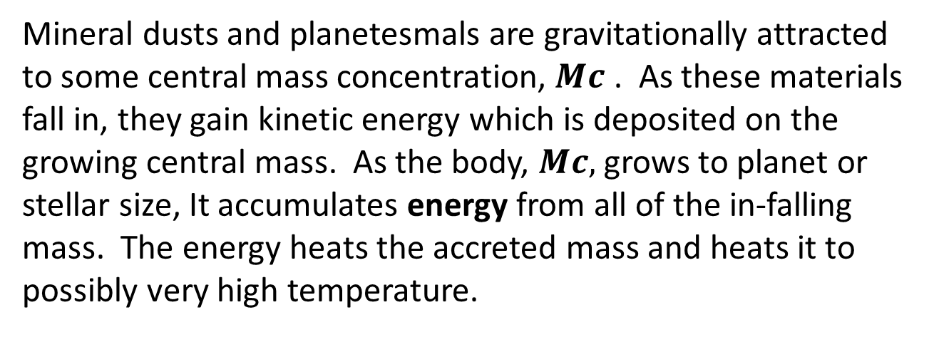
Heat from accretion
Mineral dusts and planetesmals are gravitationally attracted to some central mass concentration, $Mc$ . As these materials fall in, they gain kinetic energy which is deposited on the growing central mass. As the body, $Mc,$ grows to planet or stellar size, It accumulates energy from all of the in-falling mass. The energy heats the accreted mass and heats it to possibly very high temperature.

Slide 10
Differentiation
While most of the heat is re-radiated into space as the planet or body assembles, as temperature rises, the materials of the planet reassemble according to density. Fe, Ni and siderophile elements fall to the interior, forming the core and leaving a silicate mantle overlain by a crust of low density components.

Slide 11

Gravitational accretion
$E= \frac{3GMp2}{5Rp}$
What energy of accretion is not re-radiated during the process is held as heat with a temperature that is determined by the heat capacity of the body’s materials.

Slide 12
Heat capacity and T
Materials have very different capacities to hold heat. We call this physical ability heat capacity, C_{p}
A material with a high heat capacity holds heat with a low increase in temperature; one with a lower heat capacity requires a larger increase in temperature.
Heat capacity is usually measured according to the mass of a material with units: J · kg⁻¹ · K⁻¹ or cal · kg⁻¹ · K⁻¹ . depending upon our units used for the heat energy, either joules or calories*.
* The “diet” calorie is usually designated Calorie which is, in fact, 1 kilocalorie.

Slide 13
Heat capacities @ constant pressure C_{p} (25 C)
Material | Phase | J ∙ K⁻¹ ∙ kg⁻¹ | cal ∙ K⁻¹ ∙ kg⁻¹
Water* | liquid | 4181 | 1000
Wood | solid | 1700-2900 | 407-694
Gypsum | solid | 1090 | 261
Asphalt | solid | 920 | 220
Concrete | solid | 880 | 210
Marble, mica | solid | 880 | 210
Brick | solid | 840 | 201
Glass, silica | solid | 840 | 201
Sand | solid | 835 | 200
Soils | solid | 800 | 191
Granite | solid | 790 | 189
Hydrogen* | gas | 14320 | 3421
Nitrogen | gas | 1040 | 249
Air (STP) | gas | 1012 | 242
Iron | solid | 412 | 120
Gold | solid | 125 | 30
* Note the relatively high heat capacity of water and gases

Slide 14
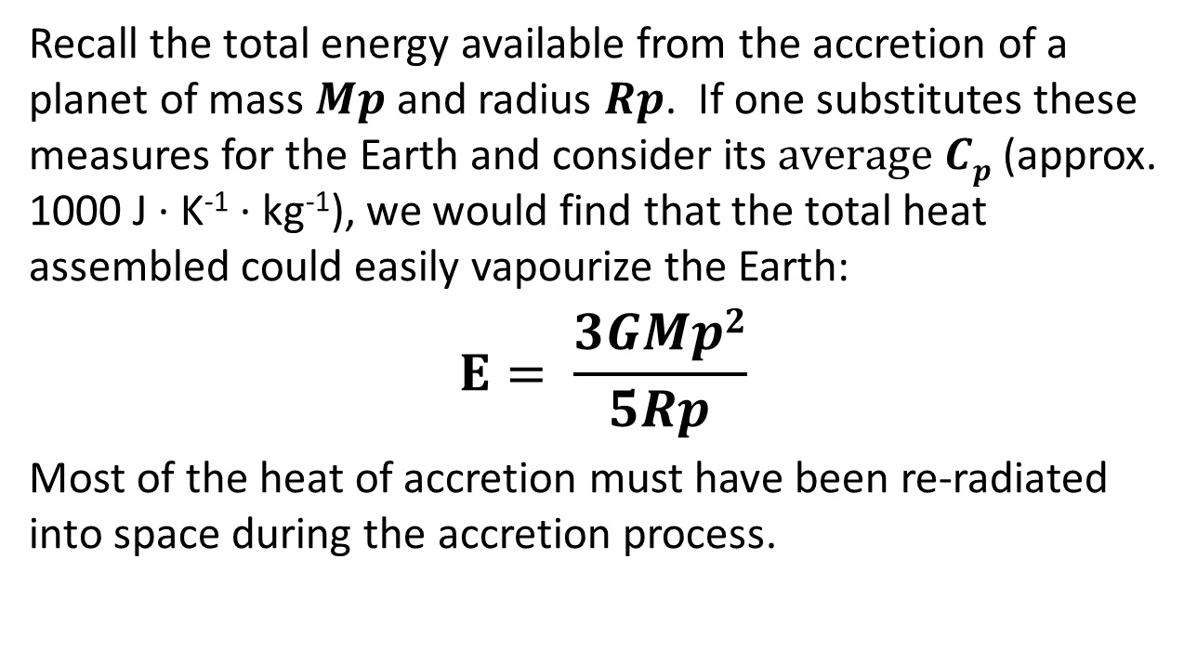
Temperature of accretion
Recall the total energy available from the accretion of a planet of mass $Mp$ and radius $Rp$. If one substitutes these measures for the Earth and consider its $average Cp$ (approx. 1000 J ∙ K⁻¹ ∙ kg⁻¹), we would find that the total heat assembled could easily vapourize the Earth:
$$E= \frac{3GMp2}{5Rp}$$
Most of the heat of accretion must have been re-radiated into space during the accretion process.

Slide 15
Structure of Earth

Slide 16
Composition of Earth’s mantle
Element | % by Mass | Compound | % by Mass
O | 44.8
Mg | 22.8 | SiO₂ | 46
Si | 21.5 | MgO | 37.8
Fe | 5.8 | FeO | 7.5
Ca | 2.3 | Al₂O₃ | 4.2
Al | 2.2 | CaO | 3.2
Na | 0.3 | Na₂O | 0.4
K | 0.03 | K₂O | 0.04
Sum | 99.7 | Sum | 99.1
https://en.wikipedia.org/wiki/Mantle_(geology)

Slide 17
Composition of Earth’s mantle
The proportions of the major 4 elements that comprise about 93% of the total mass of Earth could be assembled into the mineral Olivine with chemical composition FeMgSiO₄
Xenoliths from the mantle carried to the surface in volcanic eruptions often comprise olivine mineral but with a different composition: Fe_{0.2}Mg_{1.8}SiO₄. Why?
Most of the iron has been sequestered in Earth’s core.

Slide 18
The Moon-forming Event
The preferred story: sometime following the original accretion of the Earth and preceding the crystallization of the oldest zircon (4.404 billion years ago), a collision with a “Mars-sized” body is thought to have splashed off our Moon.
The collision probably melted the outer shell of the Earth to a depth of 1000km. From this deep magma ocean, the original crust differentiated.
There are alternative theories including the fission and capture models.
https://www.youtube.com/watch?v=vRf-hB8X7b0

Slide 19
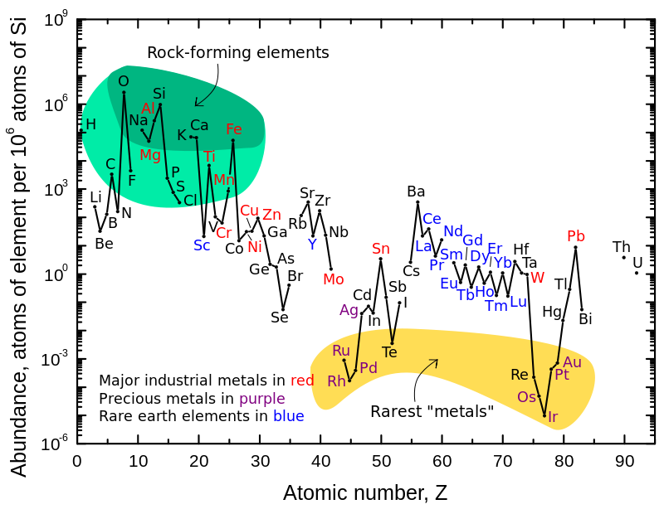
Earth’s crustal elements
https://upload.wikimedia.org/wikipedia/commons/0/09/Elemental_abundances.svg

Slide 20

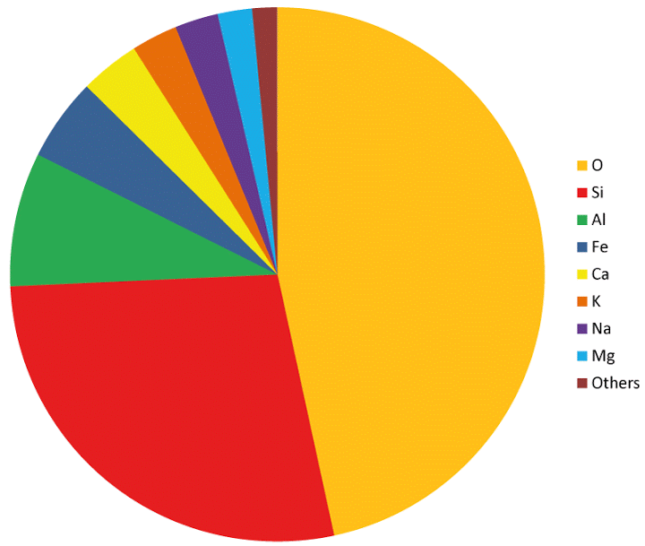
Crustal rocks
Oxygen 46.6%
Silicon 27.7
Aluminum 8.1
Iron 5.0
Calcium 3.6
Sodium 2.8
Potassium 2.6
Magnesium 2.1
Others 1.5
Hydrogen, included, as water is a major and important component in the near-surface crust and biosphere.
Crustal and biosphere elemental abundances

Slide 21
Structure of Planets -- Earth

Slide 22
Structure of Planets -- Moon
YouTube video of formation/evolution: https://www.youtube.com/watch?v=WGTBJHFNywI

Slide 23

Apollo mission 1962-72

Slide 24
Structure of Planets -- Mercury

Slide 25
Structure of Planets -- Venus

Slide 26
Structure of Planets -- Mars

Slide 27
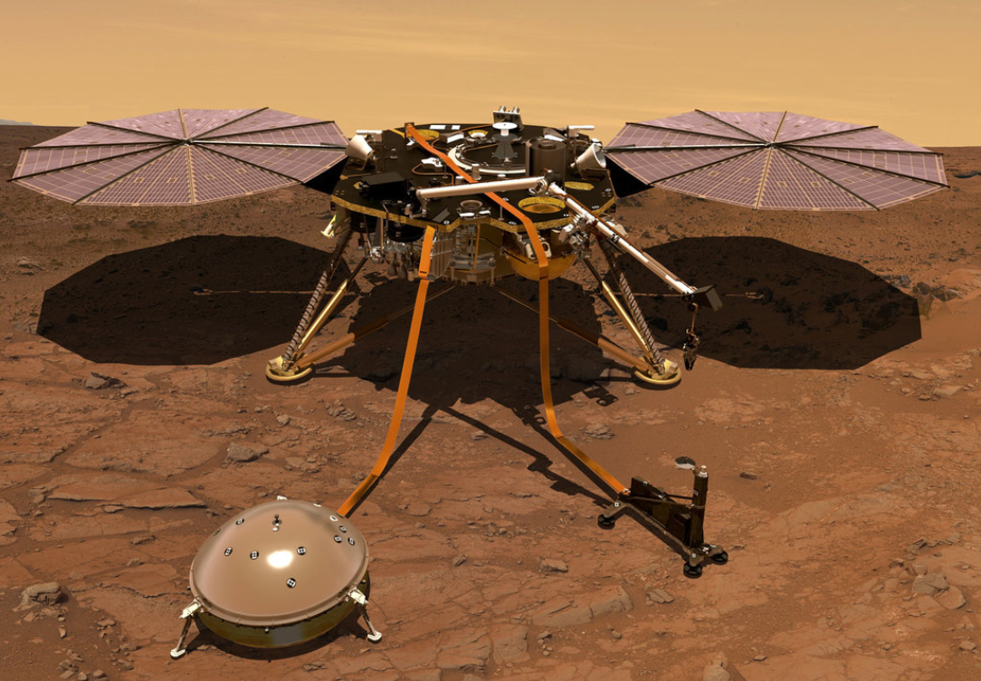
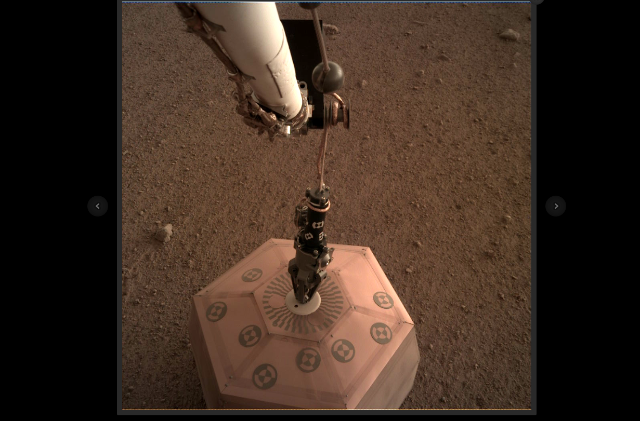
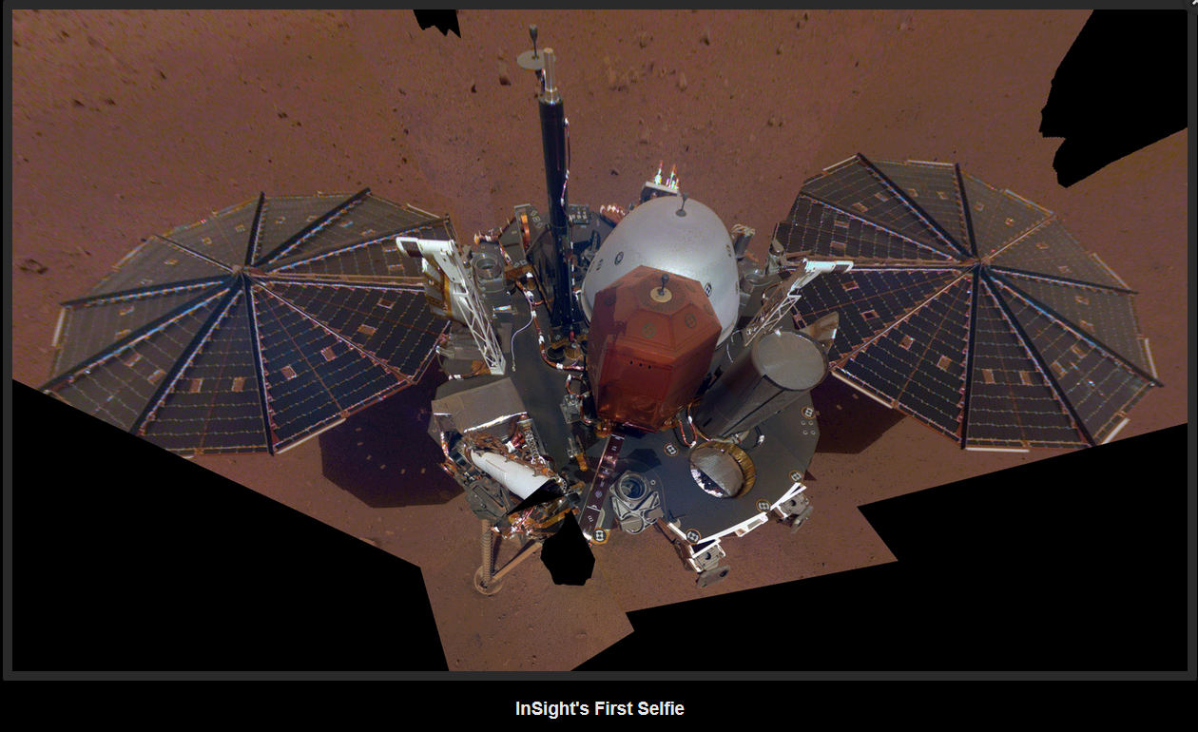
Structure of Planets -- Mars
Instruments placed on the Moon by the Apollo astronauts have given us information about the Moon’s internal structure. Seismic instruments recorded hundreds of “moonquakes” and the analysis of the seismic records brings us to the Moon model we have. In 1976, the Viking landers on Mars deployed seismic instruments but results of the seismic experiments were, at best, ambiguous.
Now, the InSight mission’s landing on Mars with contemporary seismic and heat-flow instruments should help us to unravel the interior structure and condition of Mars.
Mars InSight Mission

