Slide 1
Terrestrial Planets
Winter 2020
Week 4
Professor Olivia Jensen
Earth and Planetary Sciences
FD Adams 131C

Slide 2
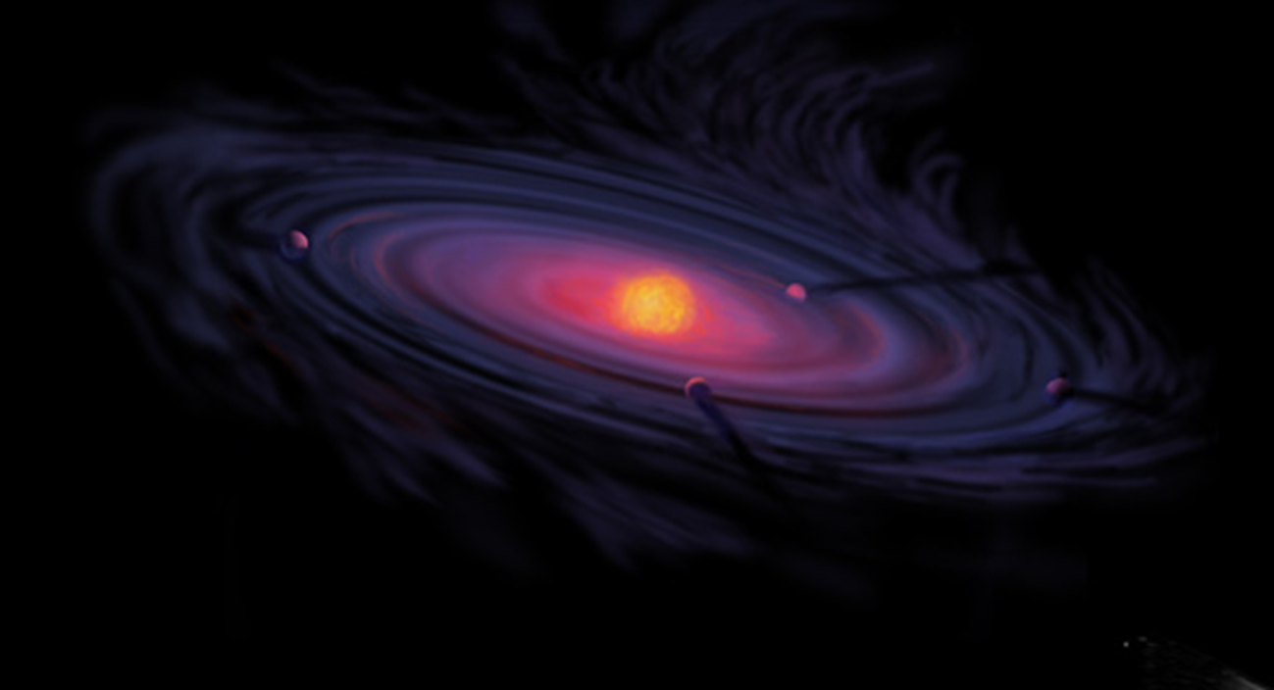
Formation of our Solar System
All isotopes of elements known to still exist in our Solar System, except for those with short decay half-life, promethium, ¹⁴¹⁻¹⁵⁶Pm, technitium ⁹³⁻⁹⁹Tc and the trans-bismuth elements, those with atomic numbers greater than 83, pre-existed in the condensing “molecular cloud”.
In the beginning, the Big Bang created the simplest of atomic nuclei, ¹H, ⁴He, traces of ²H, ³He, ³H, ⁷Be, ⁷Li and ⁶Li but nothing much else. All the more massive nuclei were created in the nuclear fires of stars and supernoval explosions.
Resulting from this nucleosynthesis, the elements that form our Earth and Solar System assembled into gases and mineral dusts.
From these our Earth, Sun and sister planets condensed.
About 5×10⁹ years ago, when the Universe was already, perhaps 8×10⁹ years old, at some gravitational centre, material from the clouds of dust and gas left behind by supernoval explosions began to assemble the mass of our Solar System.
The gravitational condensation of the dispersed cloud may have been triggered by shock waves created in the explosion of a nearby low-mass core-collapse supernova.
Artist’s image of protoplanetary nebula: By NASA [Public domain], via Wikimedia Commons
https://en.wikipedia.org/wiki/Formation_and_evolution_of_the_Solar_System

Slide 3
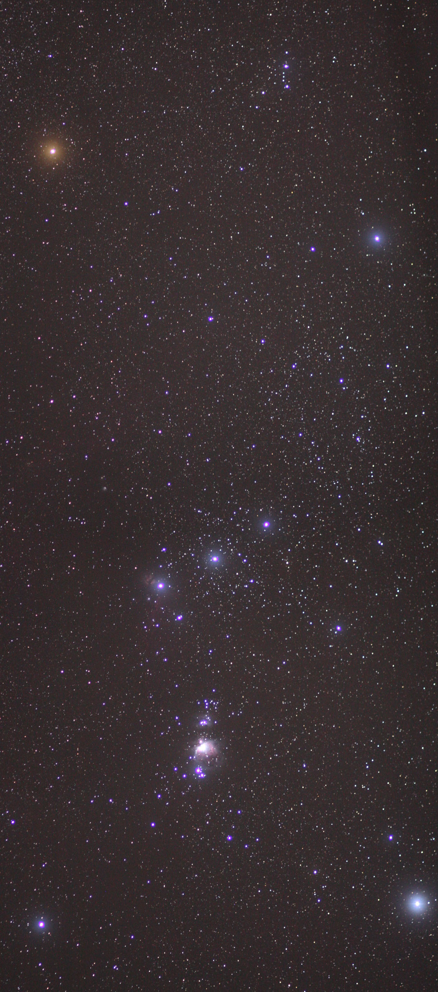
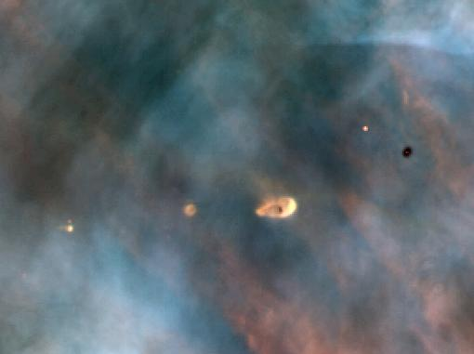
Molecular cloud: Orion Nebula
By Skatebiker at English Wikipedia [Public domain], via Wikimedia Commons
By C.R. O'Dell/Rice University; NASA [Public domain], via Wikimedia Commons

Slide 4
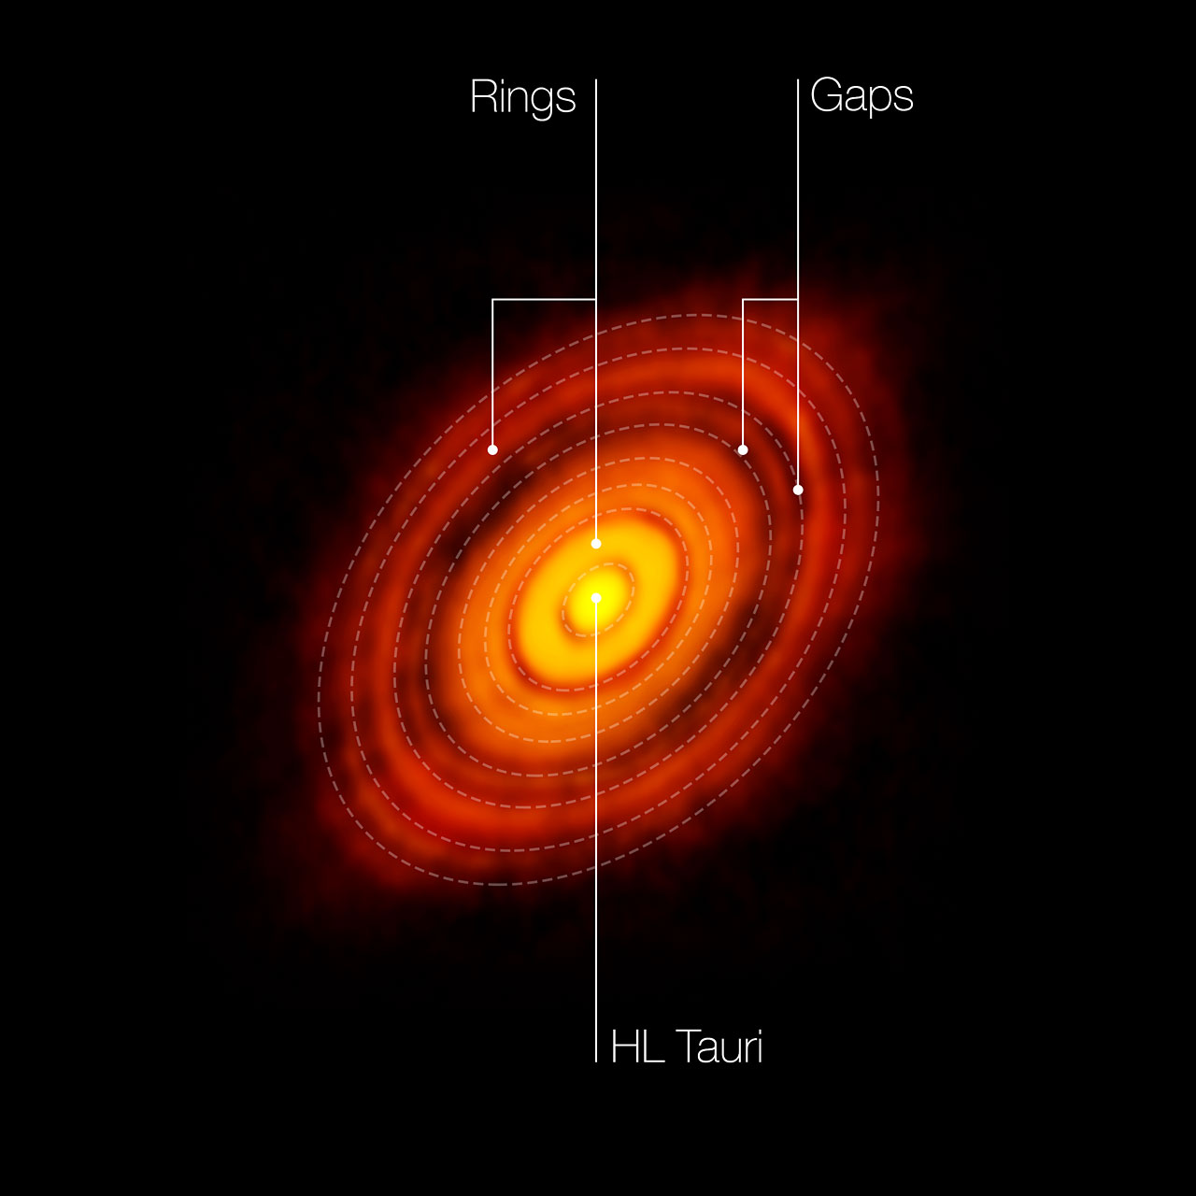
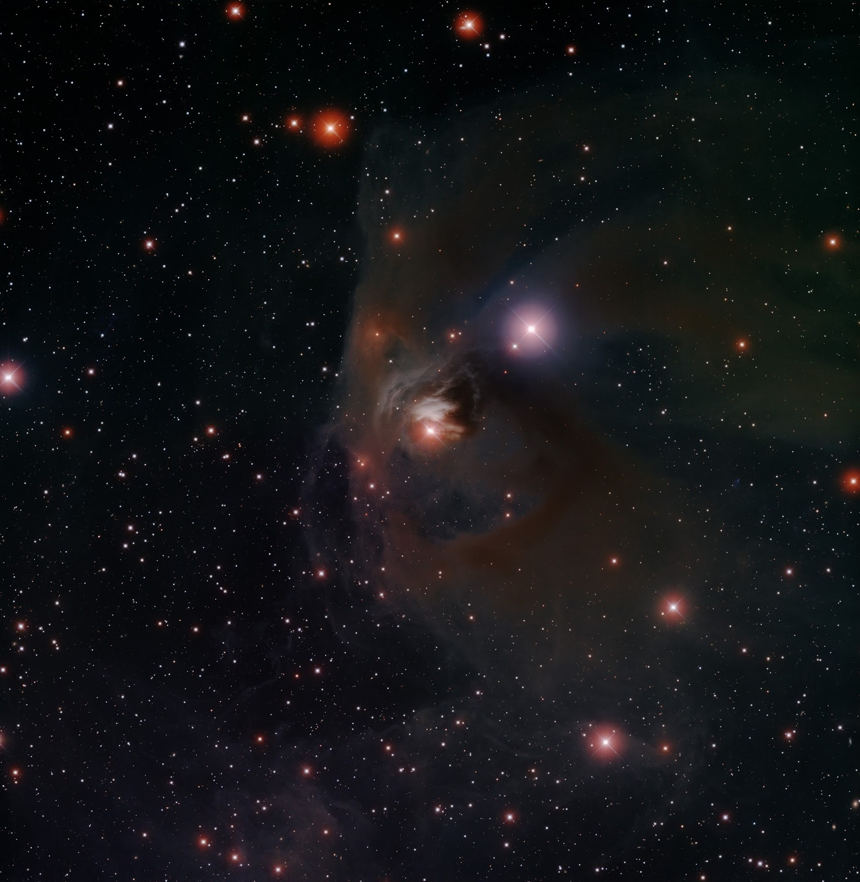
T-Tauri Molecular Cloud
http://www.eso.org/public/archives/images/screen/eso1436c.jpg

Slide 5
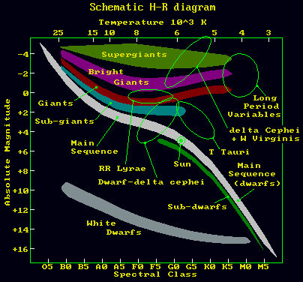
T-Tauri and H-R Diagram
http://www.britastro.org/vss/whatstar.html

Slide 6
A video diversion
James Webb Infrared Telescope:
https://www.youtube.com/watch?v=L2d7joOgVLg
ALMA imaging:
https://www.youtube.com/watch?v=aqt7s0J10f8
National Geographic: Birth of the Solar System: https://www.youtube.com/watch?v=kay2-F8uXPo

Slide 7
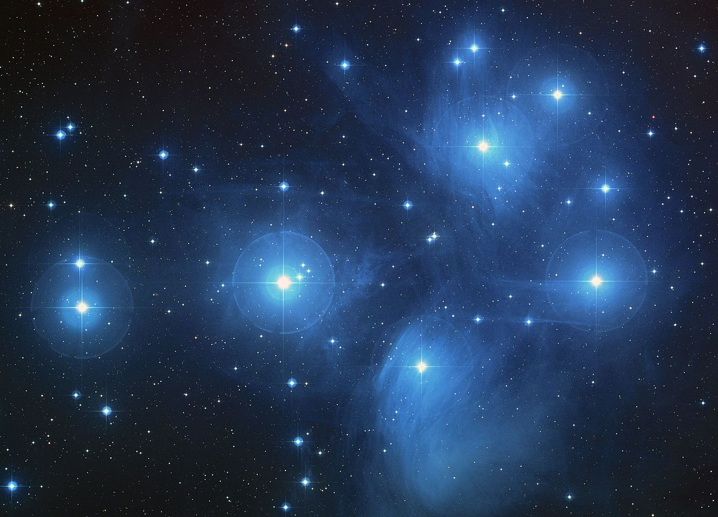

The Pleiades: a cluster of young stars
The Pleiades, an open cluster of young bright stars.
http://hubblesite.org/newscenter/archive/releases/2004/20/image/a/

Slide 8
Temperature in the Solar System
The Sun, with its surface temperature of 5800K largely determines the temperature of materials distributed throughout the Solar System. Obviously, the farther we find
ourselves from the warming Sun the colder our region of the Solar System is.
As the Sun forms and becomes radiant, the gases and dusts of the solar-planetary nebula become heated. Close to the radiant protosun, only refractory minerals (those silicates and metal oxides that make up our rocks) form. Minerals that melt at lower temperature (such as water and ammonia volatiles and ices) are driven to outer regions by the developing solar winds and radiation pressure.

Slide 9
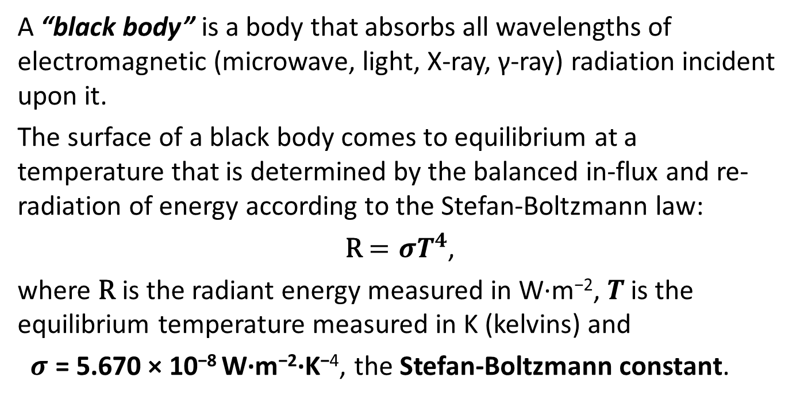
Black-body Temperature
A “black body” is a body that absorbs all wavelengths of electromagnetic (microwave, light, X-ray, γ-ray) radiation incident upon it.
The surface of a black body comes to equilibrium at a temperature that is determined by the balanced in-flux and re-radiation of energy according to the Stefan-Boltzmann law:
R $=σT^{4}$,
where R is the radiant energy measured in W·m⁻², $T^{ }$is the equilibrium temperature measured in K (kelvins) and
$σ$ = 5.670 × 10⁻⁸ W·m⁻²·K⁻⁴, the Stefan-Boltzmann constant.

Slide 10
Black body T in Solar System
Refractory minerals
Ices and volatiles

Slide 11
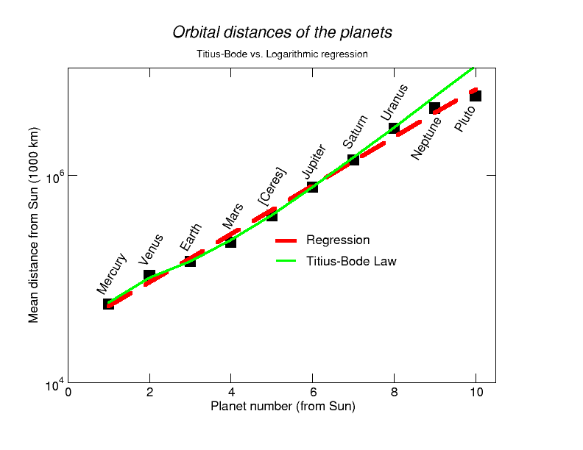

Distribution of Planets
Bode in the late 1700s tried to understand the distribution of planets; that is, the organization of their distances from the Sun. He, with Titius, offered a law that seemed to “predict” the planetary positons. The law has been variously described by different mathematical relationships. The original form of the law:
$a=0.4+0.3 ×2^{k−1}$ AU
where$k$ is the planet number counting out from the Sun and $a$ is its orbital semi-major axis.
Another simple regression relationship:
$a=0.9 e^{0.54k}$ AU
Do these empirical laws really tell us anything about the distribution of planets about other stars or are they particular to our Solar System?

Slide 12
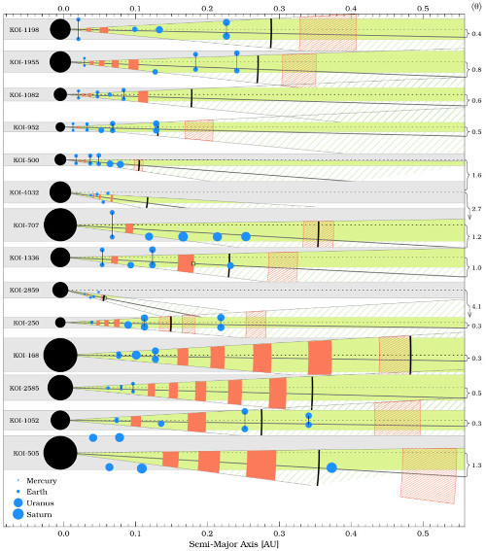
Distribution of ExoPlanets
As we now explore many other stellar-planetary systems, we see no strong evidence of such simplistic relationships. Still there may be something of a regular organization.
This diagram from a current paper argues that there is…
Boivard et al, https://doi.org/10.1093/mnras/stv221

Slide 13
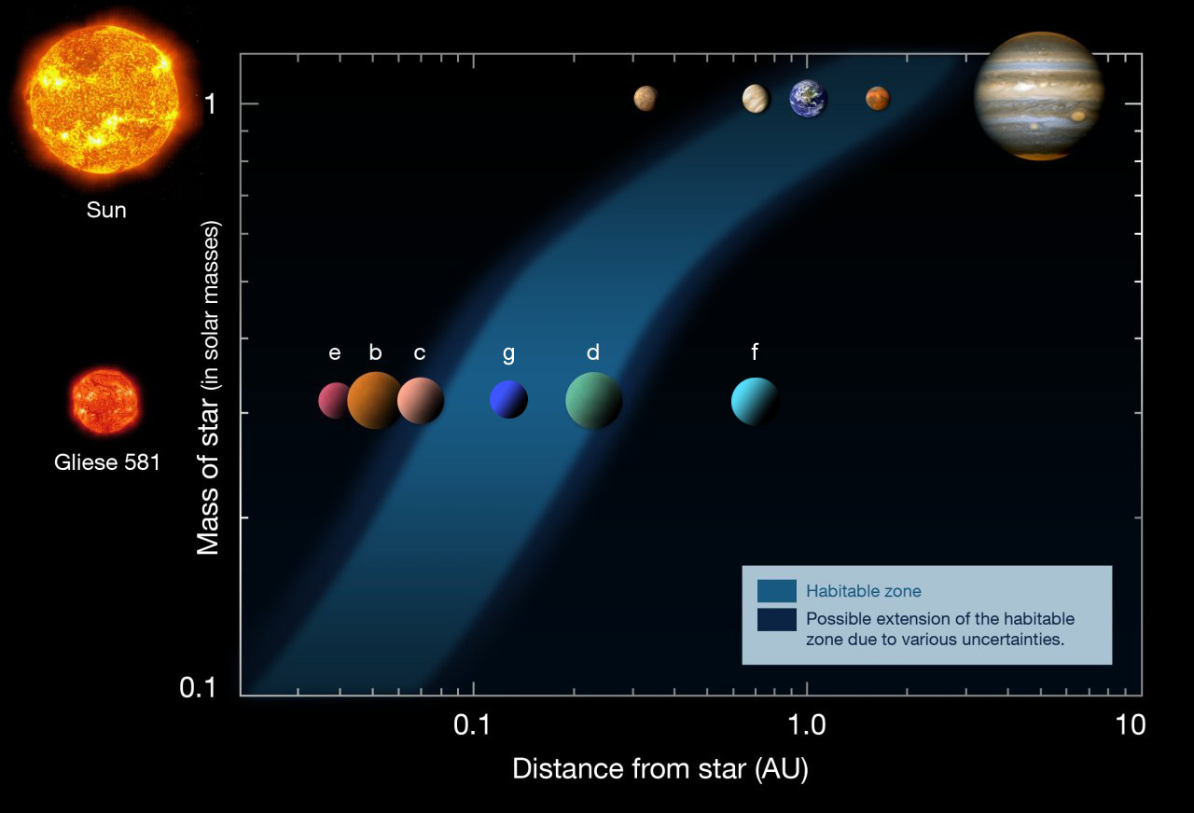
Search for ExoPlanets
Since Gordon Walker and Bruce Campbell developed the Doppler technique to look for perturbations on stars that could be caused by very large planets in orbit about them in the 1980s, astronomers, using that technique and the more successful transit (eclipse) technique have confirmed more than 3000 planets in orbit about other stars. The Exoplanet Orbit Database lists another 2500 probable candidates. This exploration leads us to believe that almost all stars have planets. As we find evermore candidates, we begin to focus on those that might be life-habitable.

Slide 14
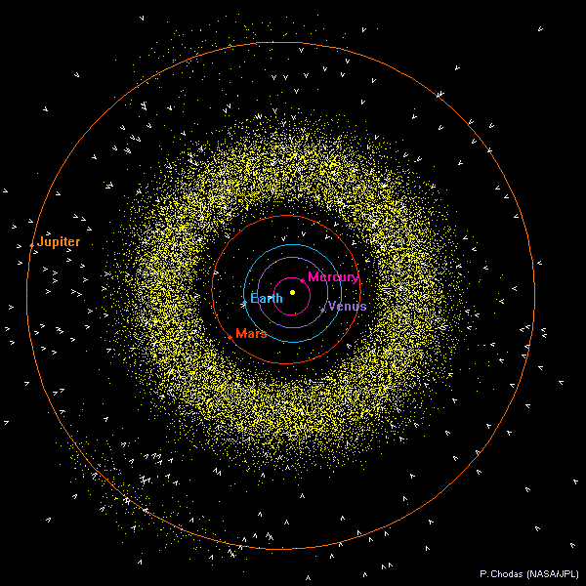
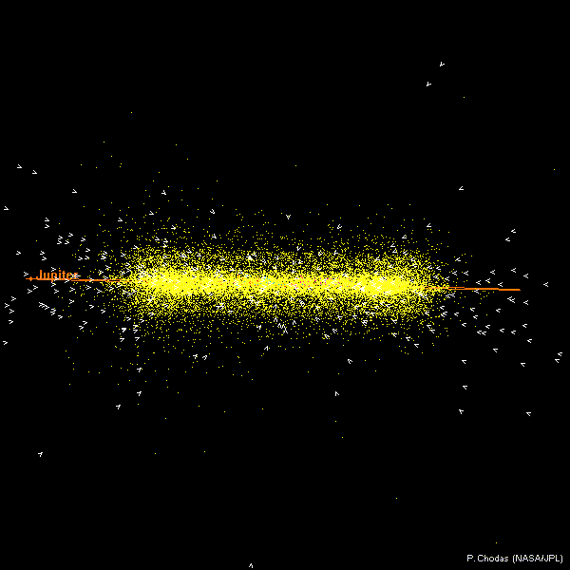
Inner Solar System

Slide 15
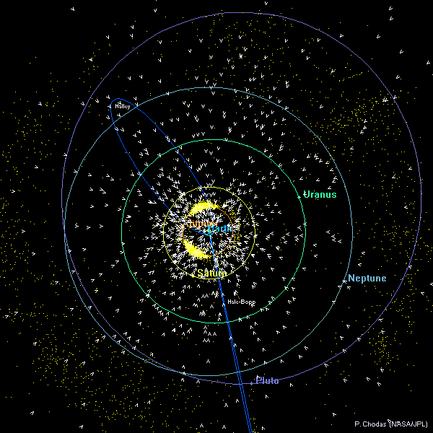
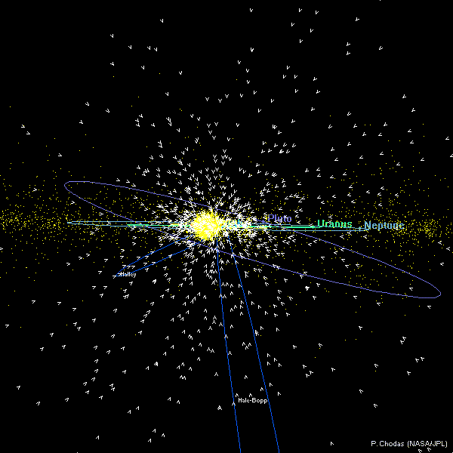
Outer Solar System

Slide 16
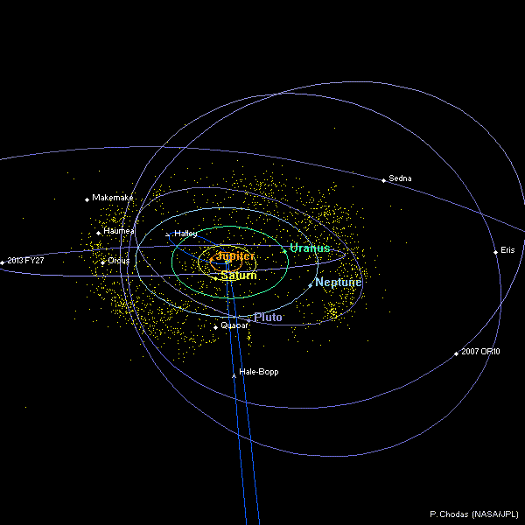
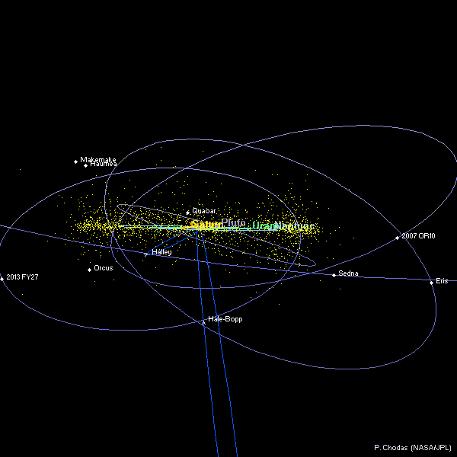
Beyond Neptune

Slide 17
The planetary system: orbital parameters
Planet | Period (yr) | Distance (AU) | Eccentricity | Inclination º
Mercury | 0.2408 | 0.39 | 0.206 | 7.0
Venus | 0.6152 | 0.72 | 0.007 | 3.4
Earth | 1 | 1 | 0.017 | 0
Mars | 1.881 | 1.52 | 0.093 | 1.9
Ceres* | 3.63 | 2.36 | 0.237 | 7.1
Jupiter | 11.86 | 5.2 | 0.049 | 1.3
Saturn | 29.46 | 9.54 | 0.056 | 2.5
Uranus | 84.01 | 19.19 | 0.047 | 0.8
Neptune | 164.79 | 30 | 0.009 | 1.8
Pluto* | 248.5 | 39.53 | 0.25 | 17.2
* Dwarf planets
Let us learn something of these planets and their orbits.

Slide 18
The Major Asteroids
Name | Size (km) | Mass x 10¹⁵ kg | Distance (AU)
Ceres | 960x932 | 870000 | 2.767
Pallas | 570x525x482 | 318000 | 2.774
Juno | 240 | 20000 | 2.669
Vesta | 530 | 300000 | 2.362
Eugenia | 226 | 6100 | 2.721
Siwa | 103 | 1500 | 2.734
Kleopatra | 217x94 |  | 2.79
Orbits in the solar system and other stellar systems:
http://janus.astro.umd.edu/javadir/orbits/ssv.html

Slide 19



