Slide 1
Terrestrial Planets
Winter 2020
Week 12
Professor Olivia Jensen
Earth and Planetary Sciences
FD Adams 131C

Slide 2
Geophysical Mapping
While direct imaging of planetary surfaces can tell us a great deal about the processes at play on a planet or moon, we have other tools to tell us even more.
Spectroscopic imaging
Magnetics
Gravity variations
Seismic imaging
Crater count density

Slide 3
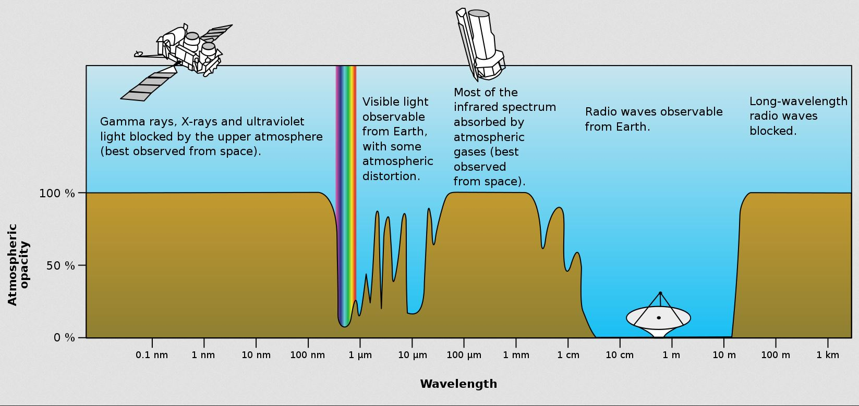
Spectroscopy
When we look at rocks or minerals, we see clear differences in their colours. Reflected light visible to our eye, spans only a very narrow band of the electromagnetic spectrum. Our atmosphere is opaque to many “colours”.
https://en.wikipedia.org/wiki/Visible_spectrum

Slide 4
Spectroscopy -- Atmospheres
The atmospheres of planets are also opaque according to their densities and their compositions. Still, we can determine the gases of their atmospheres according to the wavelengths of absorption of light.
https://en.wikipedia.org/wiki/Visible_spectrum

Slide 5
Spectroscopy -- Surfaces
For planets and moons with atmospheres thin enough to be penetrated by visible, infrared and microwave radiation, we can measure the wavelength dependent reflectance of rocks and minerals on the surface.
https://en.wikipedia.org/wiki/Visible_spectrum

Slide 6
Spectroscopy
Surfaces
For planets and moons with atmospheres thin enough to be penetrated by visible, infrared and microwave radiation, we can measure the wavelength dependent reflectance of rocks and minerals on the surface.
https://en.wikipedia.org/wiki/Visible_spectrum

Slide 7
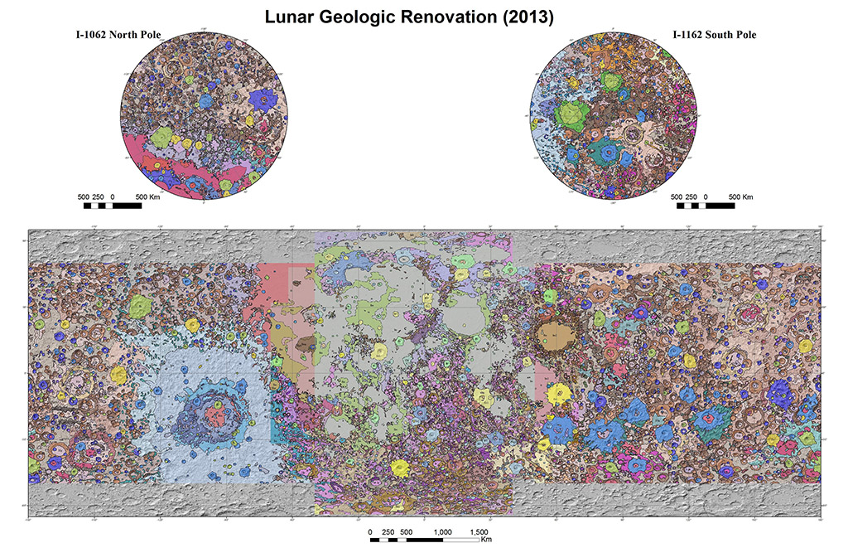
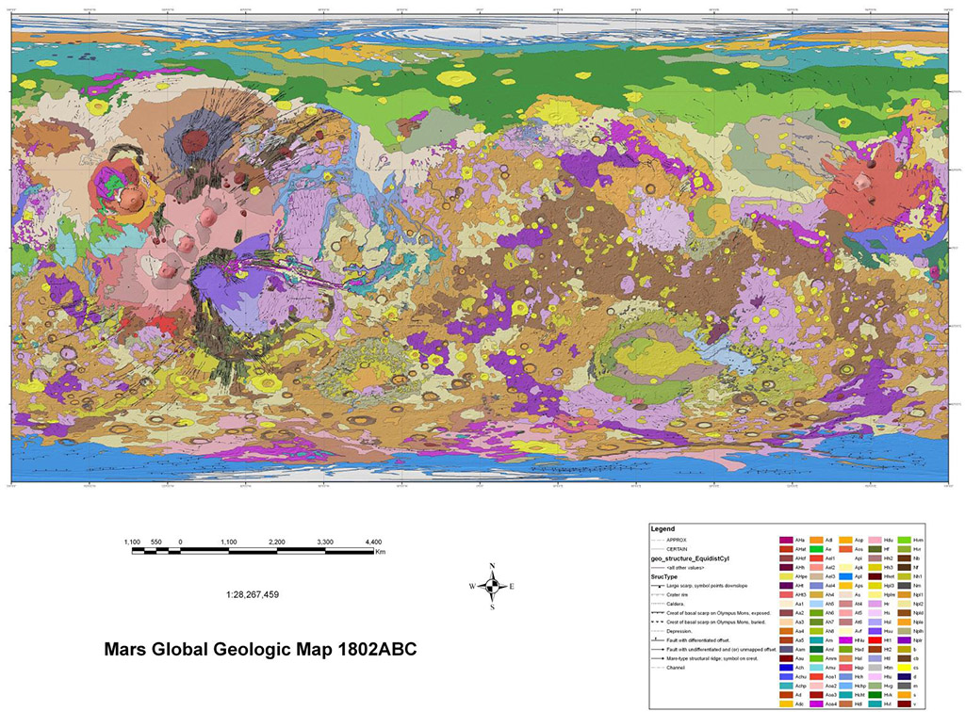
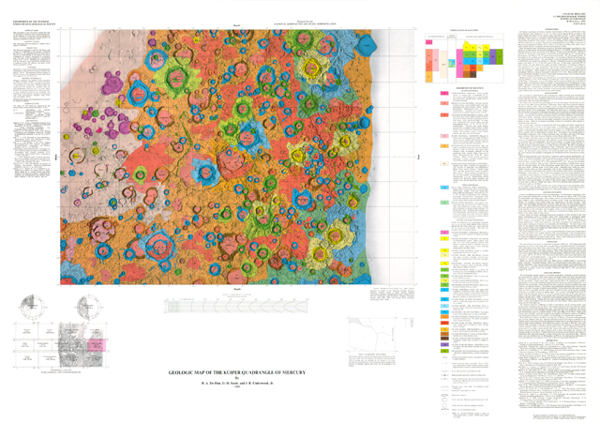
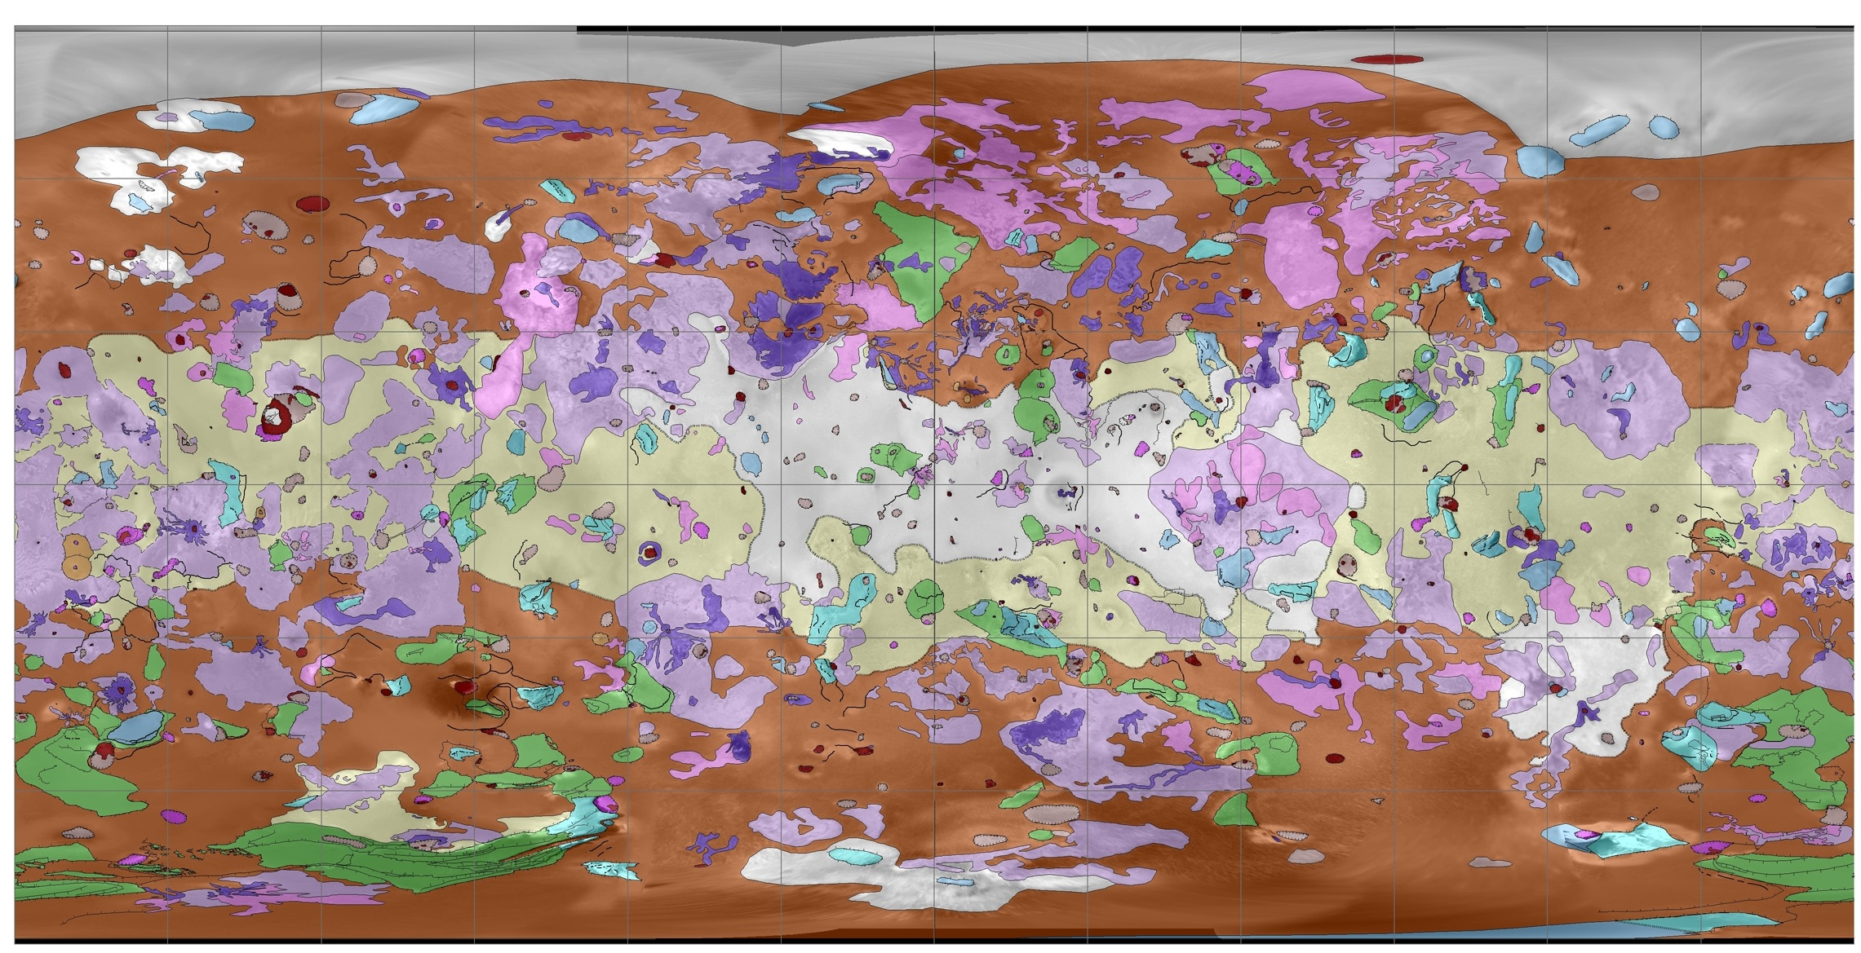
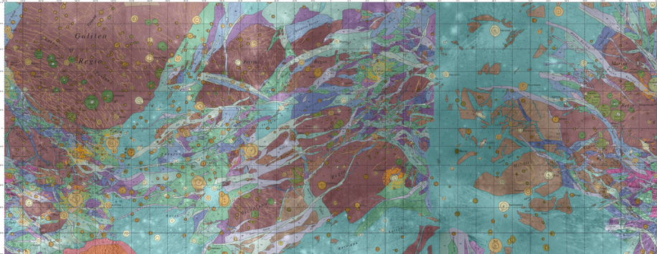
Geology by spectroscopy
Io
Mercury
Mars
Ganymede
Moon

Slide 8
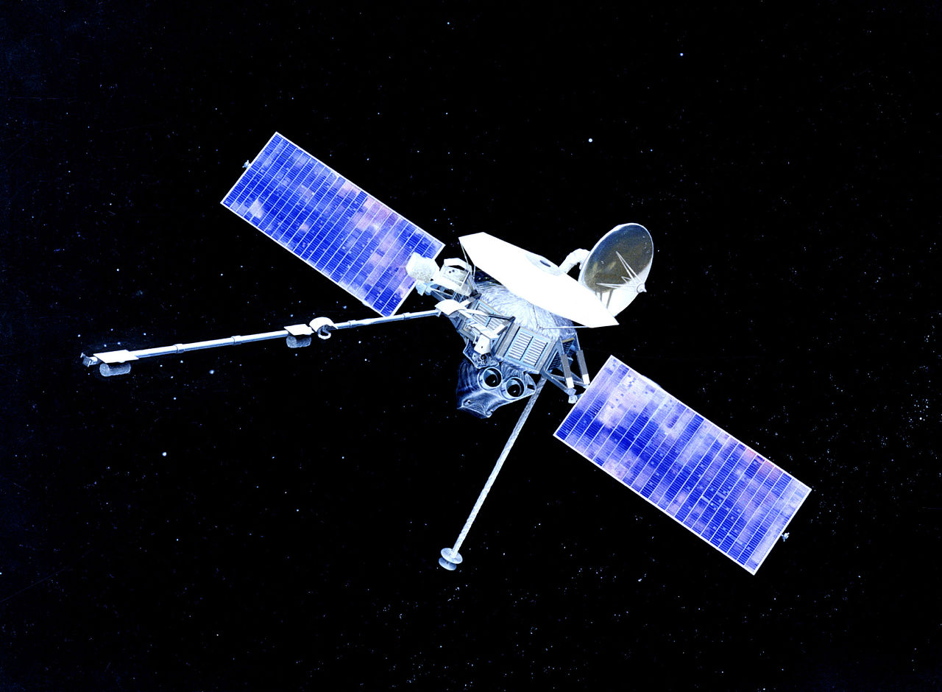
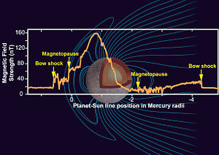
Magnetics
All “first pass” probes of other planets and moons have carried magnetometers to measure possible global magnetic fields. By mid-1970s, we knew that the Moon, Venus and Mars have no significant global magnetic fields while Mercury, like Earth did.
Internally generated global magnetic fields are a clear indication that a geodynamo action in which circulating conductive materials generate a self-sustaining field.
In 1974, Mariner 10’s close fly-by of Mercury detected a dipolar field with a dipole moment about 1% that of Earth.

Slide 9
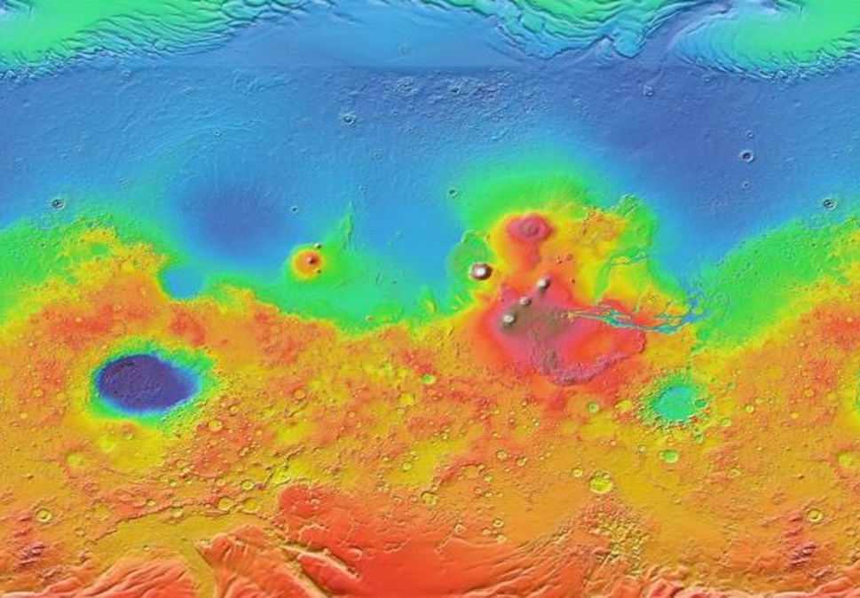
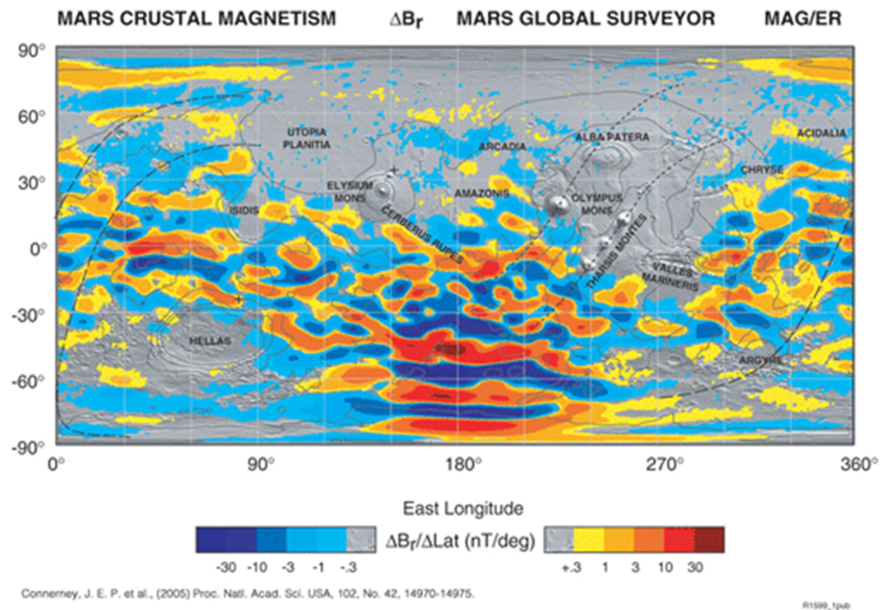
Magnetics
While Mars now has no internally generated magnetic field, there is evidence in the imprinted remnant magnetism in the crustal rock that such a field once existed. In the highlands of the southern hemisphere, that oldest terrain on Mars, magnetic striping even suggests that 4Ga, a field did exist. Moreover, the striped character of the imprinted field suggests some kind of tectonics… plate tectonics?
https://www.google.com/mars/
https://www.nasa.gov/mission_pages/mars/news/mgs_plates.html

Slide 10
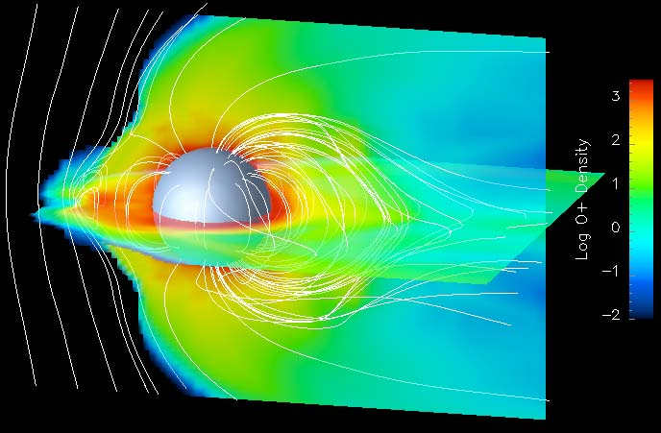
Magnetics
On other bodies?
Ganymede does have an active geodynamo and Io may have one.
Carol Paty, Georgia Institute of Technology

Slide 11
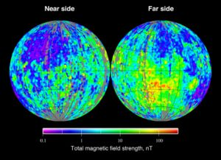
Magnetics
Crustal rocks on the Moon show weak remanence probably resulting from the original “Big Whack” or due to an ancient geodynamo.

Slide 12
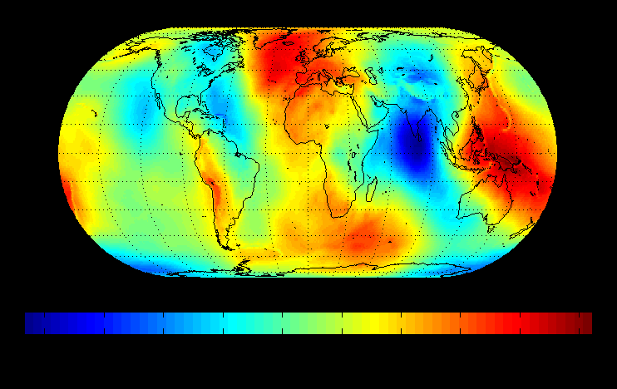
Gravity
Satellites in close orbit around planets and moons can map the detailed gravity variations that indicates anomalous mass distributions. The Earth’s “geoid” maps the gravitational equipotential surface deviations… approximately “sea level”
https://en.wikipedia.org/wiki/EGM96

Slide 13
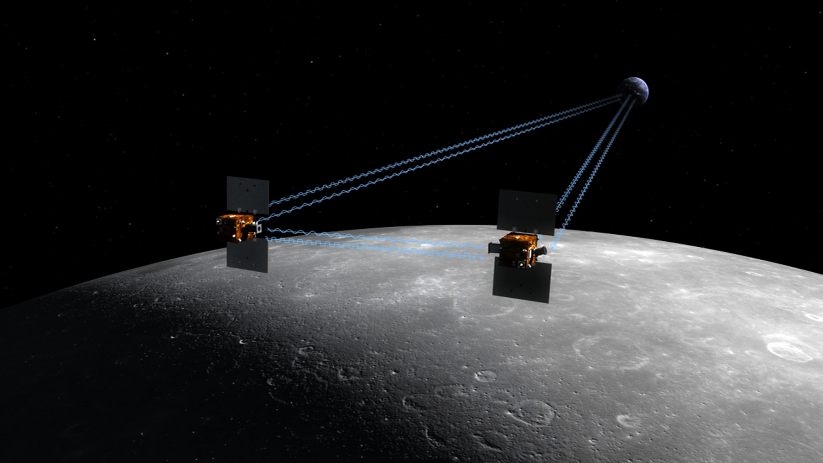
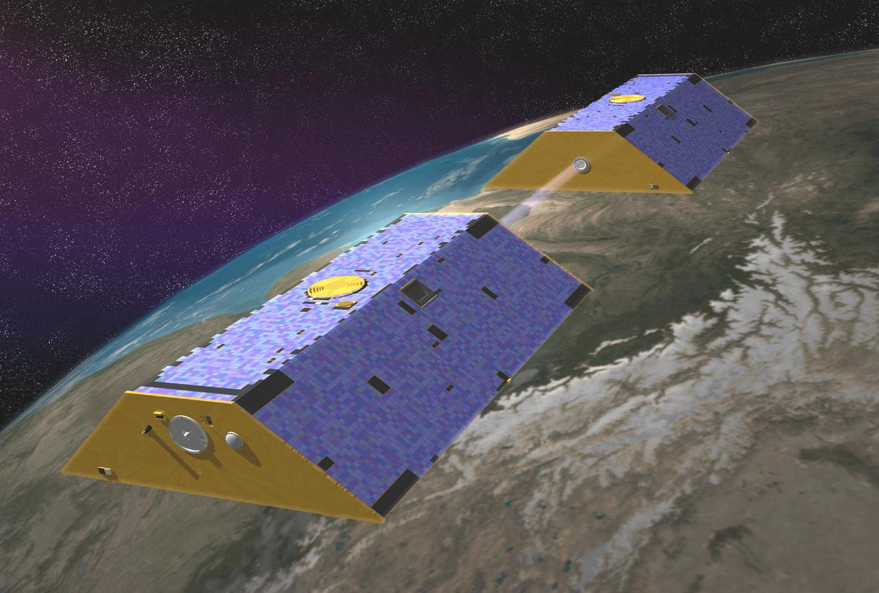
Grace and Grail
GRACE (for Earth) and GRAIL (for Moon) were paired satellites that measure the gradient of the gravity geopotential or geoid. The gradient is much more sensitive to near-surface density variations.
GRAIL
GRACE
https://en.wikipedia.org/wiki/Gravity_Recovery_and_Climate_Experiment
https://en.wikipedia.org/wiki/Gravity_Recovery_and_Interior_Laboratory

Slide 14
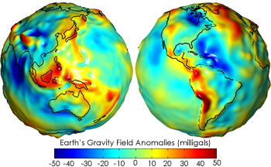
Gravity
The “gradient” of the geoid determines the gravitational acceleration on the surface. Variations in the acceleration are sensitive to crustal and shallow variations in density. Field anomalies from data by GRACE.
https://en.wikipedia.org/wiki/Gravity_of_Earth

Slide 15
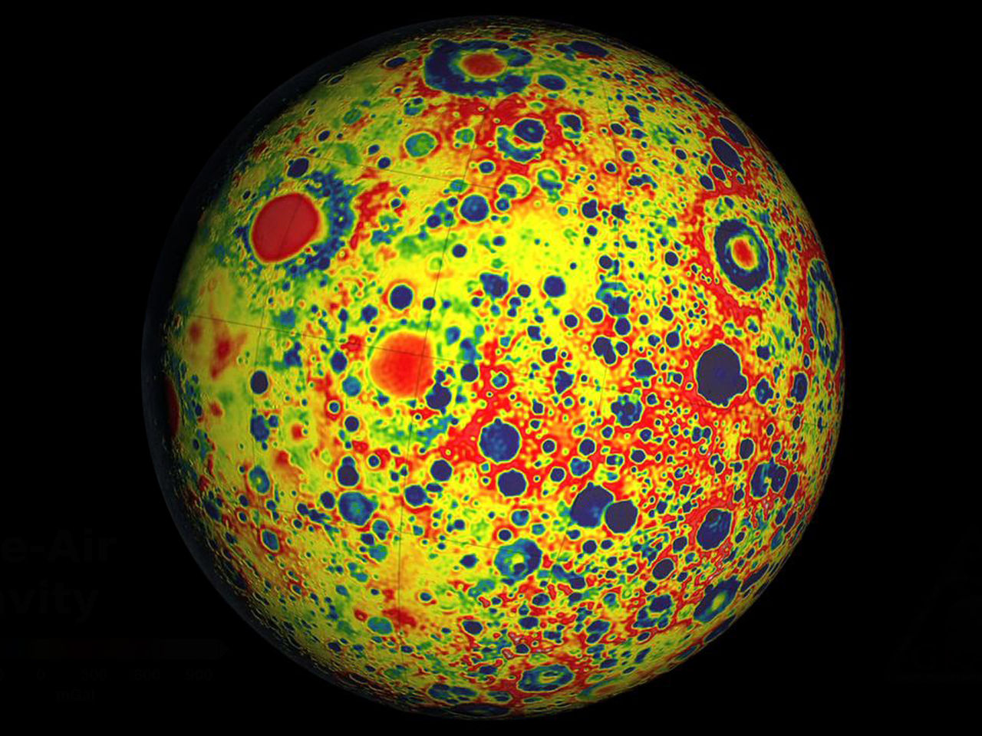
Gravity
Lunar gravity from the GRAIL satellite mission
https://en.wikipedia.org/wiki/File:GRAIL%27s_gravity_map_of_the_moon.jpg

Slide 16
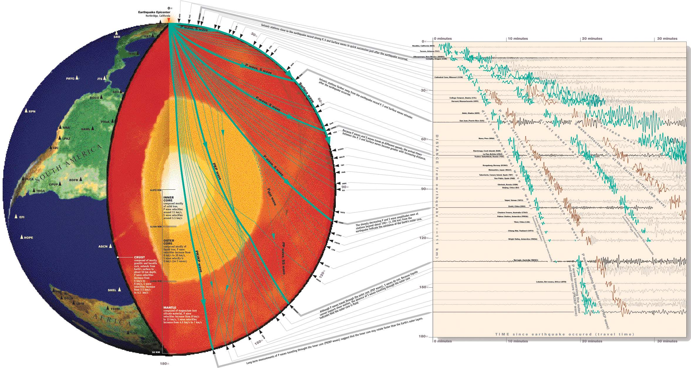
Seismology – internal structure
On Earth, earthquakes provide us with seismic waves that penetrate throughout the body of the Earth. We can “deconvolve” the wavefields to determine variations in the internal elastic structure of our planet.
If we were to have seismic instruments on other planets and moons that produced “quakes” like Earth, we could map their interiors too.
https://www.iris.edu/hq/inclass/lesson/imaging_earths_interior_with_seismic_waves

Slide 17
On Earthquakes
Focus: The point at which an earthquake starts to fracture is called the focus.
Epicentre: The place on the surface directly above the focus is called the
earthquake’s epicentre.
Fault plane: The surface area over which the fracture occurs is called the fault plane.
Slip: The distance of motion of the fracture.
Seismic waves: By measuring the field of seismic waves that issue from an earthquake, seismologists can determine the plane of faulting, the amount and direction of slip along that fault plane and the amount of energy released in the event and so understand the mechanism and tectonic stresses involved in precipitating an earthquake.

Slide 18
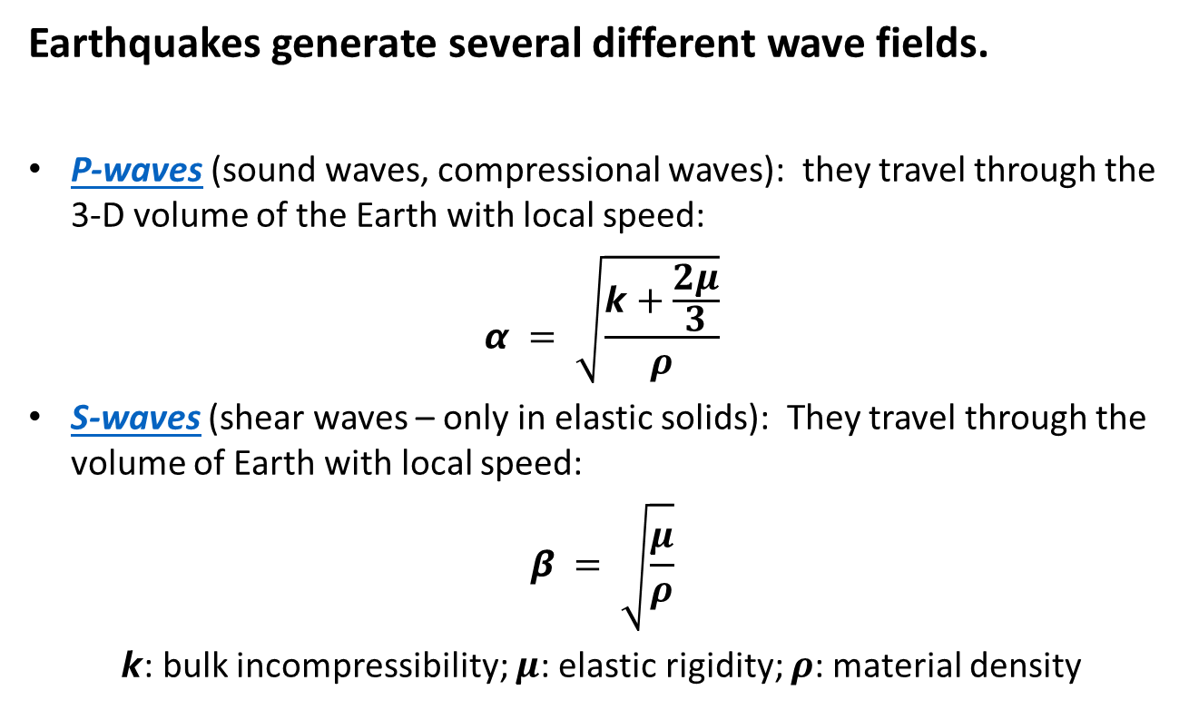
Seismic Wave Types
Earthquakes generate several different wave fields.
P-waves (sound waves, compressional waves): they travel through the 3-D volume of the Earth with local speed:
$$α = \sqrt{\frac{k+\frac{2μ}{3}}{ρ}}$$
S-waves (shear waves – only in elastic solids): They travel through the volume of Earth with local speed:
$$β = \sqrt{\frac{μ}{ρ}}$$
$k$: bulk incompressibility; $μ$: elastic rigidity; $ρ$: material density

Slide 19
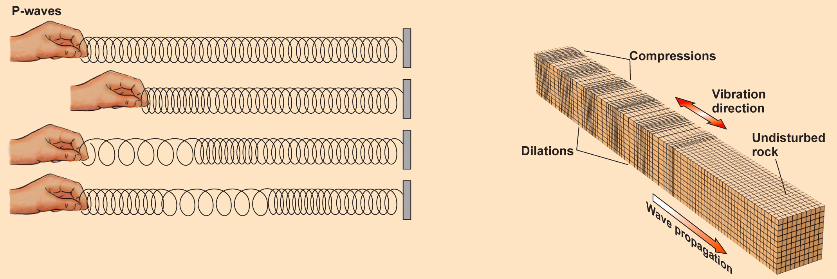
Seismic Waves
Body waves—pass through Earth’s interior.
  P-waves (primary or compressional waves).
    Waves travel by compressing and expanding material.
    Material moves back and forth parallel to wave direction.
    P-waves are the fastest.
    They travel through solids, liquids, and gases.
Fig. 8.7a

Slide 20
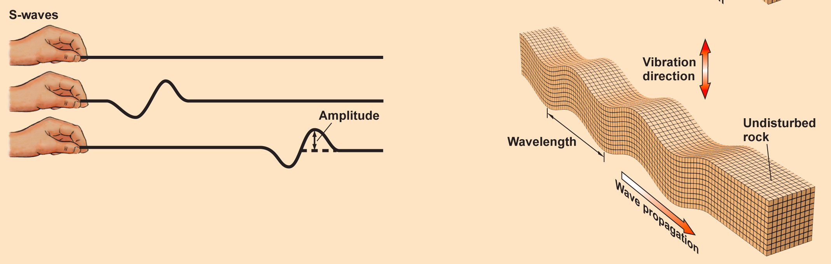
Seismic Waves
Body waves—pass through Earth’s interior.
  S-waves (secondary or shear waves).
    Waves travel by moving material back and forth.
    Material moves perpendicular to wave travel direction.
    S-waves are slower than P-waves.
    They travel only through solids, never liquids or gases.
Fig. 8.7b

Slide 21
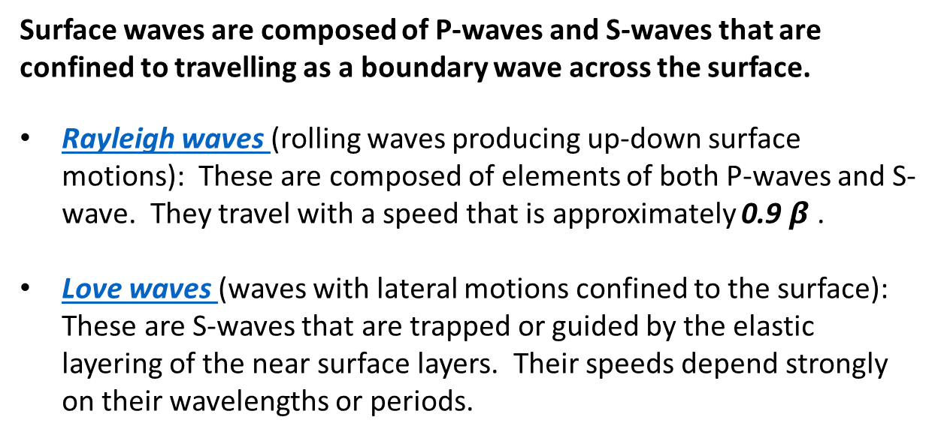
Surface waves
Surface waves are composed of P-waves and S-waves that are confined to travelling as a boundary wave across the surface.
Rayleigh waves (rolling waves producing up-down surface motions): These are composed of elements of both P-waves and S-wave. They travel with a speed that is approximately 0.9 $β$ .
Love waves (waves with lateral motions confined to the surface): These are S-waves that are trapped or guided by the elastic layering of the near surface layers. Their speeds depend strongly on their wavelengths or periods.

Slide 22
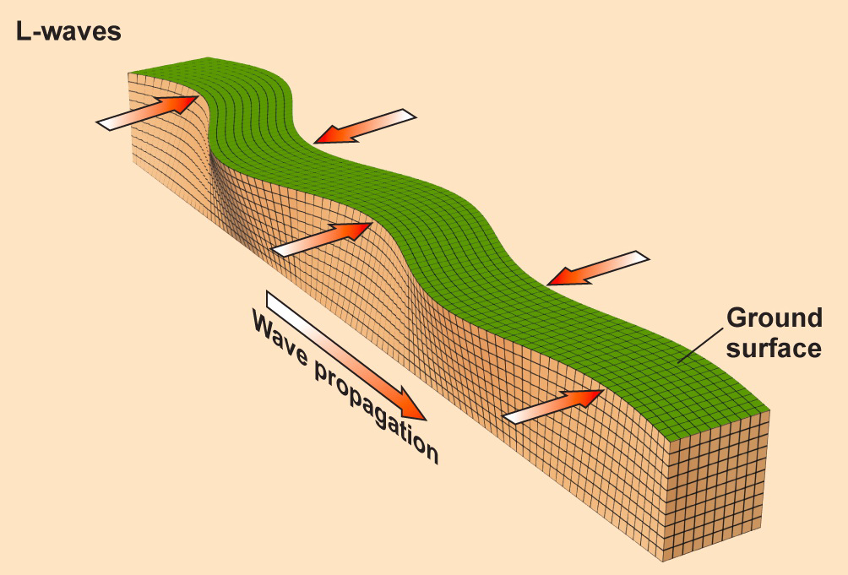
Seismic Waves
Surface waves—travel along Earth’s exterior.
Surface waves are the slowest and most destructive.
  LQ-waves (Love waves)
    S-waves that intersect the land surface.
    Move the ground back and forth like a writhing snake.
Fig. 8.7c

Slide 23
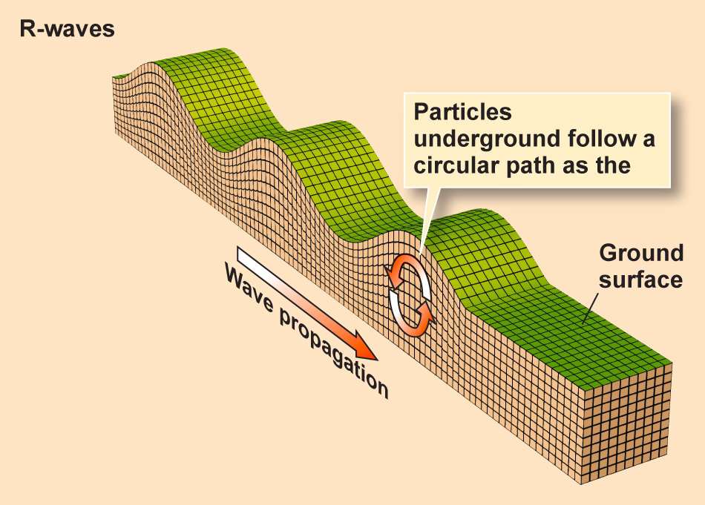


Seismic Waves
Surface waves—travel along Earth’s exterior.
  LR-waves (Rayleigh waves)
    P-waves that intersect the land surface.
    Cause the ground to ripple up and down like water.
Fig. 8.7c

Slide 24
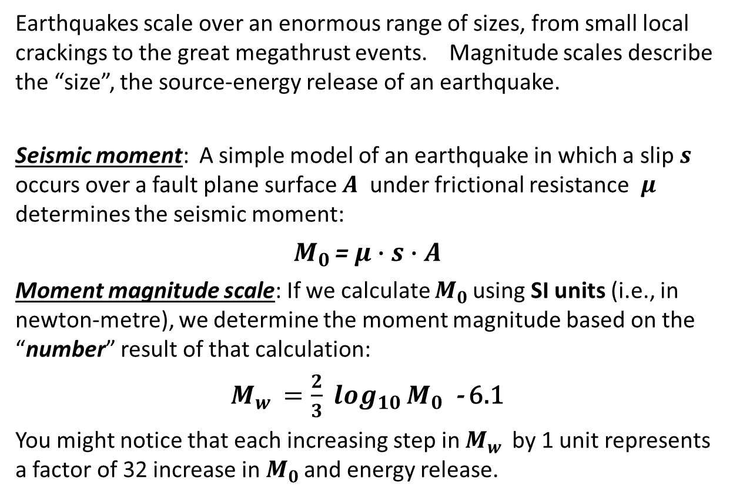
Magnitude scales
Earthquakes scale over an enormous range of sizes, from small local crackings to the great megathrust events. Magnitude scales describe the “size”, the source-energy release of an earthquake.
Seismic moment: A simple model of an earthquake in which a slip $s$ occurs over a fault plane surface $A$ under frictional resistance $μ$ determines the seismic moment:
$M_{0 }$= $μ∙s∙A$
Moment magnitude scale: If we calculate $M_{0 }$using SI units (i.e., in newton-metre), we determine the moment magnitude based on the “number” result of that calculation:
$M_{w }=\frac{2}{3} \log_{10}{M_{0 }}$ - 6.1
You might notice that each increasing step in $M_{w }$ by 1 unit represents a factor of 32 increase in $M_{0 }$and energy release.

Slide 25
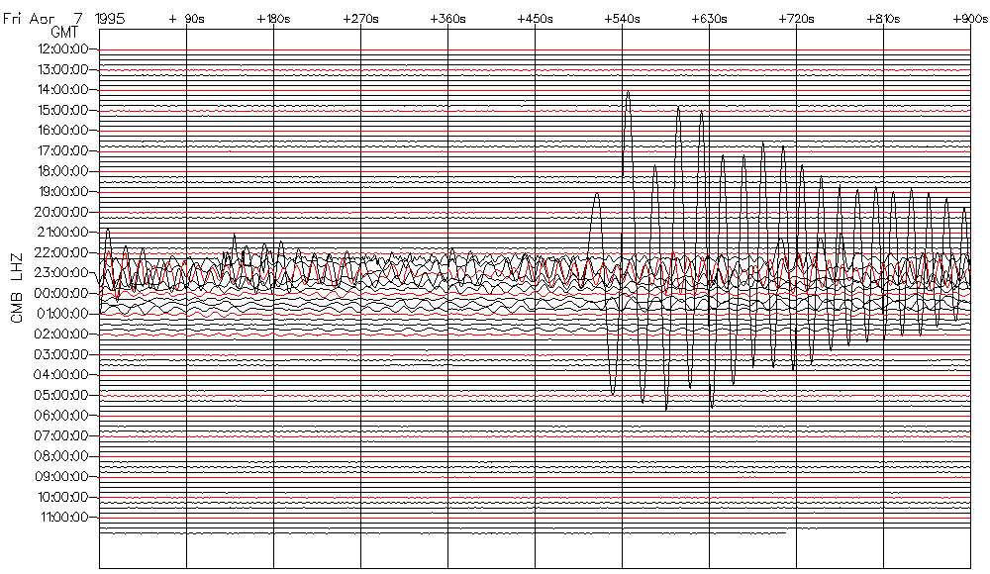


Older magnitude scales
The “Richter Scale”: In the 1930s, Richter studied earthquakes in California
and developed for their size classification his famous Richter Scale of earthquake magnitudes. Generalized for use worldwide, the scale is now computed according to a formula:
$M_{s}= \log_{10}{\frac{A}{T}}$ + $Correction\left(Δ, depth\right)$
A is the ground motion amplitude measured in milli-microns, T the period measured in seconds and corrections for great-circle distance and depth to focus.
A
P
$M_{s}\sim \log_{10 }\frac{A}{P}$ + distance-depth correction
Classical seismogram: Tonga April 7, 1995

Slide 26
Earth Structure by Seismology
With the virtually millions of pairing of seismic observation sites and earthquake sources we had, by the early 1970s, obtained a detailed view of the seismic velocities within the Earth. Constrained by our knowledge of the Earth’s moment of inertia, inversion of this data obtains the raw mechanical properties.
Geochemists and mineral physicists accord these the mechanical properties with mantle mineralogy.

Slide 27
Earth Structure by Seismology
Core-mantle boundary
Top D’’ layer
660km discontinuity
Inner core
Base of LVZ (asthenosphere)

Slide 28
Earth Structure by Seismology
Inner core
𝝁 > 0 (elastic rigidity)
Mantle
𝝁 > 0 (elastic solid)
Shell with 𝝱 = 0;
∴ 𝝁 = 0 (fluid)

Slide 29
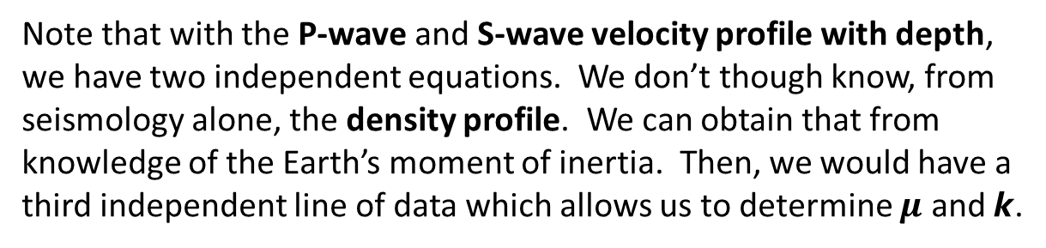

Earth Structure by Seismology
$$β = \sqrt{\frac{μ}{ρ}} α = \sqrt{\frac{k+\frac{2μ}{3}}{ρ}}$$
Note that with the P-wave and S-wave velocity profile with depth, we have two independent equations. We don’t though know, from seismology alone, the density profile. We can obtain that from knowledge of the Earth’s moment of inertia. Then, we would have a third independent line of data which allows us to determine $μ$ and $k$.

Slide 30
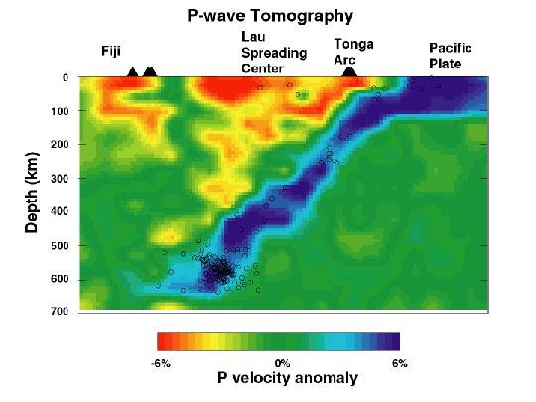
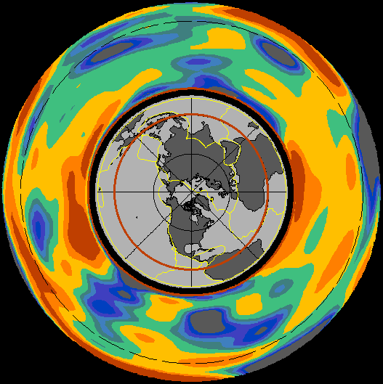
Seismic Tomography
One can perform the equivalent of a CAT-Scan on the Earth using seismic waves. In fact, seismic tomography is an older science than is medical tomography. By looking to the localized anomalies in the seismic wave velocities according to places within the Earth, we can actually track the history of descending tectonic plates and upwellings beneath spreading ridges. As the science evolves and as ever more data are obtained, we are producing a detailed picture of Earth’s interior.
Tomographic anomalies in seismic velocities are normally referenced to the PREM (Preliminary Reference Earth Model), that from which the previous velocity-depth profiles were taken. Small variations in the temperature of flowing mantle materials produces slightly negative velocity anomaly if warm than the depth average and slightly positive anomaly if cool.

Slide 31
Geology/Mineralogy by Seismology
The distinct discontinuities within the Earth as seen in seismic inversions describe geological/mineralogical changes.
– Crust: This outer skin, typically about 30km thick, shows a relatively low velocity for seismic sound waves, the (P-waves). Its base is characterized by a sharp increase in the P-wave velocity to about 8km/s at the Mohorovičić discontinuity (Moho).
– Mantle: Most of the volume (≈ 87%) of the Earth comprises the silicate, rocky mantle. The mantle has a layered structure that affects seismic wave velocities. The structure is caused by phase changes of the mantle minerals as they are compressed at depth into higher density forms.
Core-mantle boundary
Moho (crust-mantle) boundary

Slide 32
Geology/Mineralogy by Seismology
– Crust: This outer skin, typically about 33km thick, shows a relatively low velocity for seismic sound waves, the (P-waves). Its base is characterized by a sharp increase in the P-wave velocity to about 8km/s.
– Mantle: Most of the volume (≈ 87%) of the Earth comprises the silicate, rocky mantle. The mantle has a layered structure that affects seismic wave velocities. The structure is caused by phase changes of the mantle minerals as they are compressed at depth into higher density forms.
The most distinct boundaries are at ≈ 440km where olivine, [Mg, Fe]₂SiO₄, becomes compressed into the spinel structure and then at ≈ 660km where the spinel becomes further compressed into a mix of perovskite, [Mg, Fe]SiO₃, and ferro-periclase, (or magnesiowustite) [Fe,Mg]O. The lower mantle is thought to maintain this mix to the core-mantle boundary at 2970km depth. At, perhaps 2770km (the D’’ discontinuity) the pressure of 1.25GPa allows for the perovskite mineral form to compress into the post-perovskite structure. If this is the cause of the elastic discontinuity, D’’, observed by seismic experiments, the temperature there is established at about 2500K.

Slide 33
Geology/Mineralogy by Seismology
Within the mantle the most distinct discontinuities are at 440km where olivine, [Mg, Fe]₂SiO₄, becomes compressed into the spinel structure and then again at 660km where the spinel becomes further compressed into a mix of perovskite, [Mg, Fe]SiO₃, and ferro-periclase (or magnesiowustite) [Fe,Mg]O. The lower mantle is thought to maintain this mix to the core-mantle boundary at 2970km depth.
At, perhaps 2770km the pressure of 1.25GPa allows for the perovskite
mineral form to compress into the post-perovskite. If this is the
cause of the elastic discontinuity, D’’, observed by seismic experiments,
the temperature there is established at about 2500K.
Perovskite to post-perovskite transition
Spinel to perovskite/ferro-periclase transition

Slide 34
Geology/Mineralogy by Seismology
– Outer core: The outer core is essentially a liquid mix of iron, Fe, and nickel, Ni, with some alloying lighter elements, probably, sulfur, S, and possibly oxygen, O, or silicon, Si, and even carbon, C.
-- Inner core: At the centre of this liquid core is the frozen, crystalline probably almost pure iron (though perhaps with some Ni and Co and even traces of potassium, K) inner core. Its radius is 1222km.
The outer core and inner core contain about 35% of the Earth’s total mass in less than 1/8 of its volume.

Slide 35
Geology/Mineralogy by Seismology – other planets
– Moon: In 1969, the Apollo 11 mission installed seismograph systems on the Moon. Moonquakes revealed that there is a small core of the Moon; the density of the Moon suggests that it is like a mix of Fe and FeS.
-- Mars: In 1976, the Viking 2 Lander installed a seismograph on Mars. It operated for months and saw nothing that could be securely attributed to a tectonic marsquake. We have no information about Mars’ deep interior from seismology…. Yet! We did learn that it has a thin crust, 14-18km thick.
In May, 2018, the InSight lander was launched toward Mars. It installed another seismic station on the surface in December, 2018. Over the following few months, it is recording seismic surface motions that may well reveal detail about the planet’s deep interior structure.

Slide 36
Age determination of Planetary Surfaces
The final topic for the course
Except for the Moon , we have no rocks or soils collected from other bodies in the Solar System that we can use in the age-determination of their surfaces.
The 1969-72 Apollo mission to the Moon returned over 300kg of rock and soil from various locations on the Moon. These have been extensively studied during these past 45+ years.
On major use of these rocks was to determine the “age” of the surface at various lunar locations. This age determination was then compared to the surface blemishes due to impactors in the region of collection. It allowed for the calibration of a “crater-density clock”.

Slide 37
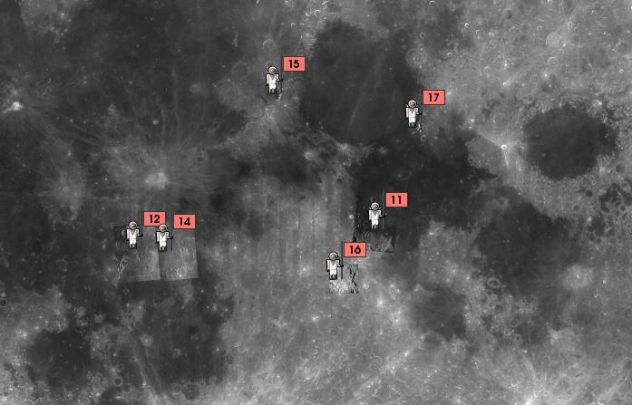
The Crater-density Clock
During the Apollo missions to the Moon, the astronauts returned rock samples to Earth. Those basaltic rocks obtained from the Mare Tranquillatus by Apollo 11 were determined through radioisotope dating to be between 3.7 and 3.9 billion years old. Rocks no younger than 3.3 billion years were returned by any of the subsequent missions that landed in maria basins.
The crater density (number of craters/area) in the regions from which rocks were returned and dated were subsequently compared to the rock age. We know that the more an area is cratered, the older the surface is. The Apollo missions allowed for the calibration of areal density of craters versus age.
https://www.google.com/moon/

Slide 38
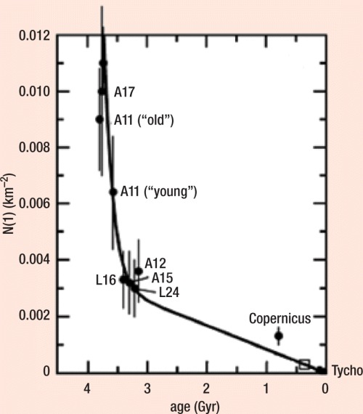
Calibration: Crater-density clock
This model (the line) compares the number of craters/km2 to the rock ages obtained by the Apollo Missions and the rock/soil return by the robotic Luna 16 and 24 missions by the USSR.
Diagram by Mineralogical Society of America

Slide 39
Crater Density Age:
Moon
The highlands of the Moon show crater-density measured ages at the “saturation limit” dating back to the formation of the Moon. The Mare basins are younger, formed by subsequent impacts.

Slide 40
Crater Density Age:
Mercury
The highlands of Mercury are old; like the Moon the Caloris basin is younger suggesting that it was formed by an impact only about 3 billion years ago.

Slide 41
Crater Density Age:
Venus
Venus’ surface is young. The planet appears to have been completely resurfaced between 400My and 700My ago.
There are few small craters as the thick atmosphere of Venus so slows the small asteroids that they don’t form significant craters on impact if they reach the surface.

Slide 42
Crater Density Age:
Earth
Only about 10% of Earth’s surface is older than about 1 billion years and all of this is continental. Erosion has erased the history of cratering.
Small craters are few because our atmosphere slows small asteroids that, then, don’t produce significant surface craters.
70% of Earth is ocean covered and not cratered.

Slide 43
Crater Density Age:
Mars
Mars shows very old surface in the Southern Highlands. For small craters, though, their lower density suggests either a once-thick atmosphere or perhaps even a large areal ocean. The Tharsis Plains near the 4 large volcanoes is younger, about 1 billion years old or less, indicating that the volcanic eruptions were relatively recent.

Slide 44
Age of Planetary Surfaces
Earth shows a distribution of ages. Ocean basins are all younger that 200 My.
Venus’ entire surface is relatively young, about 400My to 700My old.
Mars shows surfaces with a range of ages spanning the whole time since formation of the Solar System.
The Moon’s surface dates to the original formation of the Moon except for the Mare impact basins.
Mercury’s surface is mostly very old though, seemingly, not dating to the age of the Solar System.

Slide 45
We, now, end our story … I thank you for your attention during these 12 weeks. For the final lecture next Thursday, I shall make myself available in this classroom to answer any questions you might have about the materials of the course or, in fact, any other questions you may have.
The examination is scheduled for April 17th at 9:00AM in the Fieldhouse of the Currie Sports complex. I wish you all the best in your exam in this and your other courses and success throughout your time at McGill.

