Slide 1
Terrestrial Planets
Week 1
Professor Olivia Jensen
Earth and Planetary Sciences
FD Adams 131C

Slide 2
Creation of the universe, solar system, planets and satellites
Pluritas non est ponenda sine necessitate.
... William Ockham (c 1285?-1349)
Paraphrasing Ockham’s Razor: KISS (Keep it simple stupid!) … I shall try!

Slide 3
Creation mythologies
Prehistory… every human tribe holds to a creation myth that sufficiently explains their existence.
Middle eastern and western religions commonly hold to one that involves their creating “god”.
  Sumerians: The Epic of Gilgamesh describes the adventures of the King of Uruk leading to the edge of creation. (circa 2700BCE)
  Judaic-Christian: Genesis 1:1 “ In the beginning God created the heaven and the Earth....” (when? 5777 years ago)
  Islam: Sura 57:4 (Q’aran) “He is the One who created the heavens and the earth”
The indigenous people of North America, Europe and northern Asia all describe agents of creation.
The great civilizations of the Indian subcontinent, south east Asia, China and Japan all hold to stories of their creation.

Slide 4
Creation mythologies II
Philosophies and contemporary pseudo-religious cults:
  Raëlism – a UFO religion: Humans are a creation or genetic engineering experiment by more advanced beings.
  Scientology: Xenu, the dictator of the "Galactic Confederacy“ brought billions of his people to Earth 75 million years ago
  Intelligent Design: A “God” must have directly created humans and other living things because nothing so complex could have arisen without explicit design… a contemporary take on Creationism
  … and there are many, many others that we tend to discount as fanciful. But then, who decides what is fancy?

Slide 5
Creation mythologies III
The scientific model; this is the narrative that we shall follow it in this course:
  What should distinguish the scientific model of creation and evolution is that it is “testable” and any model that fails a test must be discarded or modified.

Slide 6
Creation mythologies III
The scientific model; this is the narrative that we shall follow it in this course:
  Scientists of all stripes, physicists, astrophysicists, geologists, biologists, even psychologists continually test models for failures. We are left with our contemporary narrative.

Slide 7
Creation mythologies III
The scientific model; this is the narrative that we shall follow it in this course:
We shall see that in arriving at our currently-favoured Λ-CDM Concordance Model of the Universe, we have discarded many prior models and modified those that once satisfied all their tests except for the one they failed.

Slide 8
Creation mythologies III
The scientific model; this is the narrative that we shall follow it in this course:
We shall see that in arriving at our currently-favoured Λ-CDM Concordance Model of the Universe, we have discarded many prior models and modified those that once satisfied all their tests except for the one they failed. Concordance Model continues to be under relentless challenge.

Slide 9
Creation mythologies III
The scientific model; this is the narrative that we shall follow it in this course:
The Λ-CDM Concordance Model continues to be under relentless challenge.

Slide 10
Scientific narrative
Our cosmologies properly describe models of the evolution of the Universe; they do not explain the moment of creation of the Universe!
  “Why?”. We retreat to the metaphysical edge of physics – “a quantum fluctuation of the nothing” – as an admittedly lame explanation of its “creation”.
  The Big Bang hypothesis (Georges LeMaître, 1894-1966) – the beginning. “When?” Our best estimate: 13.798 billion years ago
  de Sitter (1872-1934 )modelled the evolution of the Universe as a solution of Einstein’s General Relativistic field equations. His simple model was of an “empty” Universe.
  The Inflationary Big Bang (Alan Guth , 1947- - MIT), modified the Big Bang to explain homogeneity and distribution of observed matter
  Discovery of the acceleration of the expansion (Saul Perlmutter, Brian Schmidt and Adam Riess, Nobel Prize 2011) leads to the current Λ-CDM Concordance Model and the invocation of Cold Dark Matter and Dark Energy.

Slide 11
Quantifying the moment of creation
Let us try to answer the question: “When?” did the Big Bang occur? I suggest that we can already answer this question: “Where” did it occur?: “Right here!” But let’s first ask the question: “How old is the Earth?”
  Nicolas Steno (1669) ... recognized that the layering of Tuscan sediments ordered the history of Earth... but how old?
  Immanuel Kant (chemistry)... How long has the Sun been burning?
  James Hutton (1785, father of geology) – Why has Hadrian’s wall not shown more erosion?
  von Helmholtz (introducing physics) – The gravitational energy accumulated in the Sun’s formation could account for 20 Ma!
  Lord Kelvin (1897, geophysics cooling of Earth and in 1900, solar physics) – less than 100 million years
  John Joly (evaporation of river waters into salt water oceans) at least 90-100 million years
  Charles Walcott (paleontology - fossils and the geological clock) at least 1.6 billion years

Slide 12
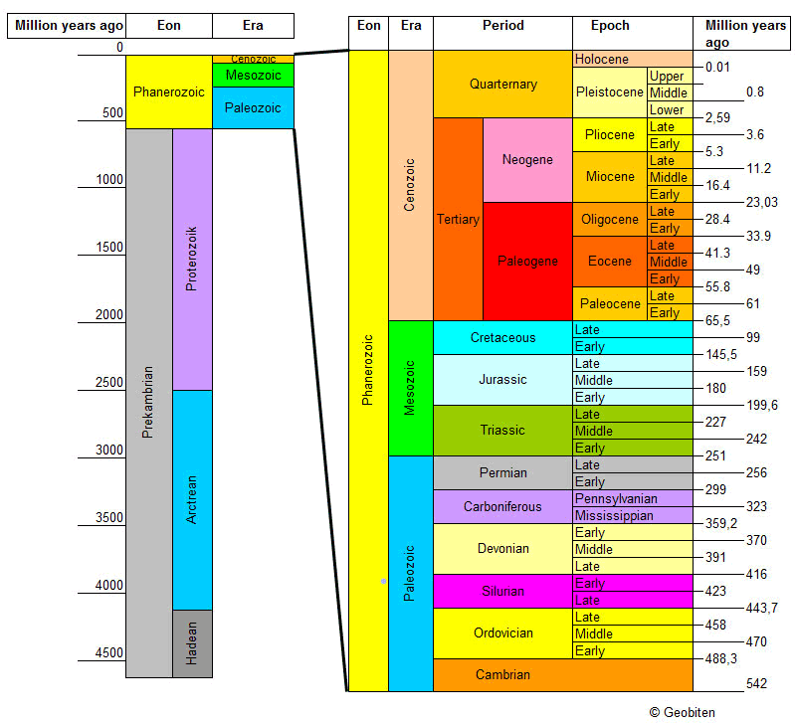
The Geological Clock
The Geological clock orders events in the geological record…
Source: https://stoneshop.se/userfiles/image/geological_timescale.png

Slide 13
Modern physics gives us a clock
  The discovery of radioactivity by Becquerel (1896) provided science a “clock” with which the actual “age” of rocks could be measured .... numbers in years could be assigned to events in the geological record.
  John William Strutt (Lord Rayleigh, 1905) measured the radium content of uranite containing rocks to find an age of 1.65 billion years,
  Bertram B. Boltwood (also 1905), working with the more stable uranium-lead system, calculated the numerical ages of 43 minerals to be in the range of 400 million to 2.2 billion years
  by the 1950s, the oldest materials found on Earth were geochronologically dated using a radioactive clock, based upon the U-Pb (uranium-lead) decay sequence, to more than 4.5 billion years...
  Now we could assign dates to the events in the Geological Clock originally based on the work of Steno and Walcott.

Slide 14

Radioactivity and clocks
Given a sufficiently large number, $N(t)$, of radioactive atoms... their nuclei would decay according to a simple statistical law, here described as a differential equation:
$$\frac{dN\left(t\right)}{dt}=−\frac{N\left(t\right)}{τ}$$
where τ is a time constant related to the half-life t_{½} as τ = t_{½}/ln 2 and ln 2 = 0.69314718... .
If we start at time t = 0 with 𝑵_{𝟎} radioactive atoms, at any later time t , we would have:
$$N\left(t\right)=N0e^{−t/τ }$$
  Let us look at a graphical example.

Slide 15
Radioactivity and clocks

Slide 16
¹⁴C dating method
The half life of a particular isotope of carbon, ¹⁴C, is 5730 years. ¹⁴C is created in the upper atmosphere through bombardment of ¹⁴N by cosmic rays from the depths of the Universe. This is the radio-isotope used in the method of radio-carbon dating. ¹⁴C (6 p⁺ and 8 n⁰) decays via β-decay back to stable ¹⁴N (7 p⁺ and 7 n⁰) according to a rule determined by its 5730-year half life. β-decay is not pressure or temperature dependent.

Slide 17
¹⁴C dating method
Common ¹²C is not radioactive. The ratio of ¹⁴C/¹²C in the atmosphere is maintained at a nearly constant level through the continuing bombardment of cosmic rays. Plants and animals take in carbon from the atmosphere with the constant ¹⁴C/¹²C ratio. While living, they maintain the atmospheric ratio but when they die they cease taking in atmospheric carbon. Within their bodies, then, ¹⁴C decays and the ¹⁴C/¹²C ratio decreases with a 5730 half life.

Slide 18
¹⁴C dating method

Slide 19
Dating on geological time scales
¹⁴C dating methods are only useful for dating during short past intervals… to perhaps 40000 years past. The geological record is more than 10000 times longer than that. Luckily there are many other clocks.
Potassium-Argon dating: There are many, many radioactive decay clocks available to us that may be used in determining the “age” of minerals within rocks. ⁴⁰K decays to ⁴⁰Ar (10.9% of decays via β-capture) and to ⁴⁰Ca (89.1% of decays via β-emission) with a half-life of about 1.3 Ga (1.3 × 10⁹ years). This long half life makes it a useful tool in aging the oldest materials on Earth.
It does, however, introduce a complication in that ⁴⁰K decays by two modes into different daughters and β-capture is pressure dependent.

Slide 20
⁴⁰Ar geochronology

Slide 21
⁴⁰Ar geochronology

Slide 22
Dating on geological time scales
Rubidium-Strontium dating: ⁸⁷Rb decays to ⁸⁷Sr via β-decay (emission of an electron) with a half-life of about 47 Ga. (A very slow ticking clock!)
Uranium-Lead dating (a double, self-checking clock): ²³⁸U decays in a complicated cascade of processes involving α-decay, β-decay and β-capture to ²⁰⁶Pb with a half-life of 4.47Ga. ²³⁵U decays similarly to ²⁰⁷Pb with a half-life of 704 Ma. Uranium lead dating on zircon crystals is regarded by most geologists as the most secure method of dating old geological materials.
Zircon crystals take up small amounts of environmental uranium when they form or “close”. They are very reliable closed “vaults” to contain the uranium and its lead decay products through billions of years. Chemically, both isotopes of U behave identically during their containment and both isotopes of Pb do as well. Their ratios only change through the physical decay processes.

Slide 23
Uranium-Lead dating:
Concordia Plots

Slide 24
Uranium-Lead dating:
Concordia Plots

Slide 25
What do we learn?
The setting of the clock and the “Oldest Materials”
“Age” in the context of rocks and minerals is the time since the radio-decay clock was last set: the “closure”
  • Oldest mineral... zircons found in Australia have been dated by the uranium-lead decay sequence to approximately 4.4 × 10⁹ years.
  • Oldest rocks... zircons within a large assembly of rocks in Northern Canada and Greenland date to between 3.96 × 10⁹ and 4.03 × 10⁹ years - the Acasta Gneiss complex. The Acasta Gneiss is a metamorphic rock, one which has undergone some important physical and even mineralogical-chemical transformations but zircons within the rock secure the age date.

Slide 26
Older rocks?
The Nuvvuagittuq faux amphibolites
A mantle-derived igneous rock that has maintained its physical integrity since its solidification has been found near Porpoise Cove in northwestern Quebec with zircon U−Pb ages of about 3.86×10⁹ years.
More recent isotopic analysis (using Sm−Nd dating) on bulk samples of the now-famous faux-amphibolites in this Nuvvuagittuq greenstone belt show a deficiency of ¹⁴²Nd in comparison to all other known rock masses on Earth. The ¹⁴²Nd deficiency is argued to result from the crystallization of the rock minerals from a magmatic mass that was originally deficient in ¹⁴⁶Sm and therefore a magma that was not well mixed with the mantle and crust during the formation of the early Earth.
The deficiency argues for an age of 4.28 × 10⁹ years. This source mass has retained its negative isotopic anomaly in ¹⁴²Nd since its original accretion. Some areas of the continental surfaces are very, very old.

Slide 27
Meteorites are older!
The Allende meteorite is the largest carbonaceous chondrite ever found on Earth. The fireball was witnessed at 01:05 on February 8, 1969, falling over the Mexican state of Chihuahua. The CAI (calcium-aluminum silicate inclusions) date to 4.567 × 10⁹ years. This is taken to be the “age” of the terrestrial planets including the Earth: 4,567,000,000 years!
Interestingly, the CAI also comprise a small amount of ²⁶Mg. It should not have condensed with the CAI-silicates. ²⁶Al could/would! But ²⁶Al decays with a very short half-life to common ²⁶Mg. This is the source of the ²⁶Mg.
That there is magnesium in these CAI tells us that the minerals that condensed into the Allende meteorite had been formed very shortly before condensation in a prior supernoval explosion.

Slide 28
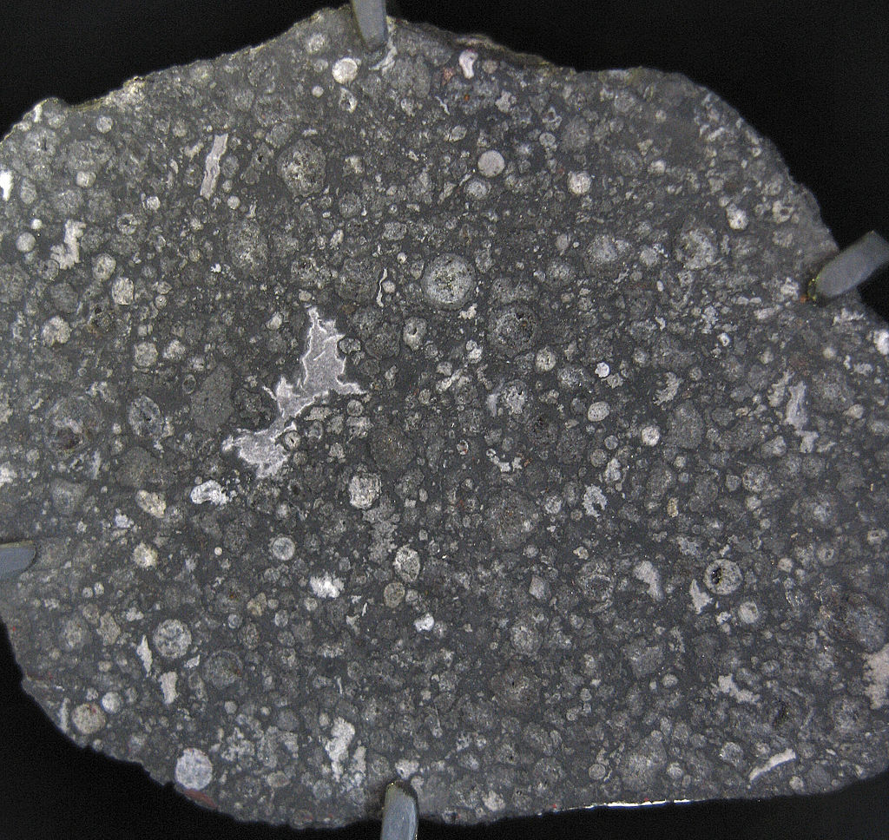
Meteorites are older!
Calcium-Aluminum-Silicate inclusion containing ²⁶Mg.
This CAI has been dated to 4.567 billion years of age.

Slide 29
Meteorites are older!
Meteorites which fall upon the Earth – almost all seem to have set their clocks before 4.55 × 10⁹ years ago (4.55 Ga). The oldest cluster has been dated to 4.567 × 10⁹ years. This latter date is now attributed to be the age of condensation of minerals in the inner part of the solar nebula from which the Sun and planets formed.
This is taken to be the “age” of the Earth: 4,567,000,000 years!
What characterizes these minerals and materials? The unique Tagish Lake meteorite that fell on the lake in northern British Columbia in 2000 is believed to represent the most primitive materials from the condensing solar nebula.

Slide 30
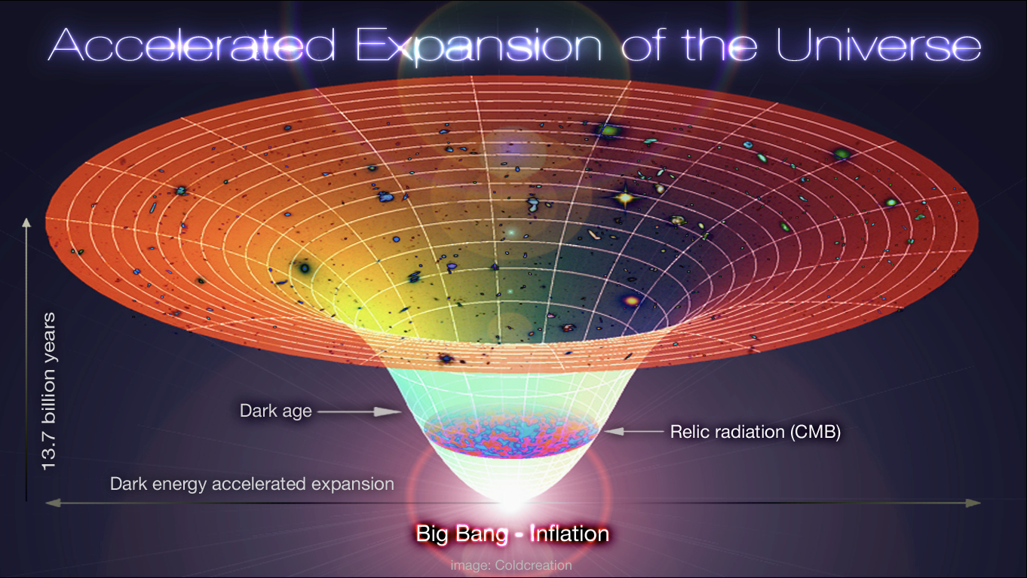
The Λ-CDM Concordance Model
← Sun and planets →
←First stars form (~100Ma)
Transparency of space →
←Plasma expansion and cooling
← Moment of “creation” and “inflation”
By Design Alex Mittelmann, Coldcreation

