Slide 1
GRAVITATIONAL wAVES
Pythagoras, the metric tensor and relativity

Slide 2
Measuring distance in 3-space
Euclidean geometry is that simplest geometry of 2-dimensional planes and 3-dimensional spatial volumes.
Cartesian coordinates (homogeneous in x, y, z) nicely address positions in a Euclidean 3-space.
We could use other coordinate systems (e.g. spherical polar coordinates) but Cartesian coordinates map place in Euclidean geometry well.

Slide 3
Distances
Pythagoras is regarded as the first pure mathematician. His famous theorem, known to every high school student, is the basis for a remarkable thread of measurement through Euclidean geometry that leads directly to Einstein’s Theory of Relativity.
For plane Euclidean geometry and measuring, using Cartesian coordinates, we determine that:
$H= \sqrt{X2+Y2}$
$$H$$
$$Y$$
$$X$$

Slide 4
Non-Euclidean Geometry?
On the surface of a sphere, a non-Euclidean geometry,
$$H< \sqrt{X2+Y2}$$
This is easy to see through the following “experiment”. Starting at a place on Earth, 1 km south of the North Pole, walk 1 km east, $E$, make a 90º turn left and walk 1km north $N$.
Where are you? You are on the North Pole and the North Pole is only 1 km from your starting point.
$$H<\sqrt{E2+N2}$$
The sphere is a closed geometry. For open (hyperbolic) geometries,
$H> \sqrt{X2+Y2}$.
Note that we think the Universe has very slightly open geometry.

Slide 5
Length and interval
Now, what of the distance between 2 points in Euclidean 3-space with their locations measured using Cartesian coordinates. Let us determine the distance according to the Pythagorean rule:
$$D2=X2+Y2+Z2$$
In Euclidean 3-space the rule holds just as shown above. But, if the geometry of the space is non-Euclidean, the rule as shown does not hold.
If we define the separation of the two points in vector component form, $\vec{D}=[X, Y, Z]$ we might recognize that $D2=\vec{D}∙\vec{D}$ . We might alternately use a linear algebraic expression of this distance measure:
$D2=\left[\begin{matrix}X & Y & Z\end{matrix}\right]\left[\begin{matrix}X \\ Y \\ Z\end{matrix}\right]$.

Slide 6
Metric Tensor
You might also recognize that we could write this previous equation as:
$$D2=\left[\begin{matrix}X & Y & Z\end{matrix}\right]\left[\begin{matrix}1 & 0 & 0 \\ 0 & 1 & 0 \\ 0 & 0 & 1\end{matrix}\right]\left[\begin{matrix}X \\ Y \\ Z\end{matrix}\right]$$
The identity matrix form in this linear algebraic equation,
$\overset{̿}{I}= \left[\begin{matrix}1 & 0 & 0 \\ 0 & 1 & 0 \\ 0 & 0 & 1\end{matrix}\right]$
is, properly, the metric tensor for measurement of distances in a Euclidean 3-space described with Cartesian coordinates. To remind ourselves that this is actually a tensor and not just an identity matrix, we often use the symbolic notation: δ_{ij} where i and j independently represent the x, y and z coordinates.

Slide 7
What is 4-space-time?
In 1905, Albert Einstein published his (Special) Theory of Relativity which explained the Lorentz transformation (known earlier) for moving observations and observers.
Einstein’s special wisdom was to recognize that time, $t$, provided a 4th dimension. To “explain” the Lorentz transformations, he set the time-like dimension as $x0=c t$ where $c$ is the speed of light in vacuo, constant to all observers. The conventional 3 spatial dimensions, we shall call $x1, x2 , x3.$
An “event” is described by its moment in time and its position in space: $[ x0 x1 x2 x 3 ]$ . The “interval” (equivalent to distance) between two events is given by a Pythagorean-like measurement:
$s 2=−x02+x12+x22+x32$ .

Slide 8
Geometry of space-time
This interval measurement implies an inherent Lorentz-Minkowski geometry for (empty) space-time:
$s 2=−x02+x12+x22+x32$ ,
$$s 2=\left[ x0 x1 x2 x3 \right]\left[\begin{matrix}−1 \\ 0 \\ \begin{matrix}0 \\ 0\end{matrix}\end{matrix}\begin{matrix} 0 \\ 1 \\ \begin{matrix} 0 \\ 0\end{matrix}\end{matrix}\begin{matrix}0 \\ 0 \\ \begin{matrix}1 \\ 0\end{matrix}\end{matrix}\begin{matrix} 0 \\ 0 \\ \begin{matrix} 0 \\ 1\end{matrix}\end{matrix}\right] \left[\begin{aligned}x0 \\ x1 \\ x2 \\ x3\end{aligned}\right]$$
The modified identity-like matrix represents the metric tensor of Lorentz-Minkowski Geometry of space-time in 4-Cartesian Coordinates.
We often represent all the elements of this metric tensor with a single symbol: $ημυ$ where μ and υ can each, independently, take on the value, 0, 1, 2, or 3.

Slide 9
Gravitational Waves
A passing gravitational wave appears as oscillatory perturbations of some of the elements of the metric tensor. The metric tensor, $ημυ$ , becomes, $gμυ$ $=$ $ημυ$ $+$ $hμυ$ , where the perturbation metric has form:
$hμυ =\left[\begin{matrix}−1 \\ 0 \\ \begin{matrix}0 \\ 0\end{matrix}\end{matrix}\begin{matrix} 0 \\ 1 \\ \begin{matrix} h 21 \\ h 31\end{matrix}\end{matrix}\begin{matrix}0 \\ h 12 \\ \begin{matrix}1 \\ h 32\end{matrix}\end{matrix}\begin{matrix} 0 \\ h 13 \\ \begin{matrix} h 23 \\ 1\end{matrix}\end{matrix}\right]$ .
Each $hij =hji$ . The metric tensor remains symmetric. Subtlety, this means that the wave does not change the volume of the local spatial geometry.
$hij =a cos(ωt+φ)$ .
The amplitude of the oscillations that have, so-far, been observed are extraordinarily small, $a ≈{10}^{−23}.$

Slide 10
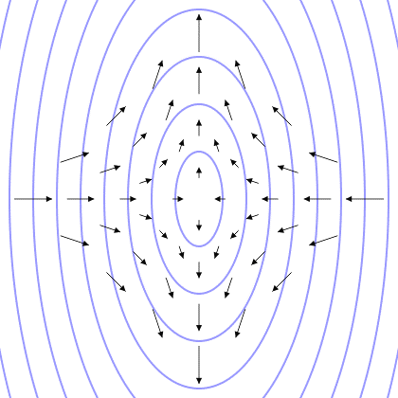
Spatial geometry oscillates
Raoul NK (Own work) [CC BY-SA 3.0 (http://creativecommons.org/licenses/by-sa/3.0)], Wikimedia Commons

Slide 11
Places in the geometry move
https://commons.wikimedia.org/wiki/File:GravitationalWave_PlusPolarization.gif

Slide 12
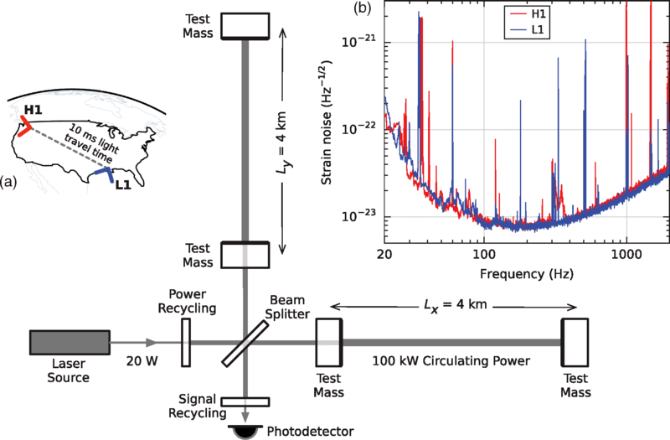
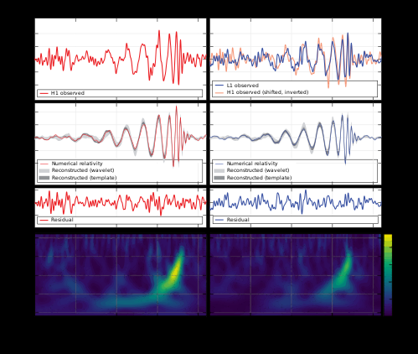
First observations by LIGO
A wave observed caused by the in-spiralling collision of 2 black holes
The LIGO observatories
The discovery article in Phys. Rev.
Abbott, B. P. et al. - Observation of Gravitational Waves from a Binary Black Hole Merger B. P. Abbott et al. (LIGO Scientific Collaboration and Virgo Collaboration) Phys. Rev. Lett. 116, 061102 doi:10.1103/PhysRevLett.116.061102
https://en.wikipedia.org/wiki/Gravitational_wave

