Slide 1
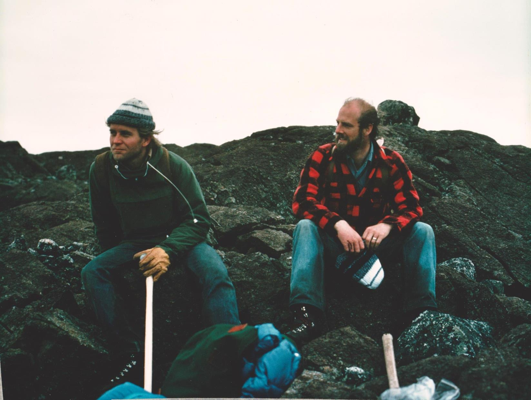
Martian Soils
Mantle Probe or just “Dirt”?
Don Francis
EPS - McGill University
Cape Smith Fold Belt
circa 1977

Slide 2
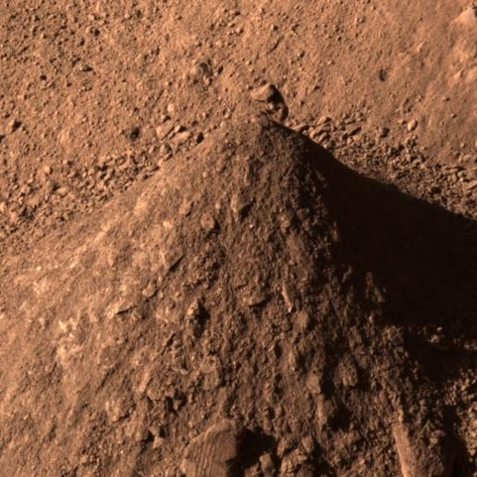
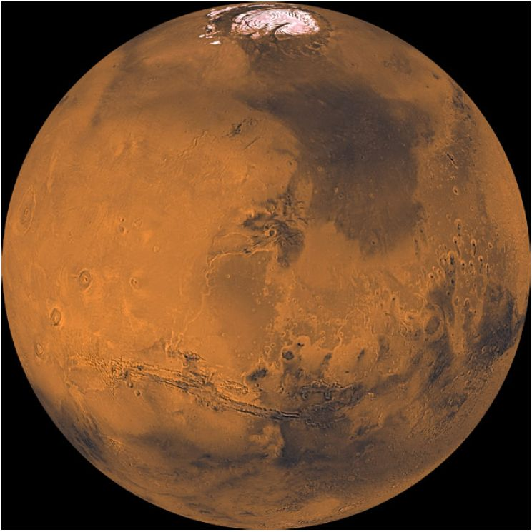
Phoenix
Martian
Soil
Phoenix
arctic lowlands
Planet-wide Uniformity
Retain Igneous Composition
Mantle Source with Ol Fo:80
10 Kb multi-saturation - Stagnate Lid Tectonics
Bi-modal Fe content in Terrestrial Planets
Sulfide Line in the Solar Nebulae

Slide 3
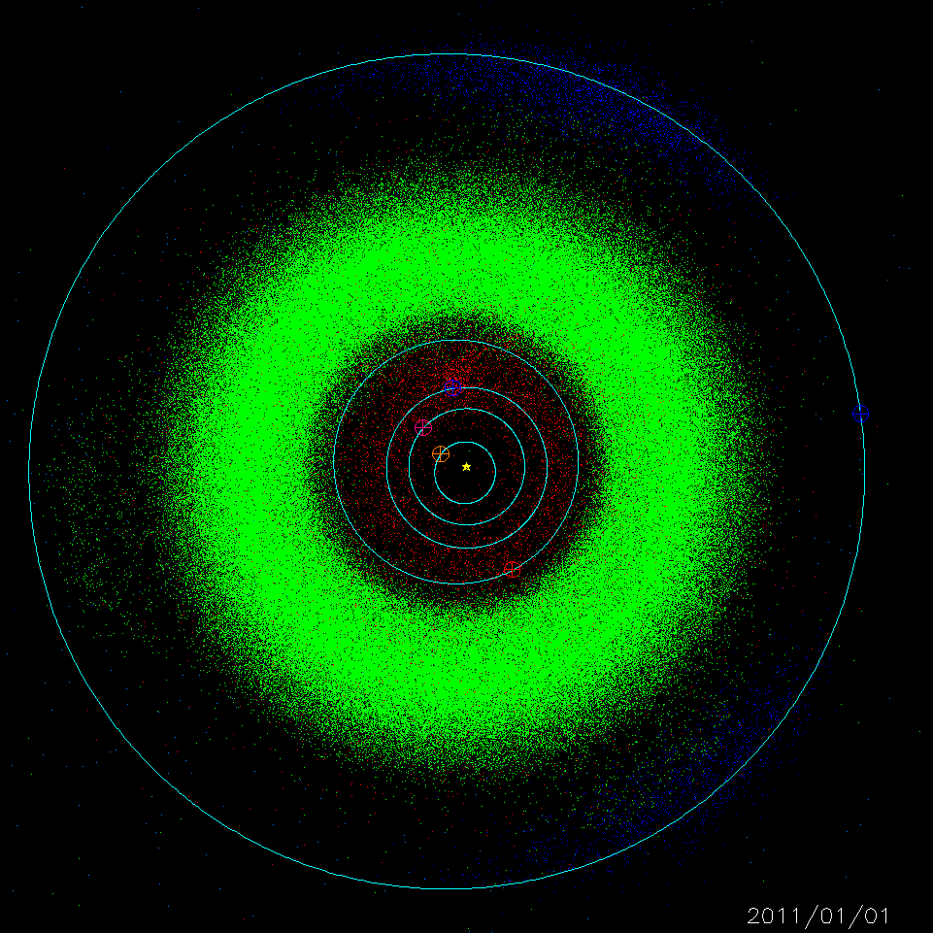
AsteroidBelt
Snow Line
Tar Line
Asteroid Belt
Melting
&
Differentiation
undifferentiated
Ices, C
+
high-T
Metal, Oliv, Opx,
Glass
&
low-T Hydrated
Silicates
Carbonaceous & Low-T
Hydrated Silicates

Slide 4
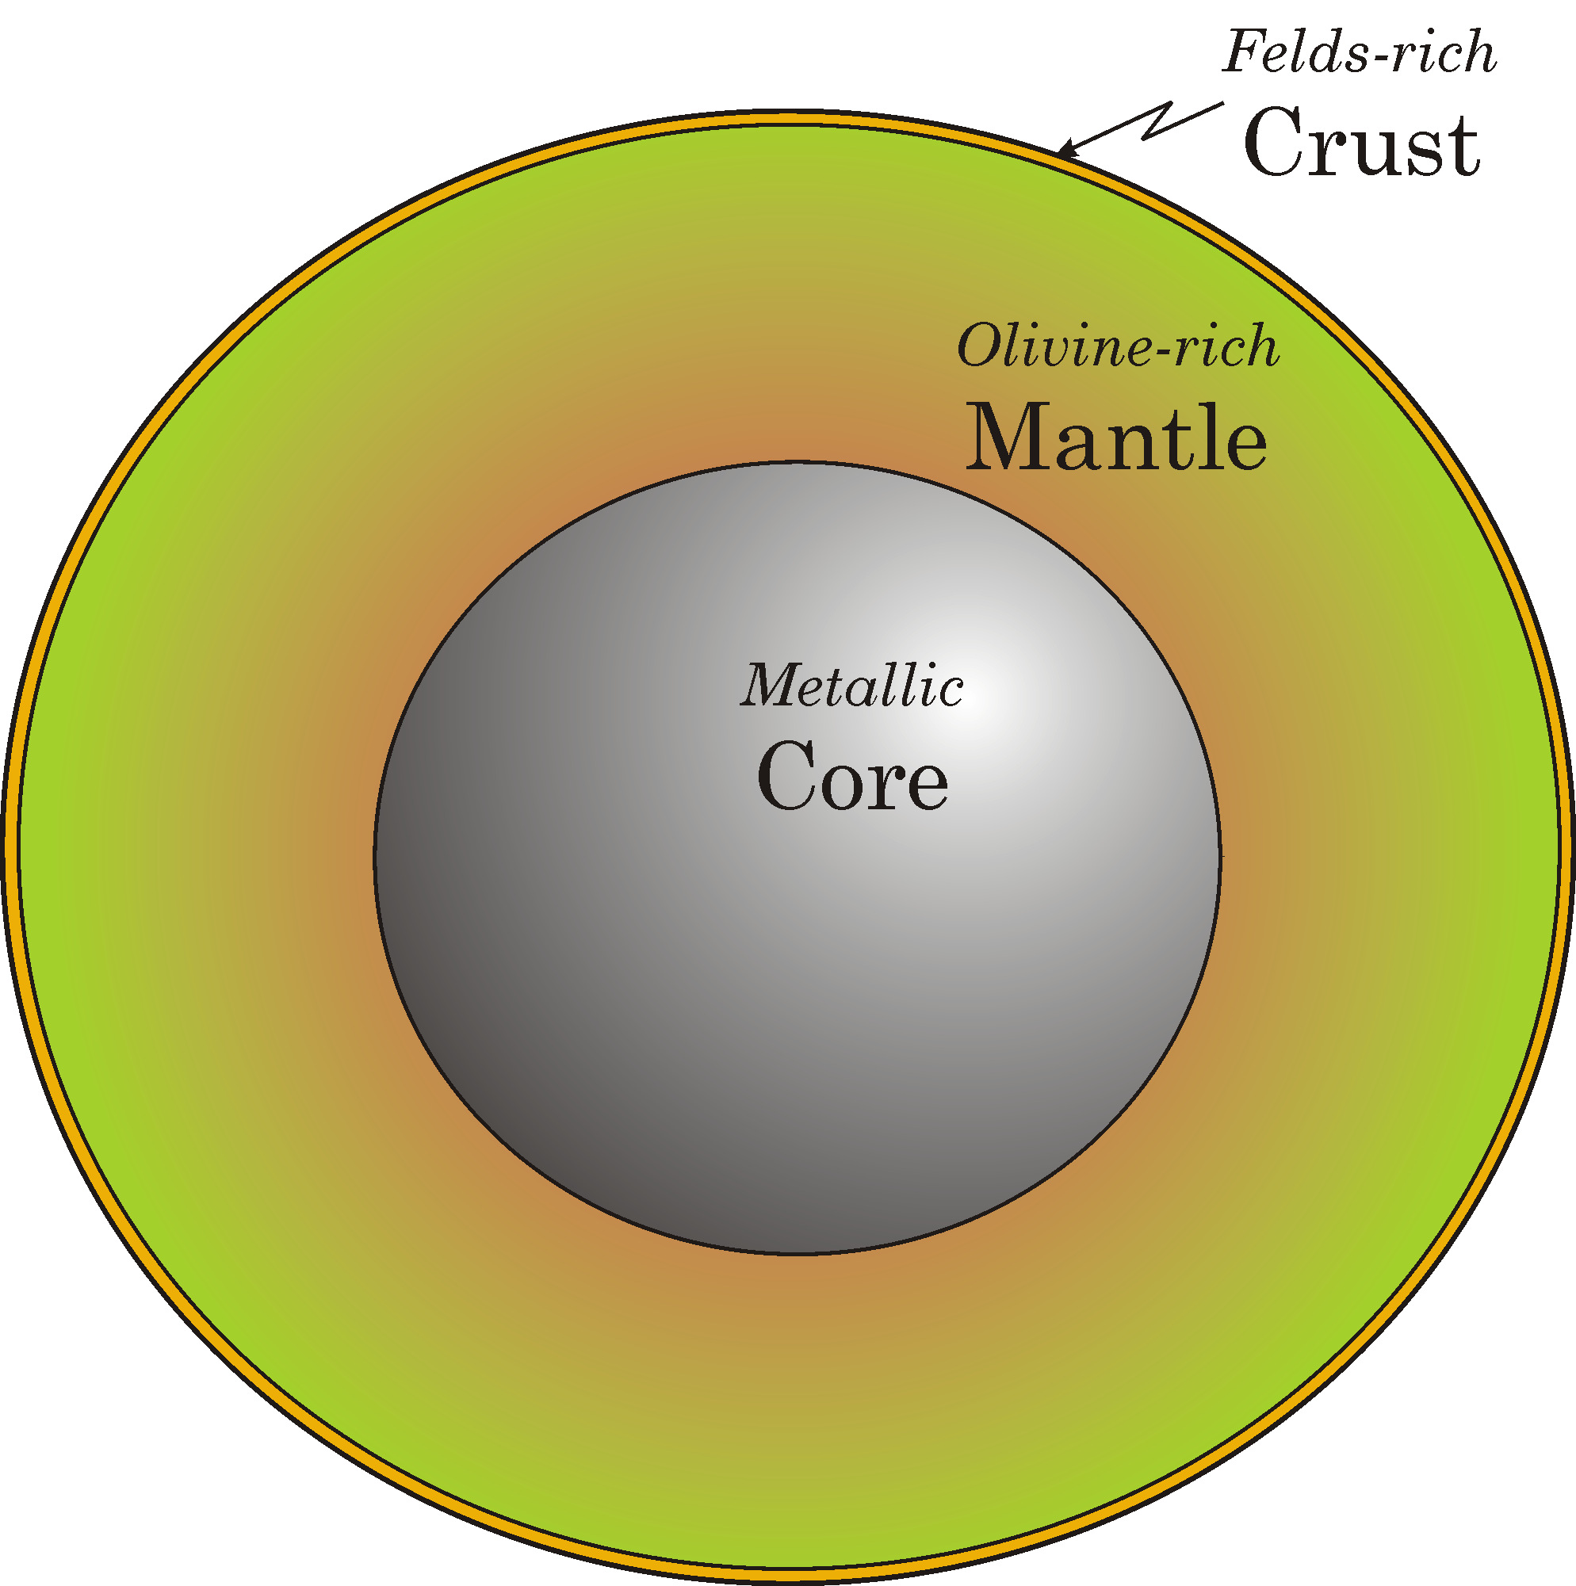
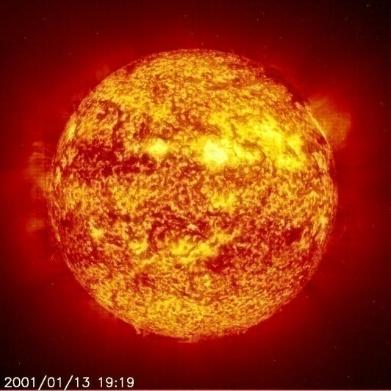
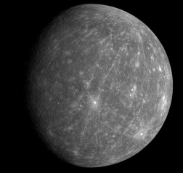
Sun - Terrestrial Planets
Fe in the Terrestrial Planets?
Fe_{total} = Fe²⁺ + Feº
Feº
Fe²⁺

Slide 5
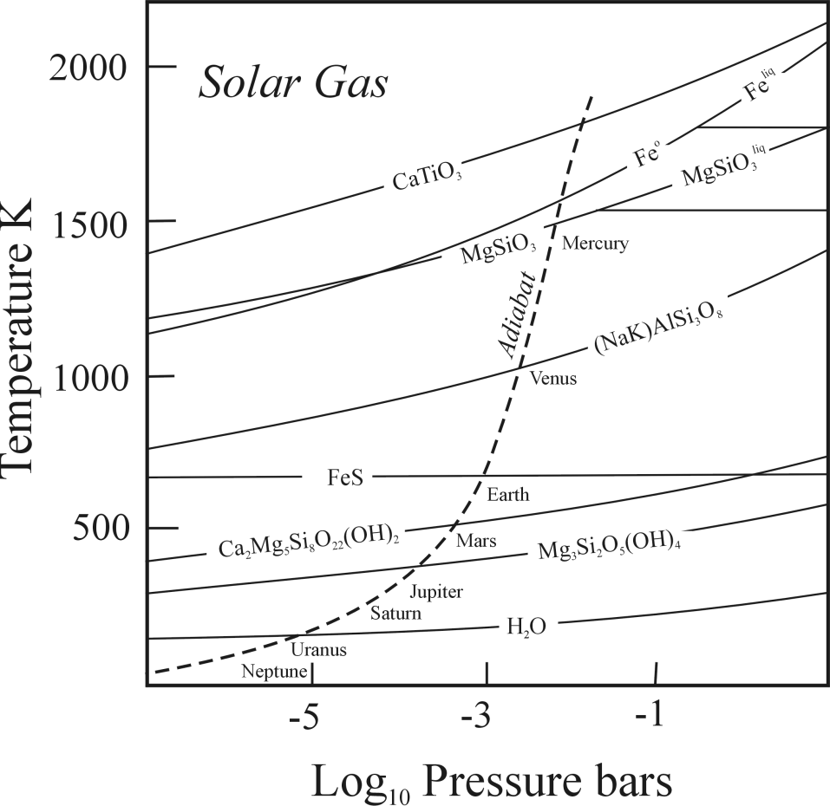
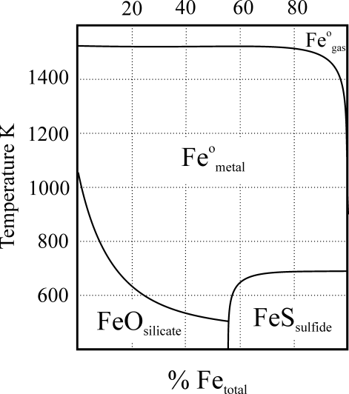
Solar Gas Condensation Sequence
Predicts that Fe will be more oxidized with increasing heliocentric distance.
Feº_{metal} + H₂O FeO_{silicate} + H₂
Mercury
Fe Metal
Venus
Earth
FeO
FeS
Mars
after Lewis

Slide 6
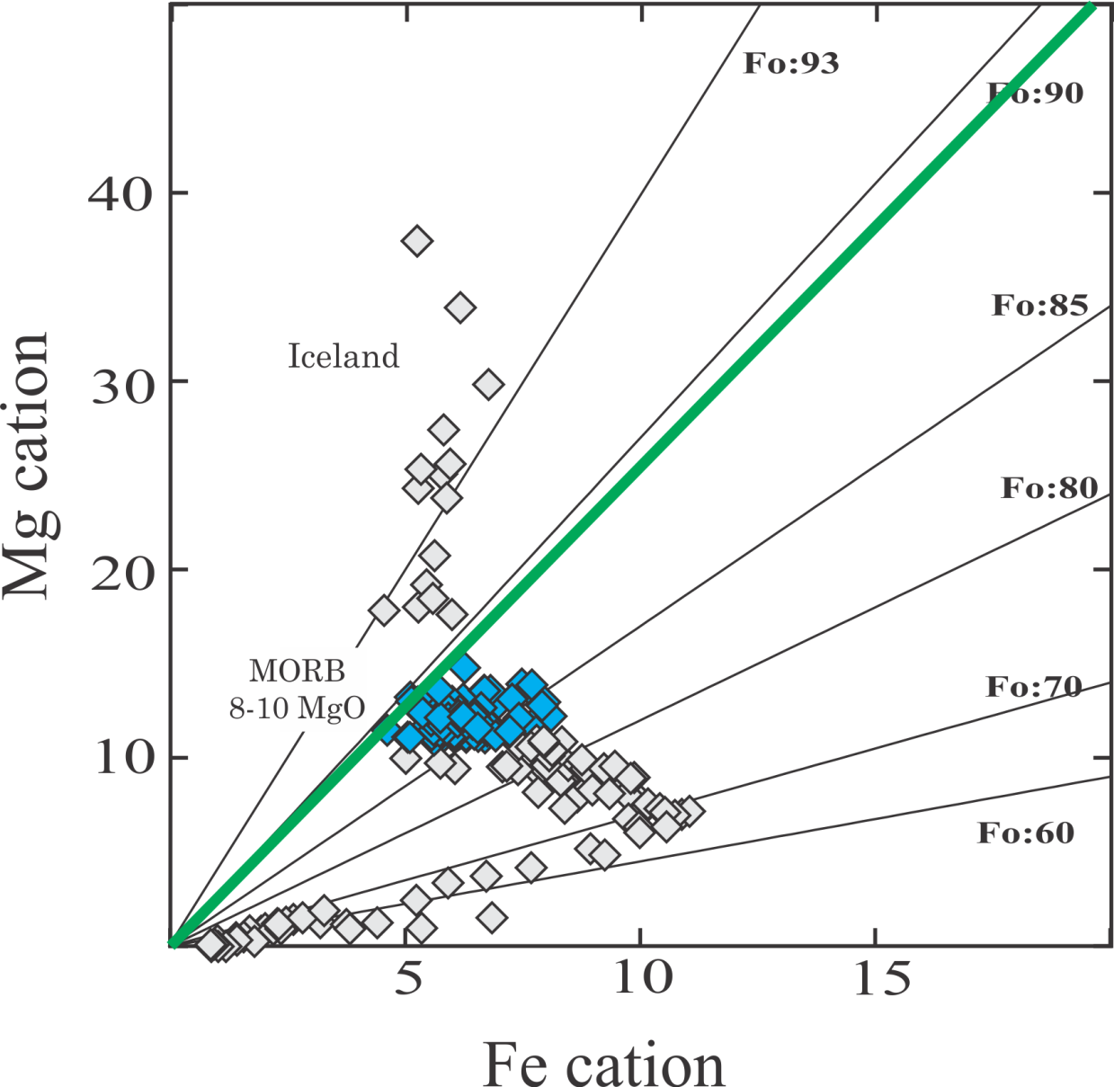
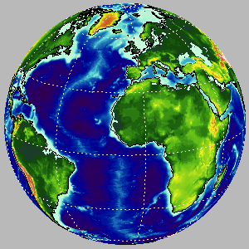
Earth - MORB
Mantle Fo 89

Slide 7
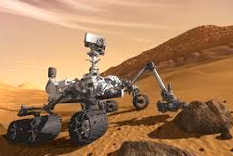
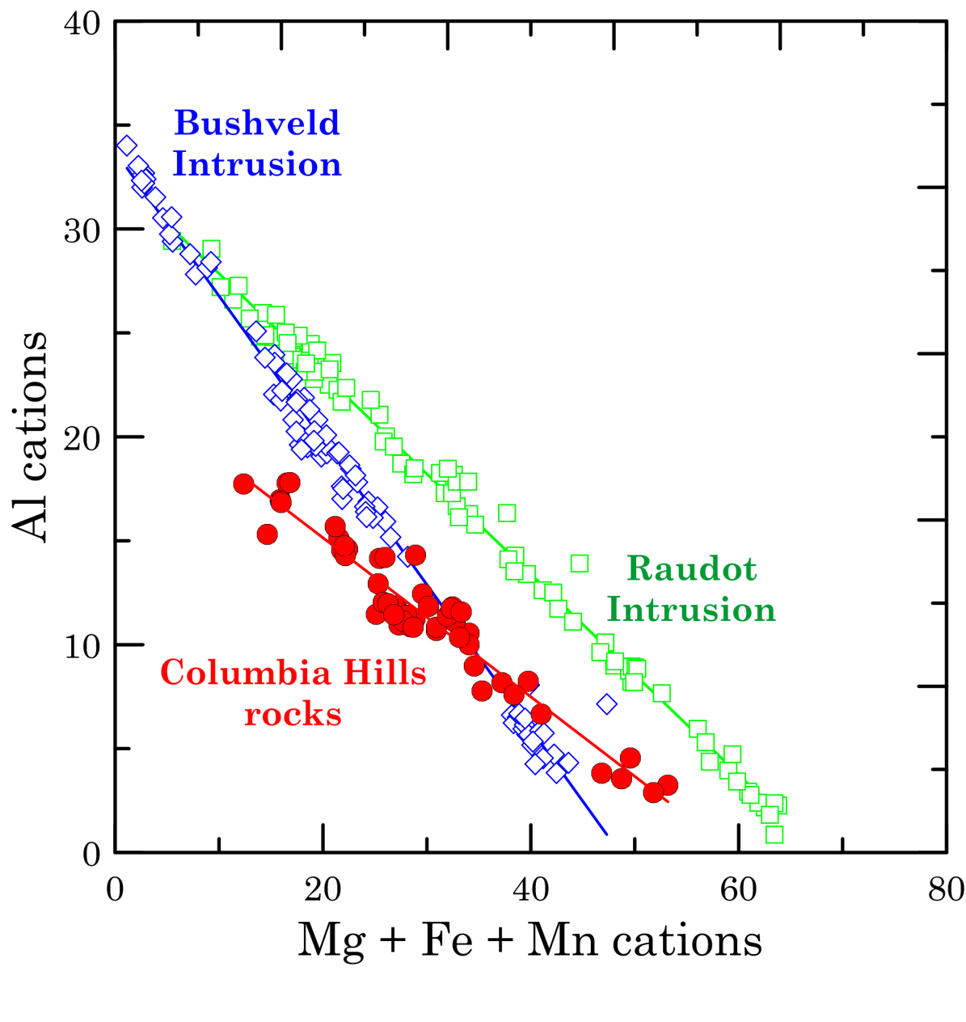
Spirit
at Gusev Crater
on Mars
Columbia Hills
Spirit
Igneous Trend?
APXS
analyses
Dejan

Slide 8
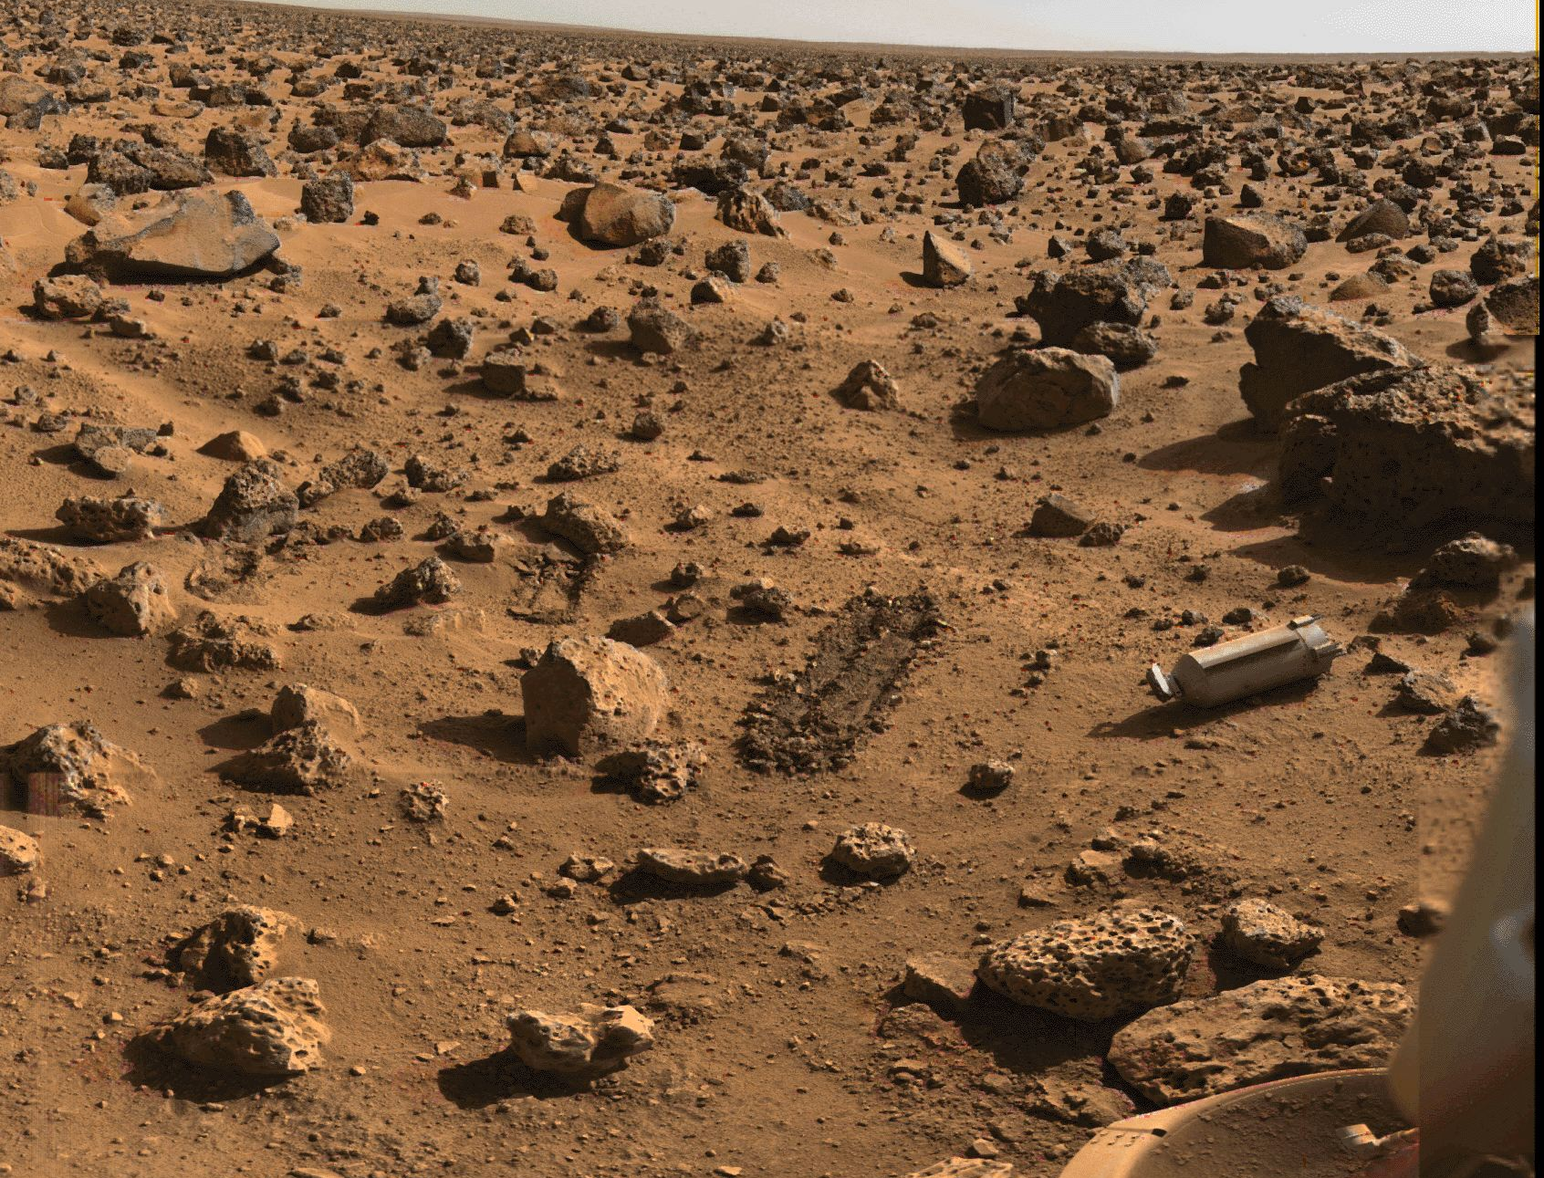
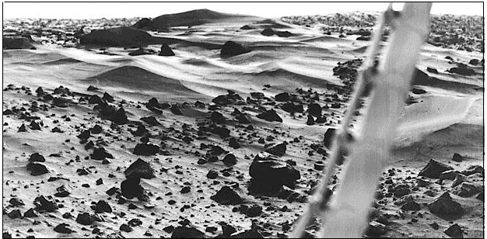
Bright
Dust
Bright Dust
Dark
Soil
Bright Dust
on
Dark Soil
Viking 2
Utopia Planitia
northern lowlands

Slide 9
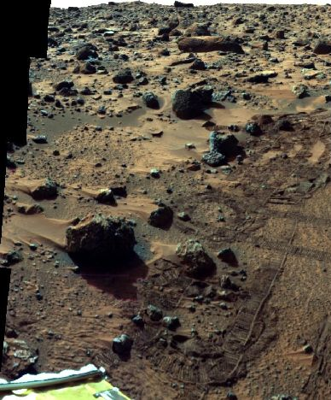
Bright Dust
on
Dark Soil
Pathfinder
Ares Vallis

Slide 10
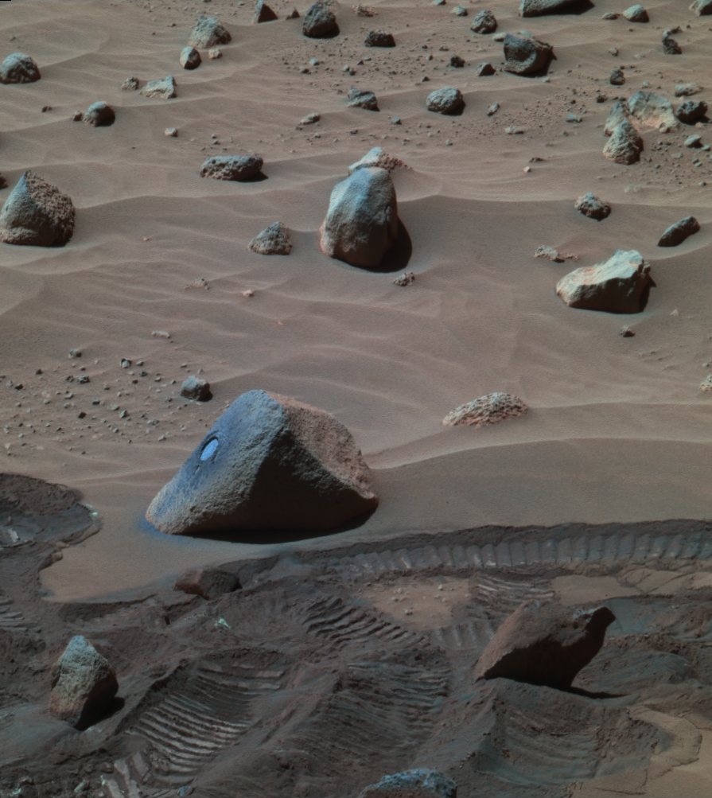
Bright Dust
On top of Dark Soil
Spirit
Columbia Hills
Wishstone

Slide 11
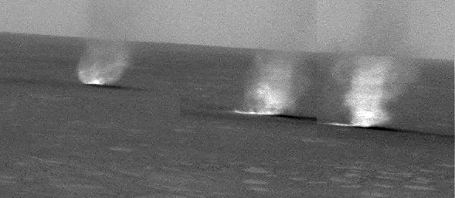
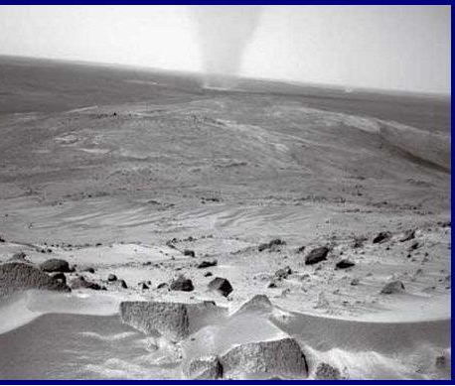
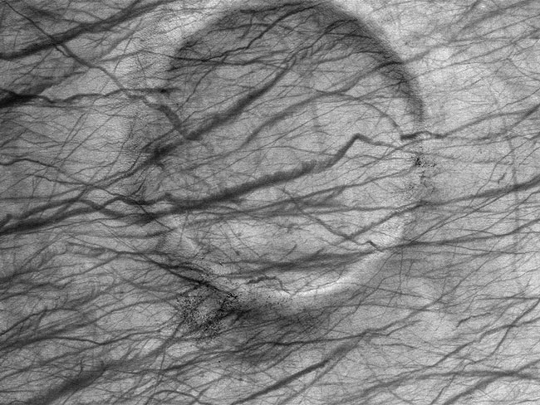
Dust Devils stir up Bright Dust
leaving dark tracks
Spirit in the Columbia Hills
Bright Dust

Slide 12
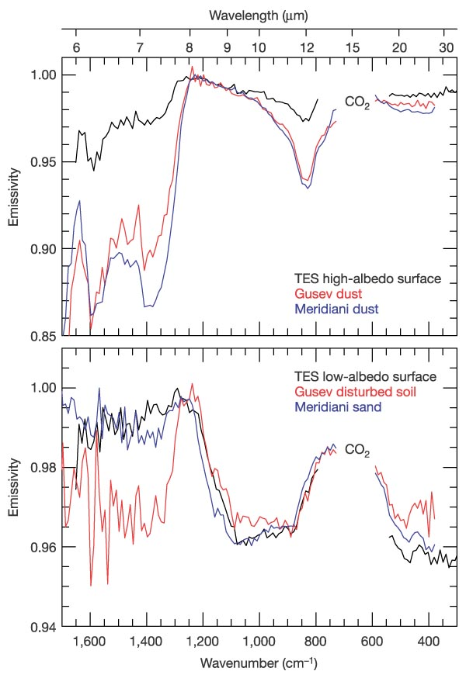
Bright Dust
Absence of strong absorption bands in the range 8-12 um indicates absence of fresh ferromagnesian silicates.
Dark Soil and Sand
Strong absorption bands indicate the presence of fresh olivine, pyroxene, feldspar, and sulfates in the dark soils
Fe in Silicated
Absorption
Bands
McSween et al. 2010

Slide 13
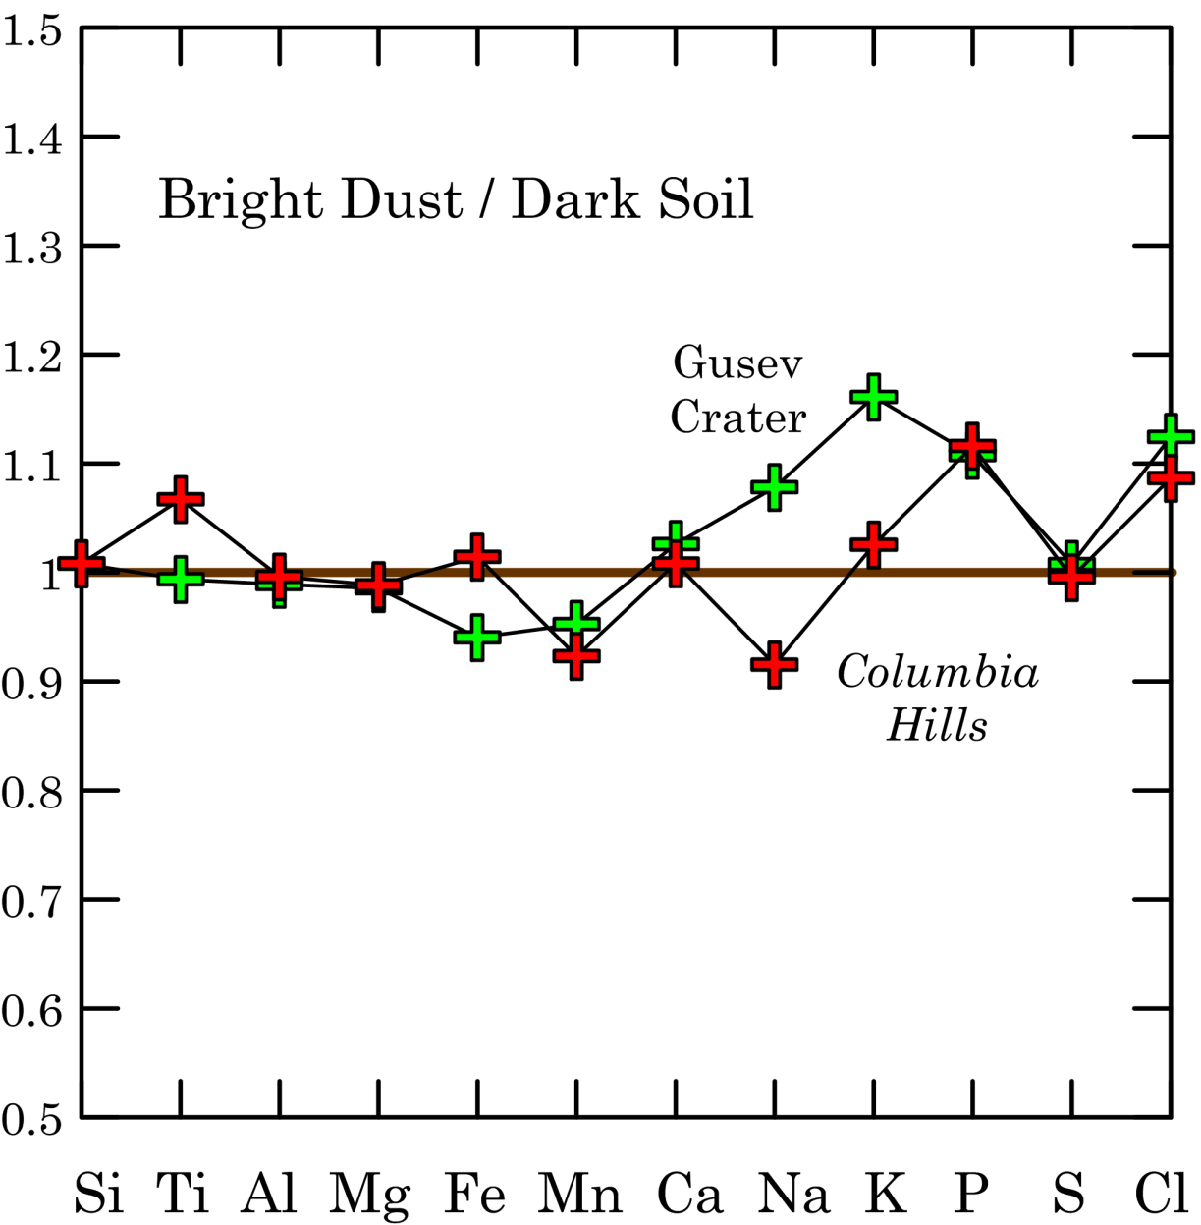
Despite their physical and mineralogical differences, the Bright Dust and Dark Soil have very similar major element compositions.

Slide 14
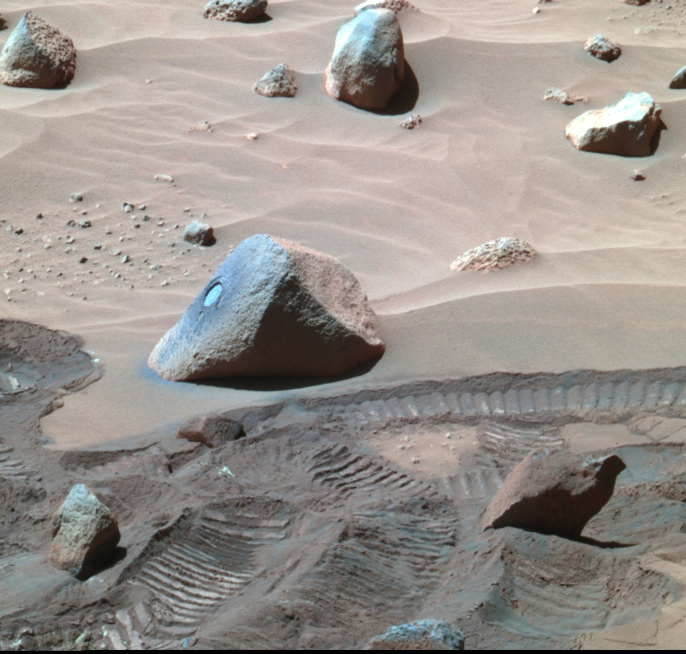
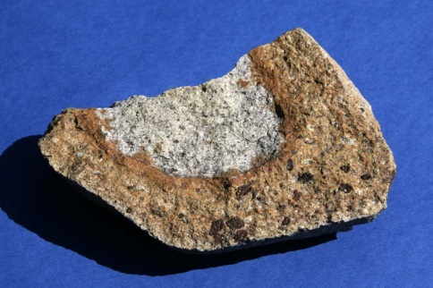
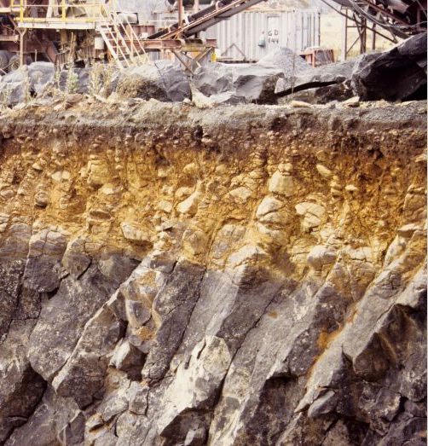
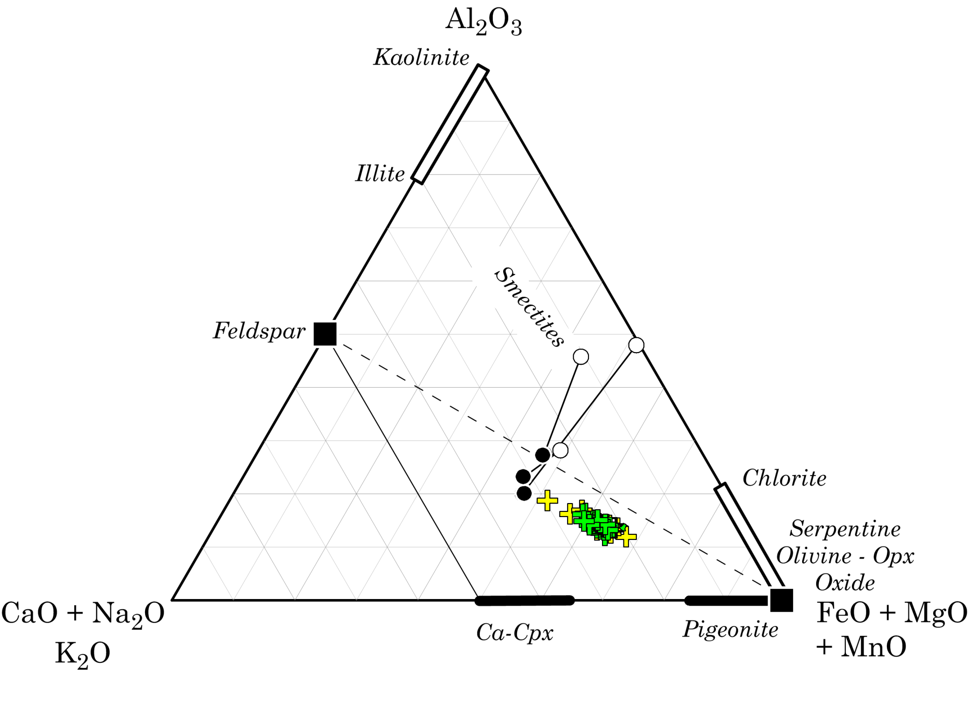
Dust
Soil
Terrestrial Weathering

Slide 15
Martian Soils
Sample | Viking-1 | Viking-2 | PathFinder | Gusev | Columbia | Meridiani
 |  |  |  | Crater | Hills | Planum
SiO2 | 44.3 | 42.8 | 46.6 | 45.7 | 46.5 | 45.7
TiO2 | 0.9 | 1.0 | 1.1 | 0.9 | 0.9 | 0.9
Al2O3 | 5.6 | 5.6 | 8.3 | 9.9 | 10.5 | 9.9
MgO | 8.5 | 8.5 | 8.1 | 8.8 | 8.8 | 8.8
FeO | 18.4 | 20.3 | 17.7 | 16.4 | 15.6 | 16.4
MnO | ---- | ---- | 0.5 | 0.3 | 0.3 | 0.3
CaO | 5.4 | 5.0 | 6.5 | 6.3 | 6.3 | 6.3
Na2O | ---- | ---- | 1.8 | 2.9 | 3.1 | 2.9
K2O | 1.0 | 1.0 | 0.4 | 0.4 | 0.5 | 0.4
P2O5 | 0.0 | 0.0 | 1.9 | 0.8 | 1.0 | 0.8
SO3 | 8.5 | 6.5 | 6.0 | 6.5 | 5.5 | 6.5
Total | 94.9 | 93.0 | 98.9 | 98.8 | 99.0 | 98.8
Trace | Elements | in ppm
Ni | ---- | 0 | 1000 | 498 | 509 | 498
Cr | 0 | 0 | 1143 | 2506 | 2092 | 2506
Zn | 0 | 0 | 0 | 307 | 307 | 307
Br | 0 | 0 | 0 | 54 | 53 | 54
Cl | 8000 | 6000 | 6167 | 6721 | 6550 | 6721

Slide 16
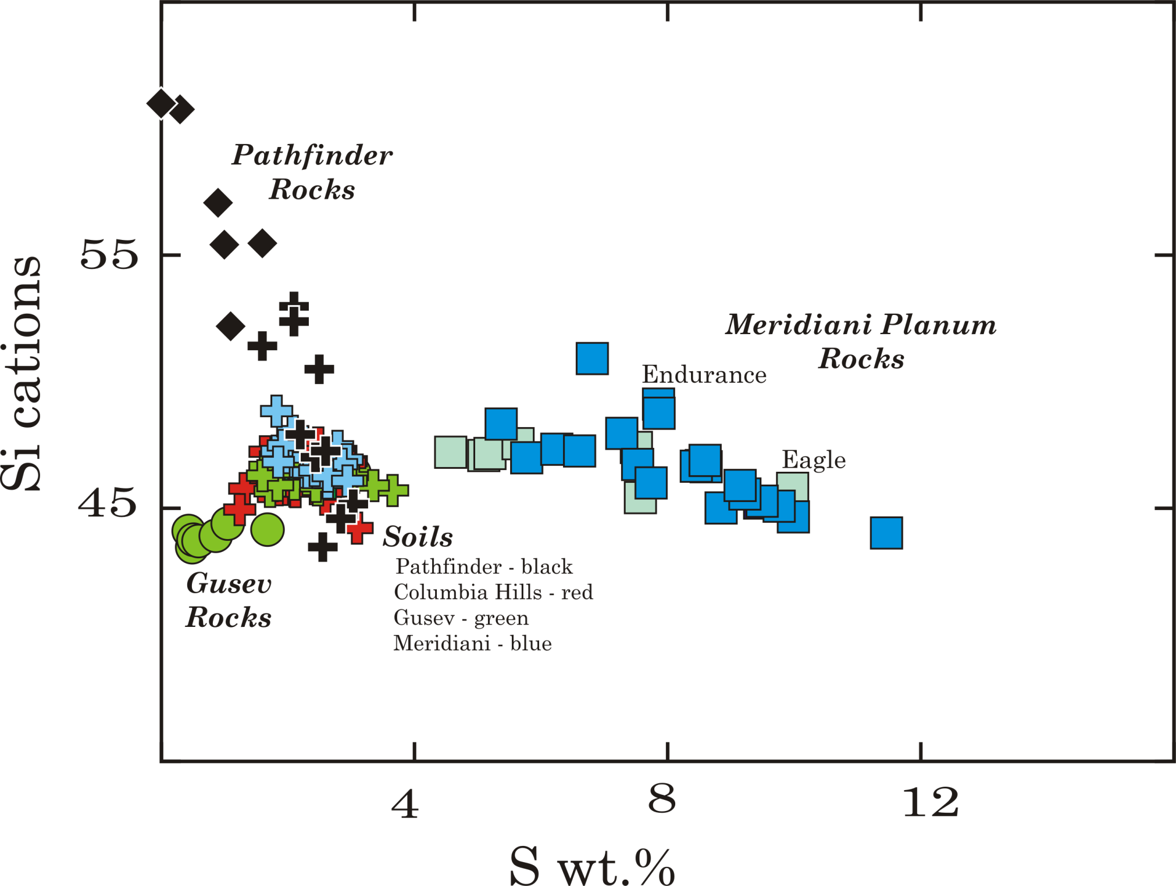

Slide 17
Mineralogy of Martian Soils
 | CIPW |  | MiniTES |  | CIPW
 | Norm |  | Spectra |  | NORM - SO₃
 |  |  |  |  | SiO₂, clay
Quartz | 3.9 |  | 9.0 |  | 0.0
Feldspar | 41.3 |  | 24.0 |  | 43.5
Clinopyroxene | 11.1 |  | 3.5 |  | 2.6
Orthopyroxene | 25.1 |  | 30.0 |  | 29.5
Olivine | 0.0 |  | 19.5 |  | 11.1
Magnetite | 7.1 |  |  |  | 7.5
Ilmenite | 1.9 |  |  |  | 2.4
Mg-Fe Sulfate | 6.9 |  |  |  | 0.0
Apatite | 2.0 |  |  |  | 2.6
Sulfate |  |  | 7.5
Clay |  |  | 4.5
After McSween et al. 2010

Slide 18
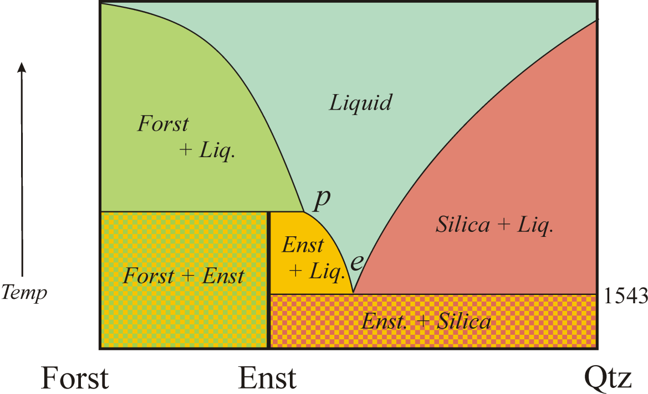
The absence of olivine in calculated Norms, but apparent presence, as evidenced in TES spectra, has important implications:
May imply that the Martian soils are just “Dirt”:
mechanical mixtures of 2 components; fresh ground-up basalt and older weathering products, including detrital quartz and clay minerals
Might, however, be explained by the olivine reaction relationship, as occurs in many Terrestrial basalts.

Slide 19
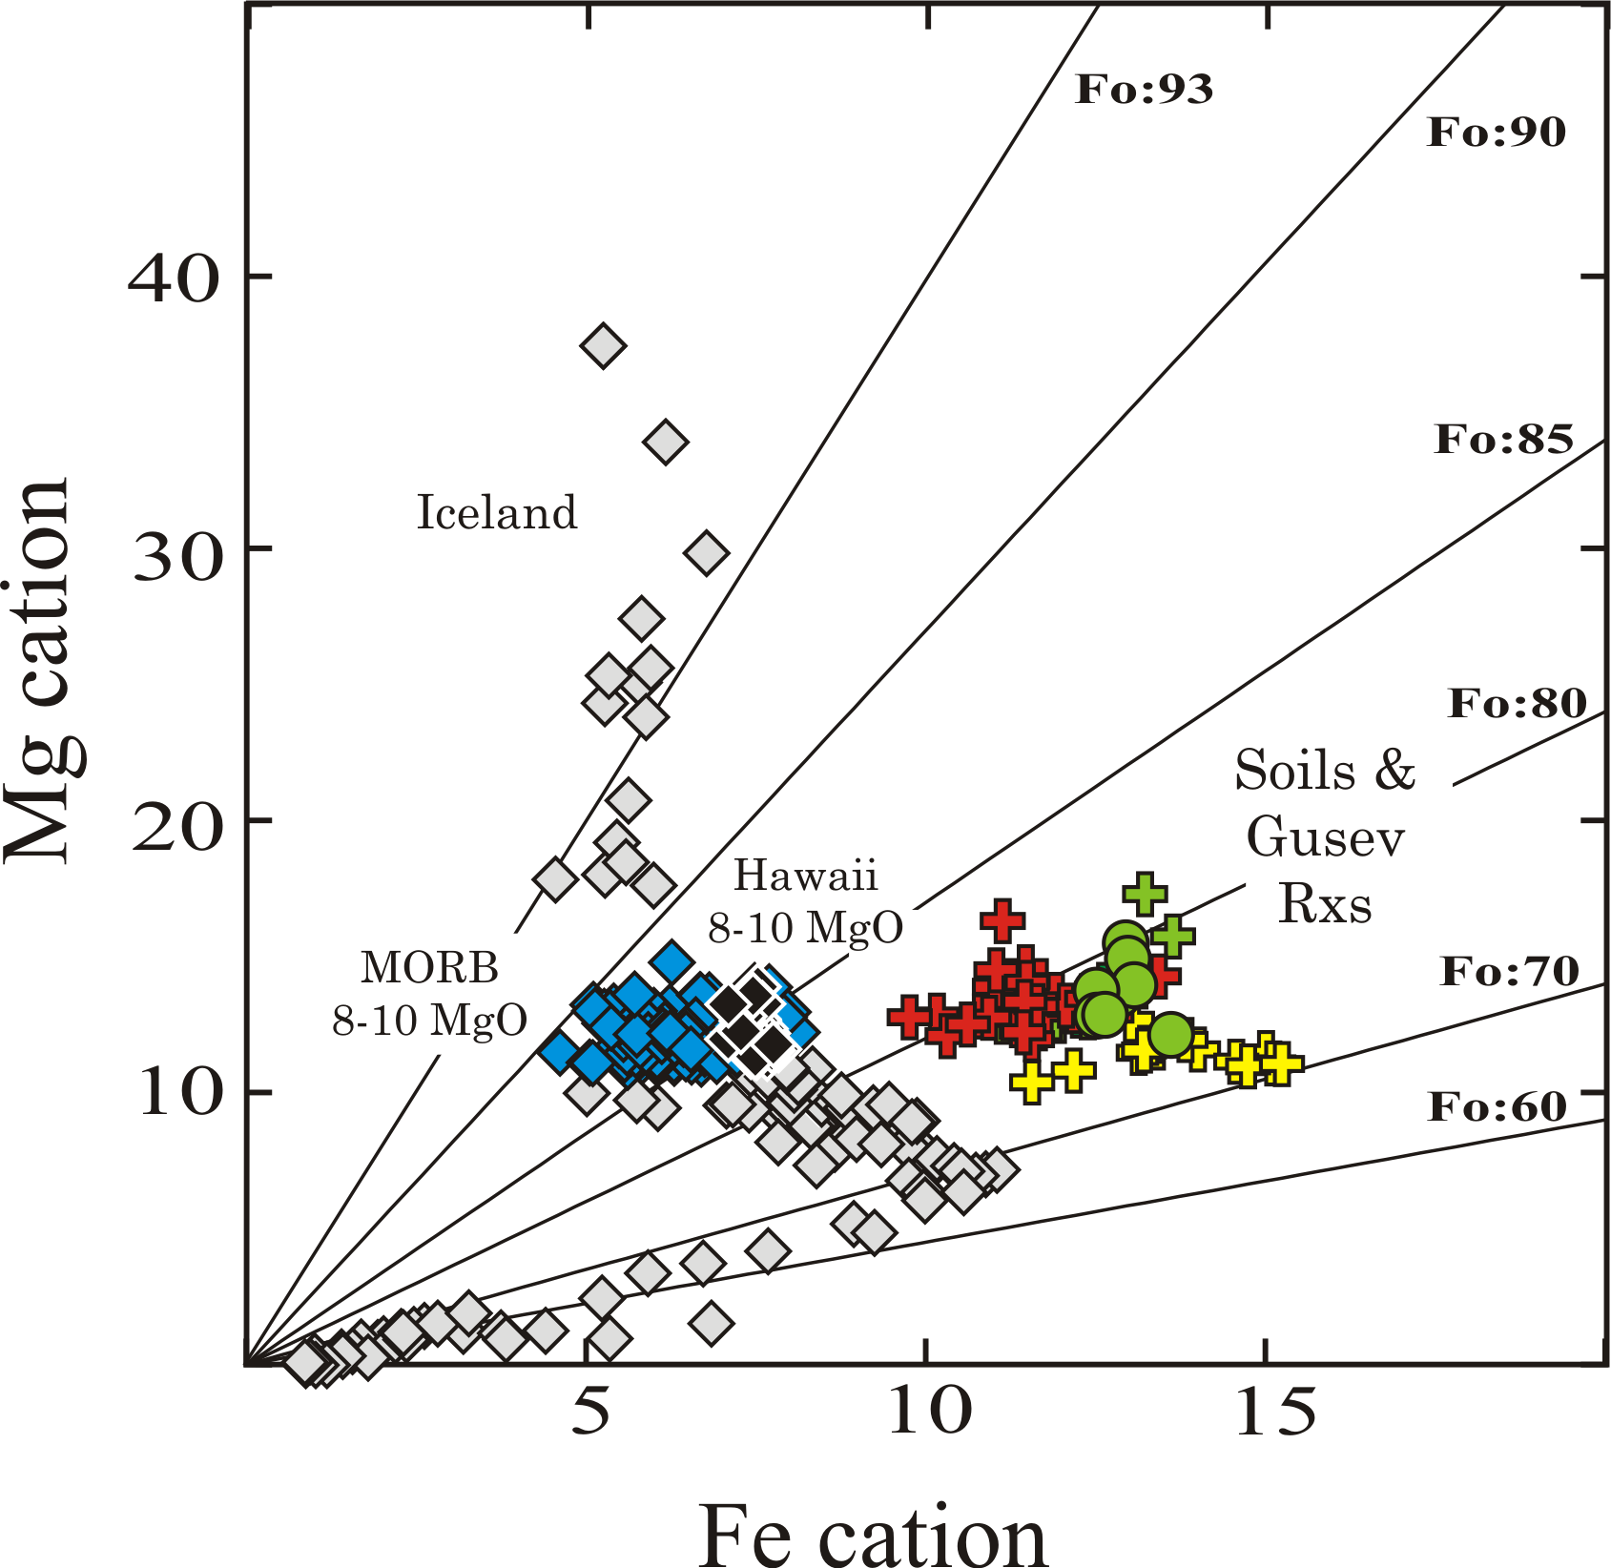
0.90
0.73

Slide 20
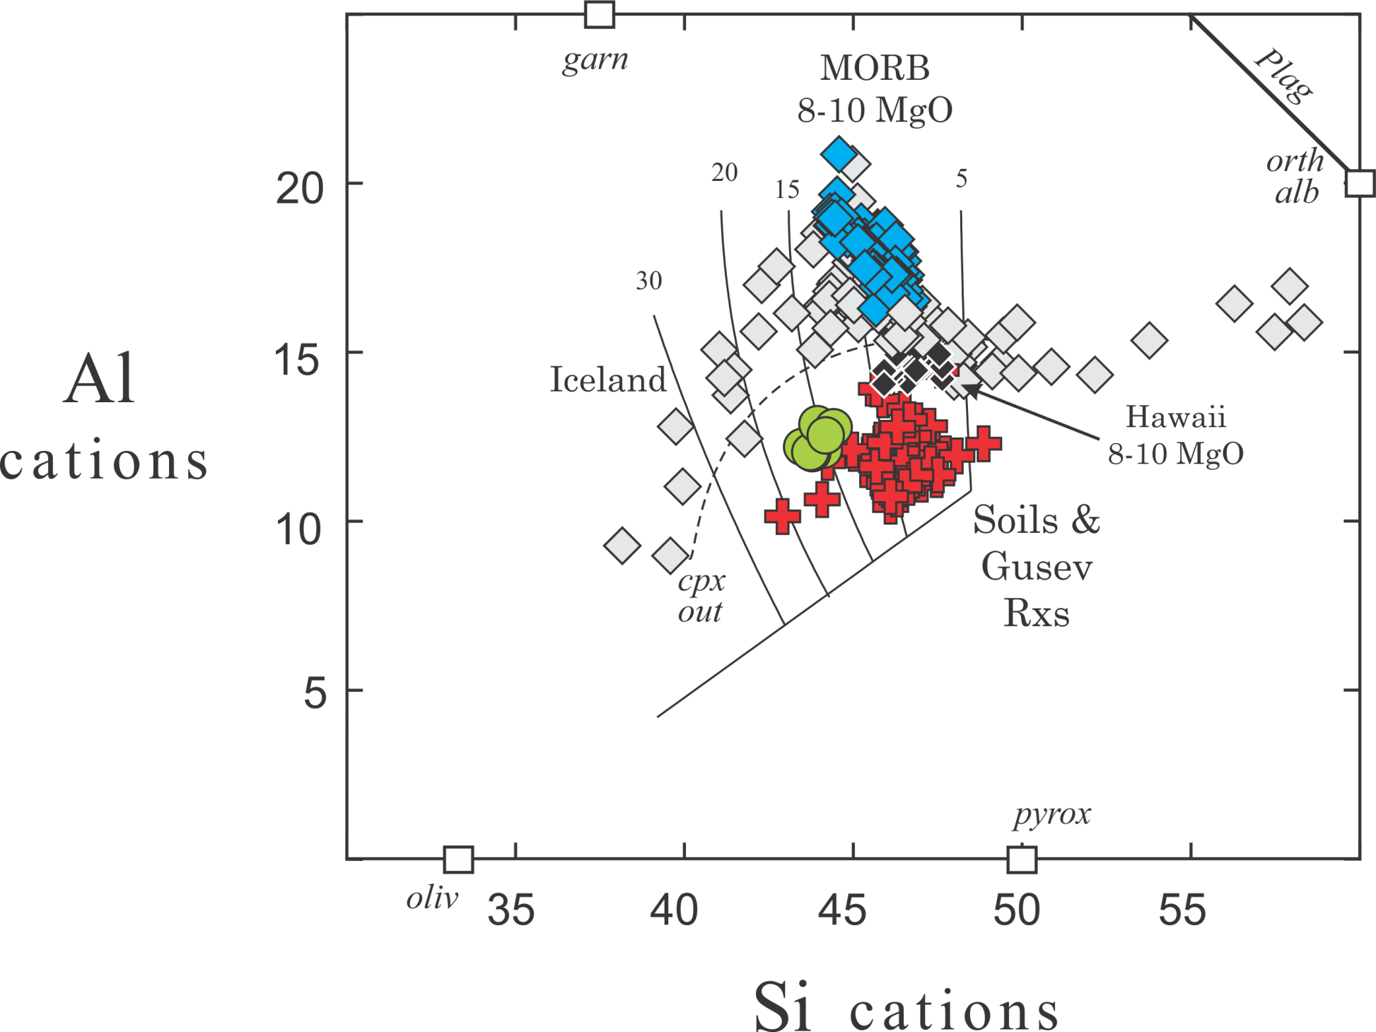

Slide 21
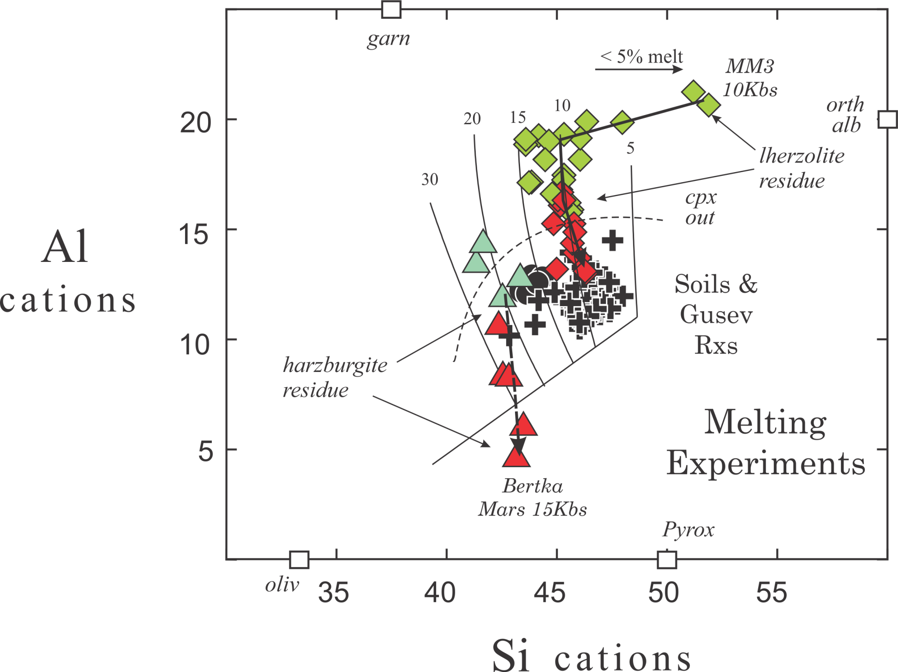

Slide 22
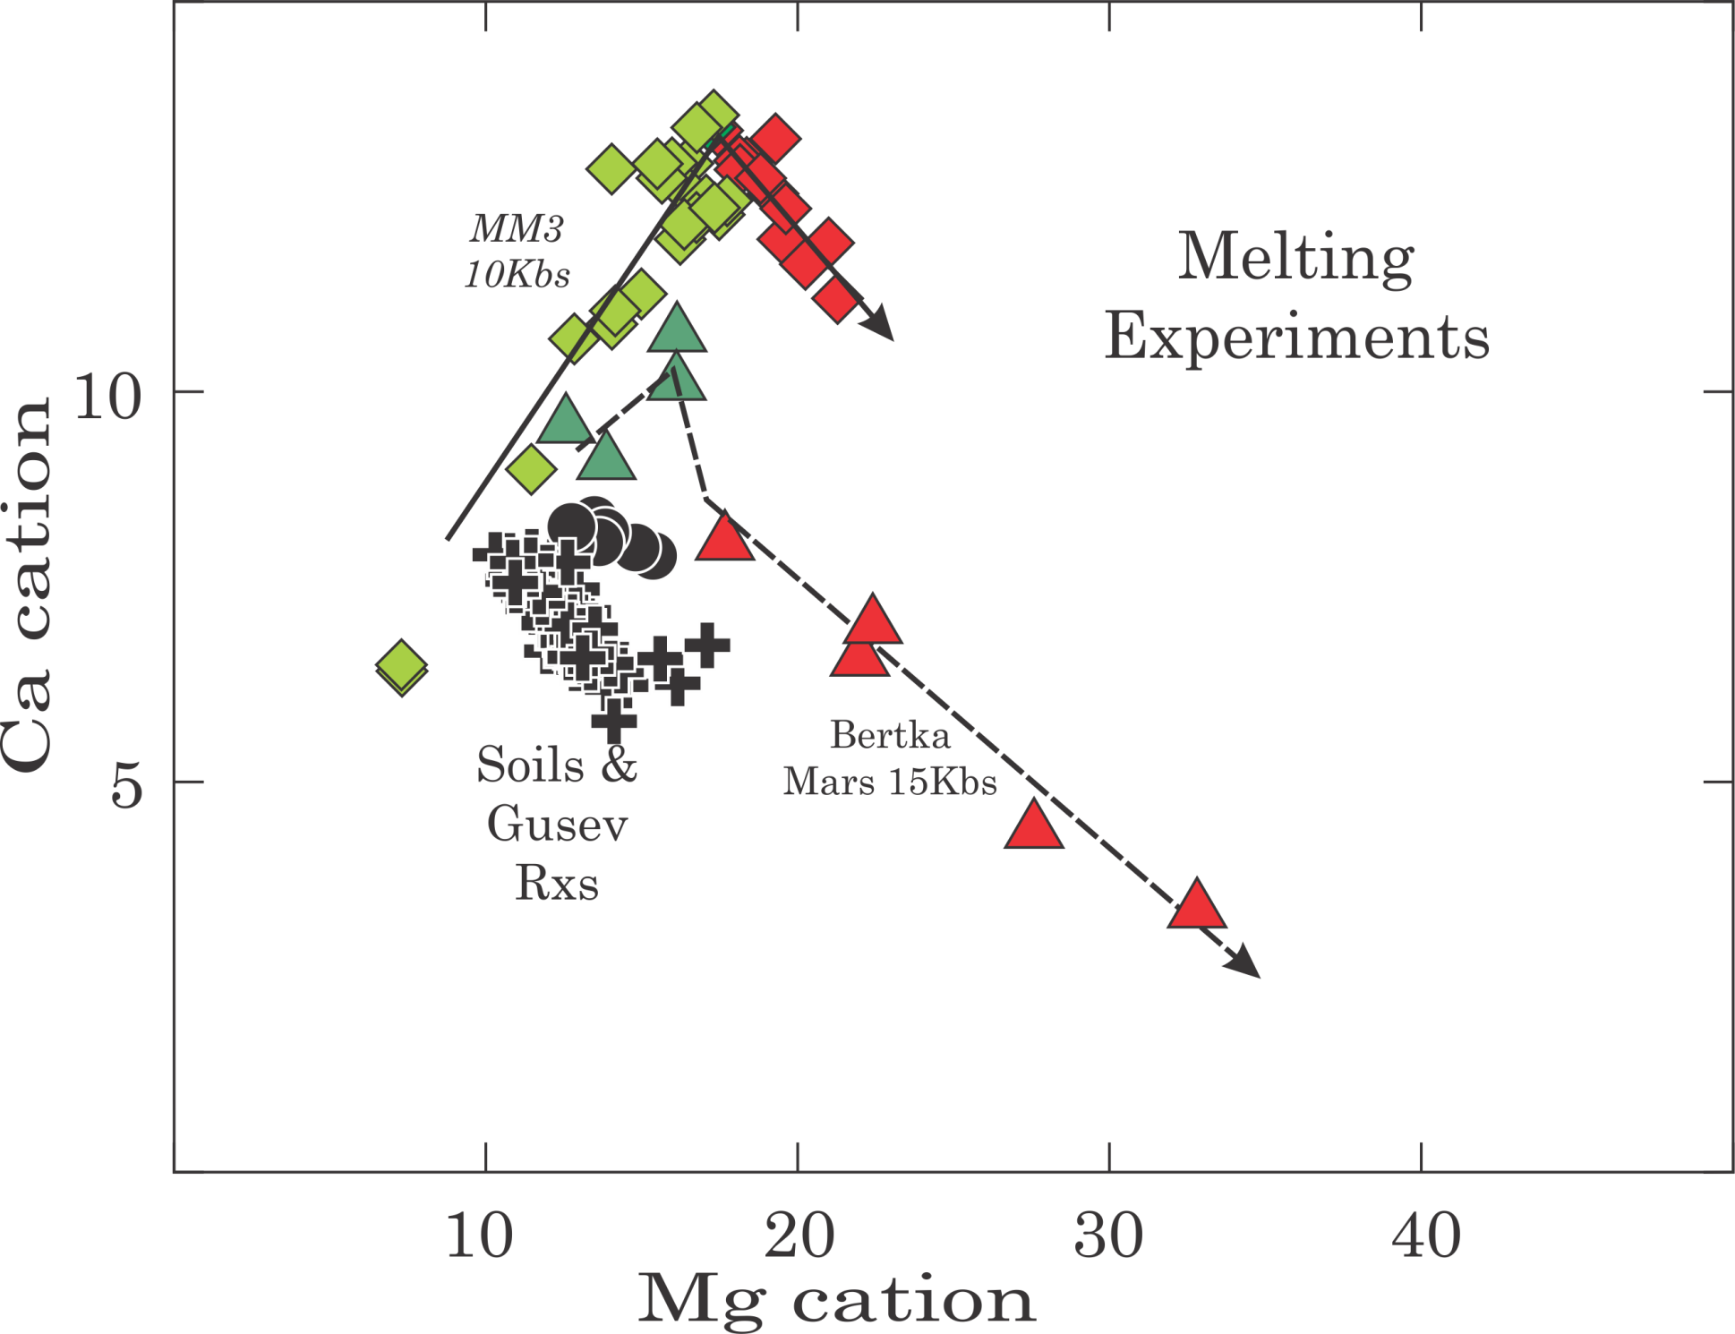

Slide 23
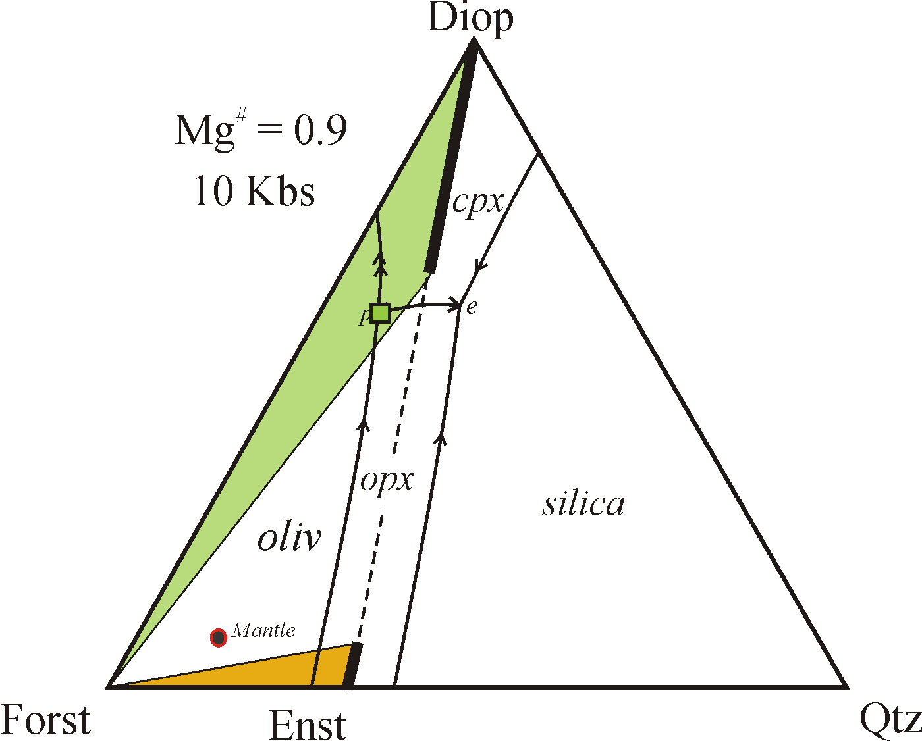
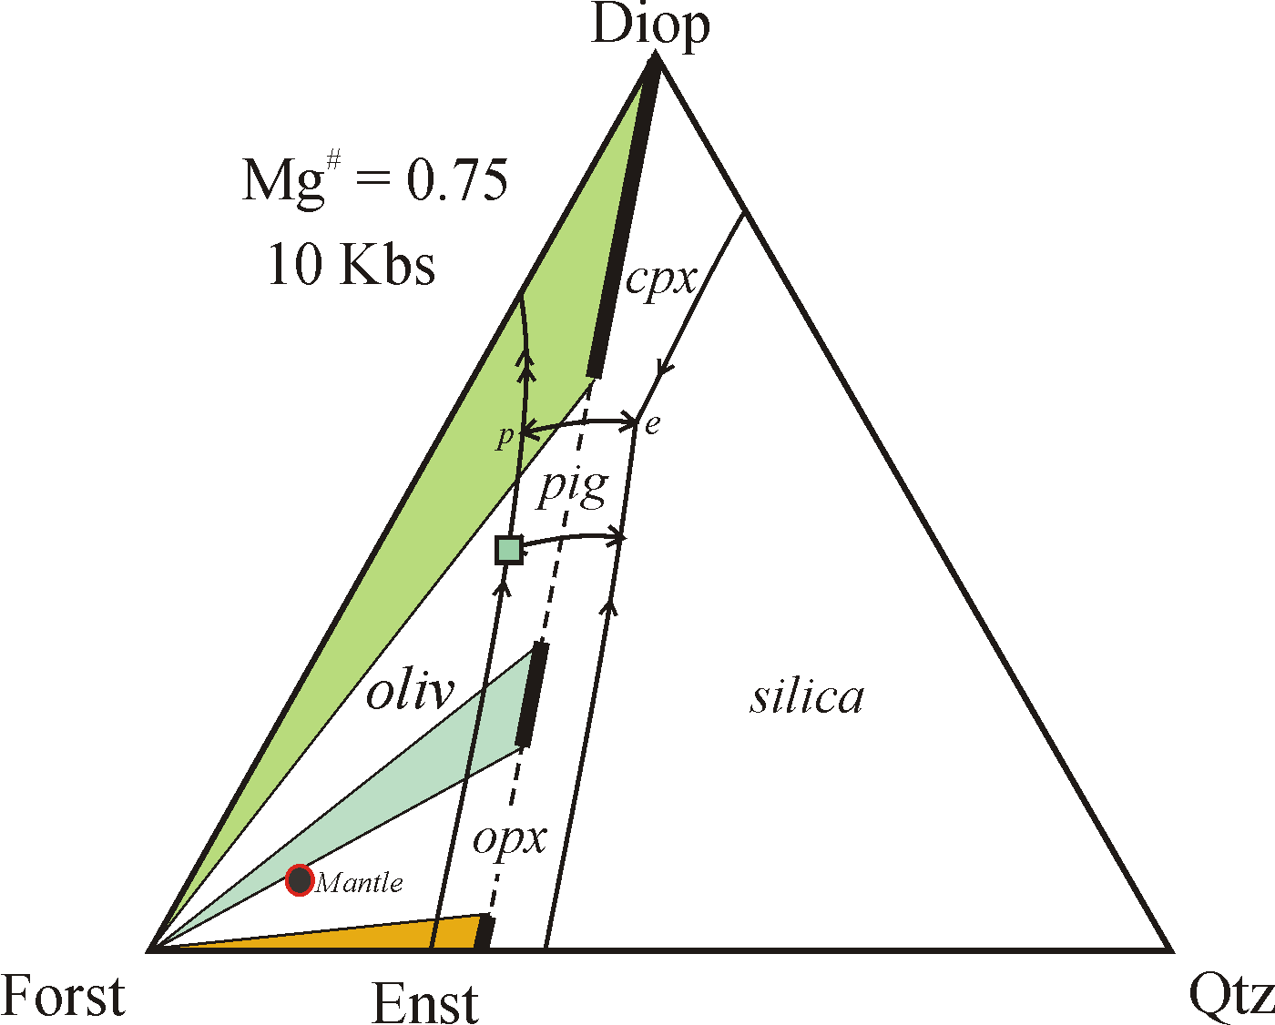
Earth
Mars
pigeonite
After Kushiro

Slide 24
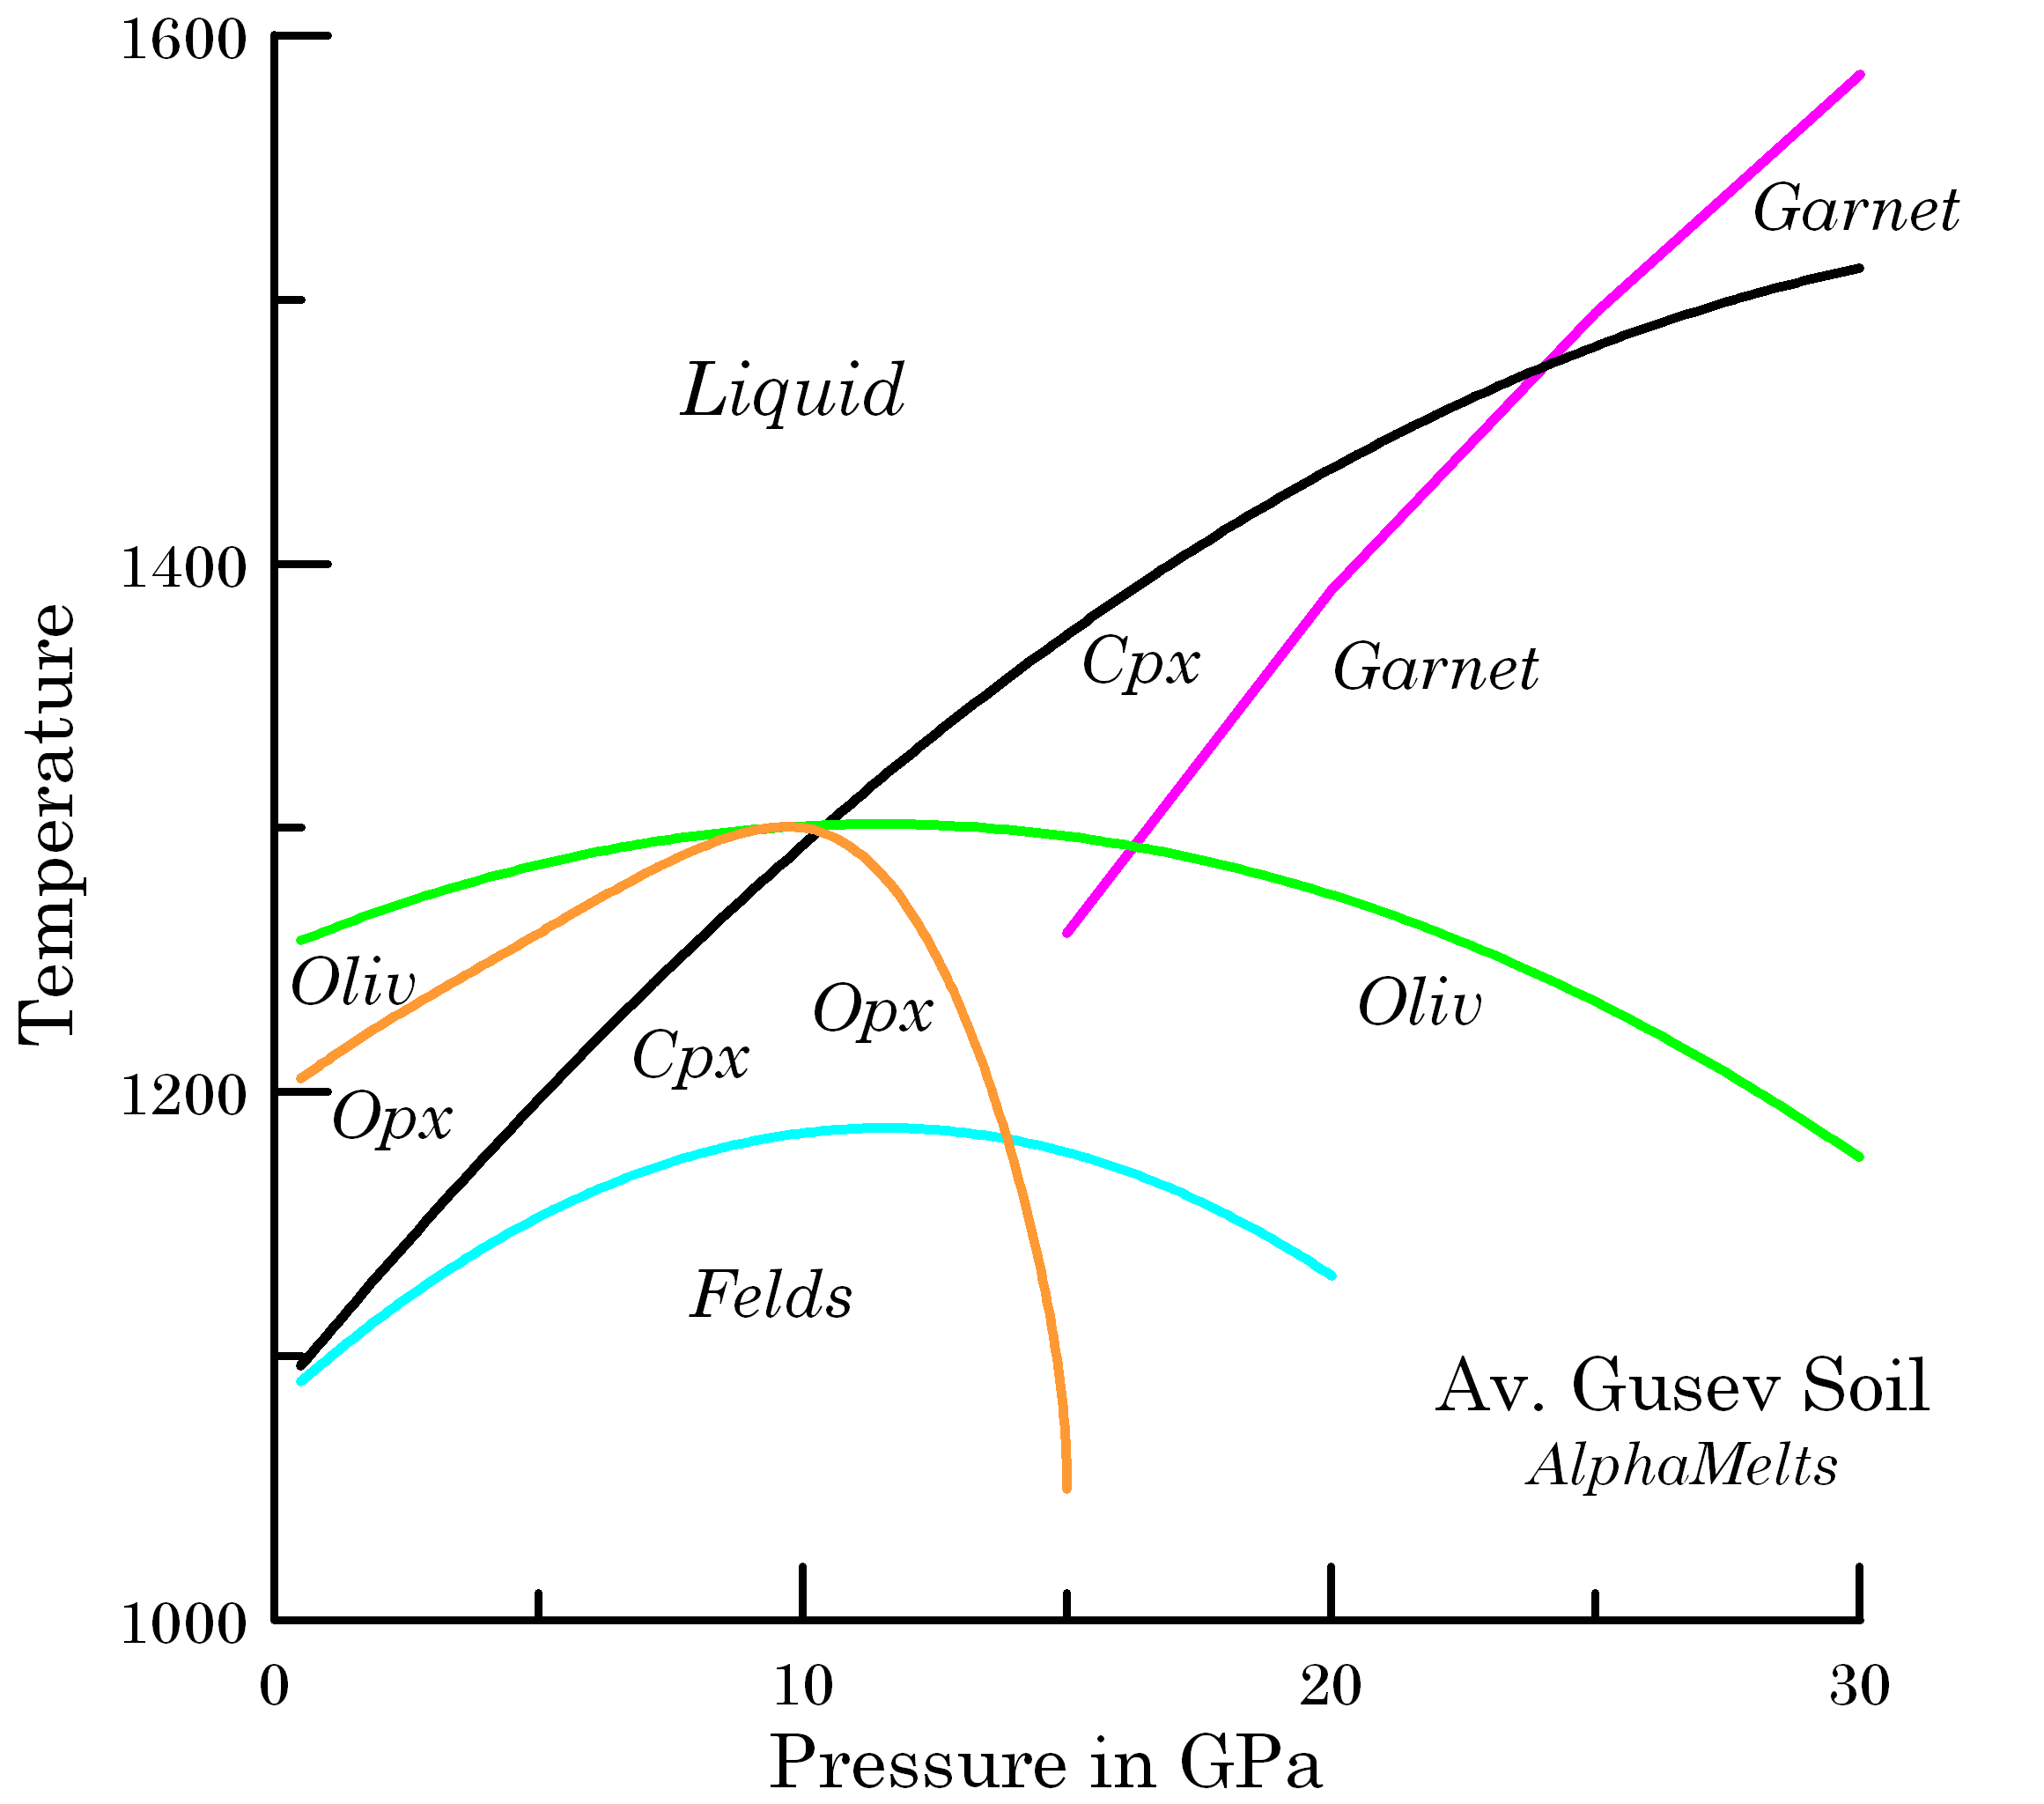

Slide 25
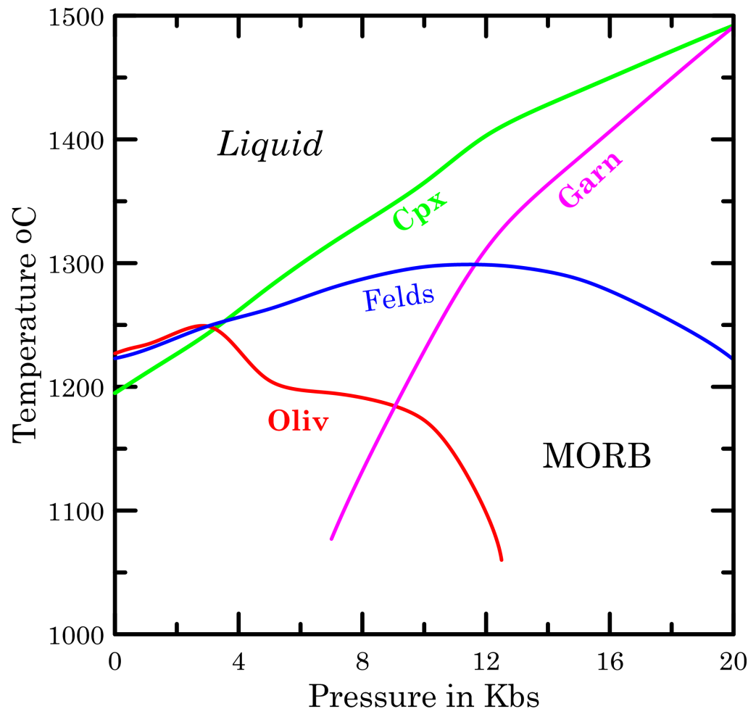
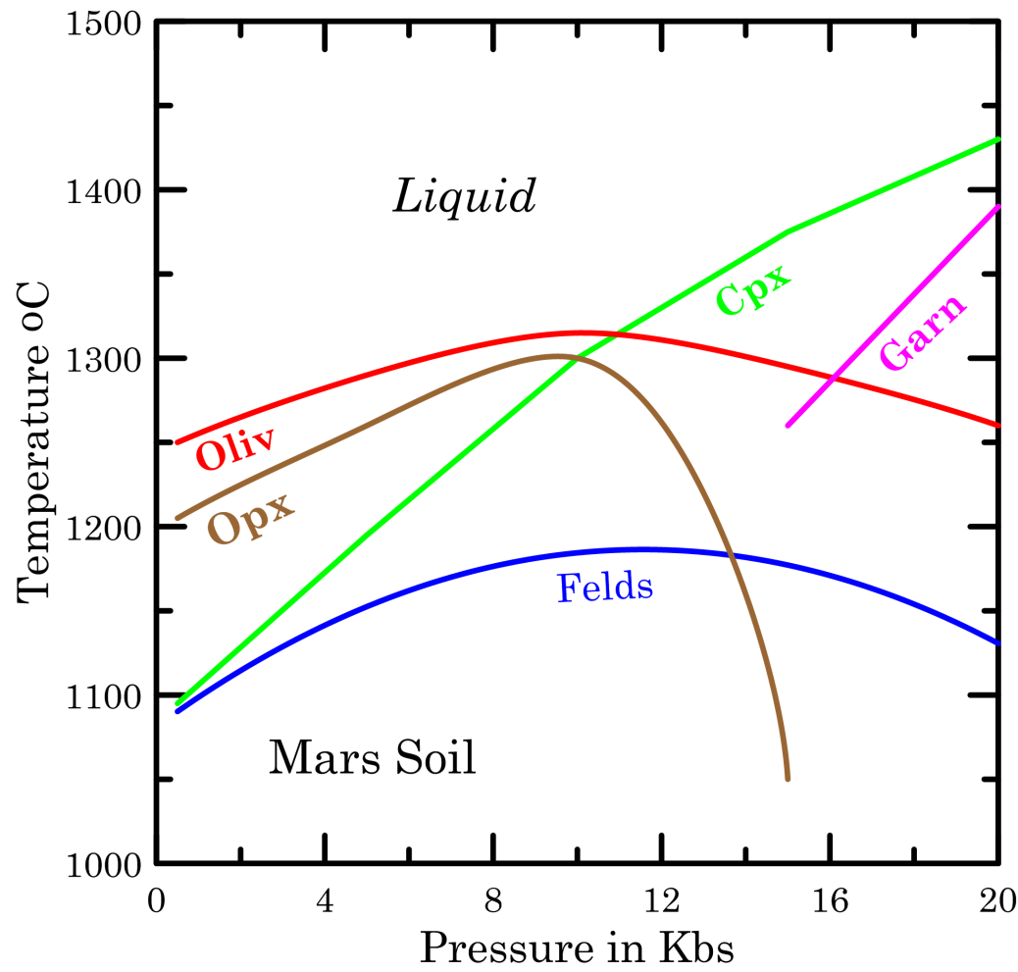

Slide 26
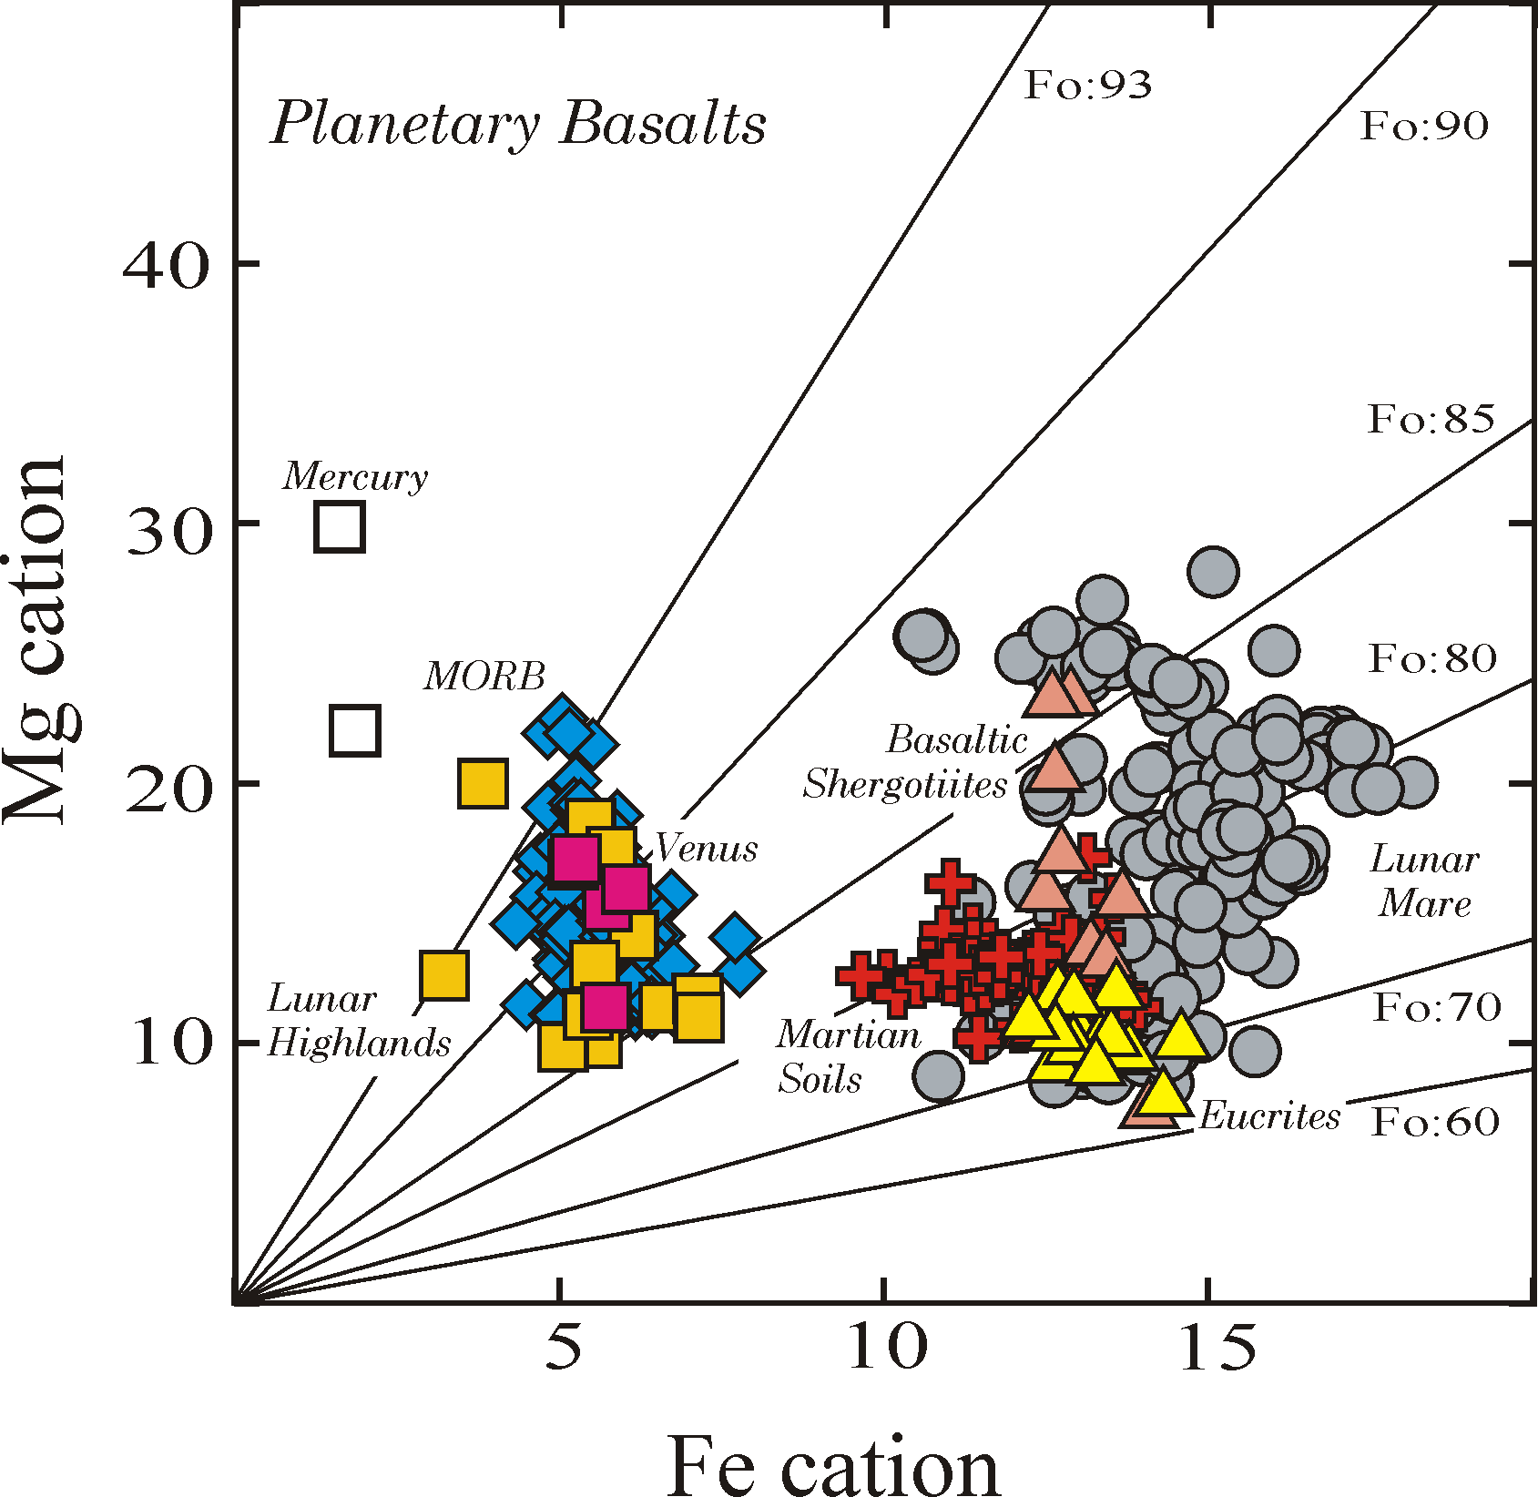
Two Populations

Slide 27
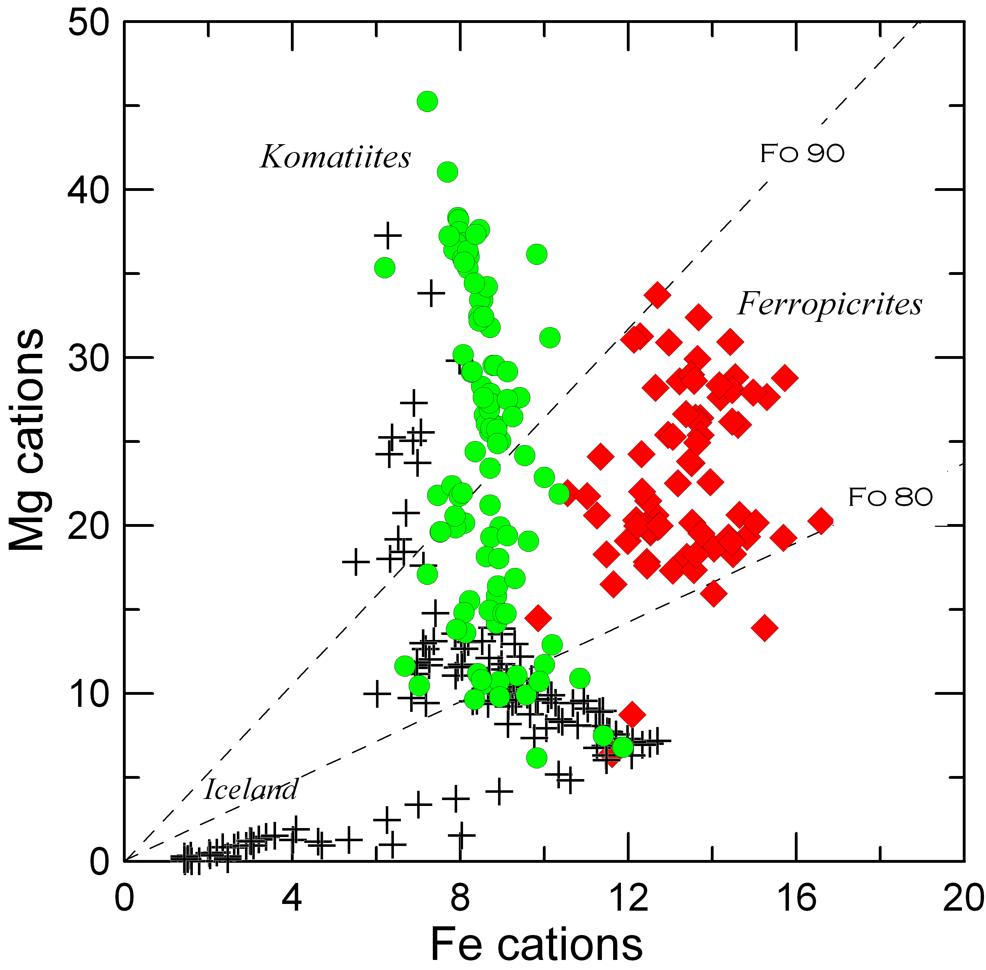
Neo-Archean
Earth
MORB

Slide 28
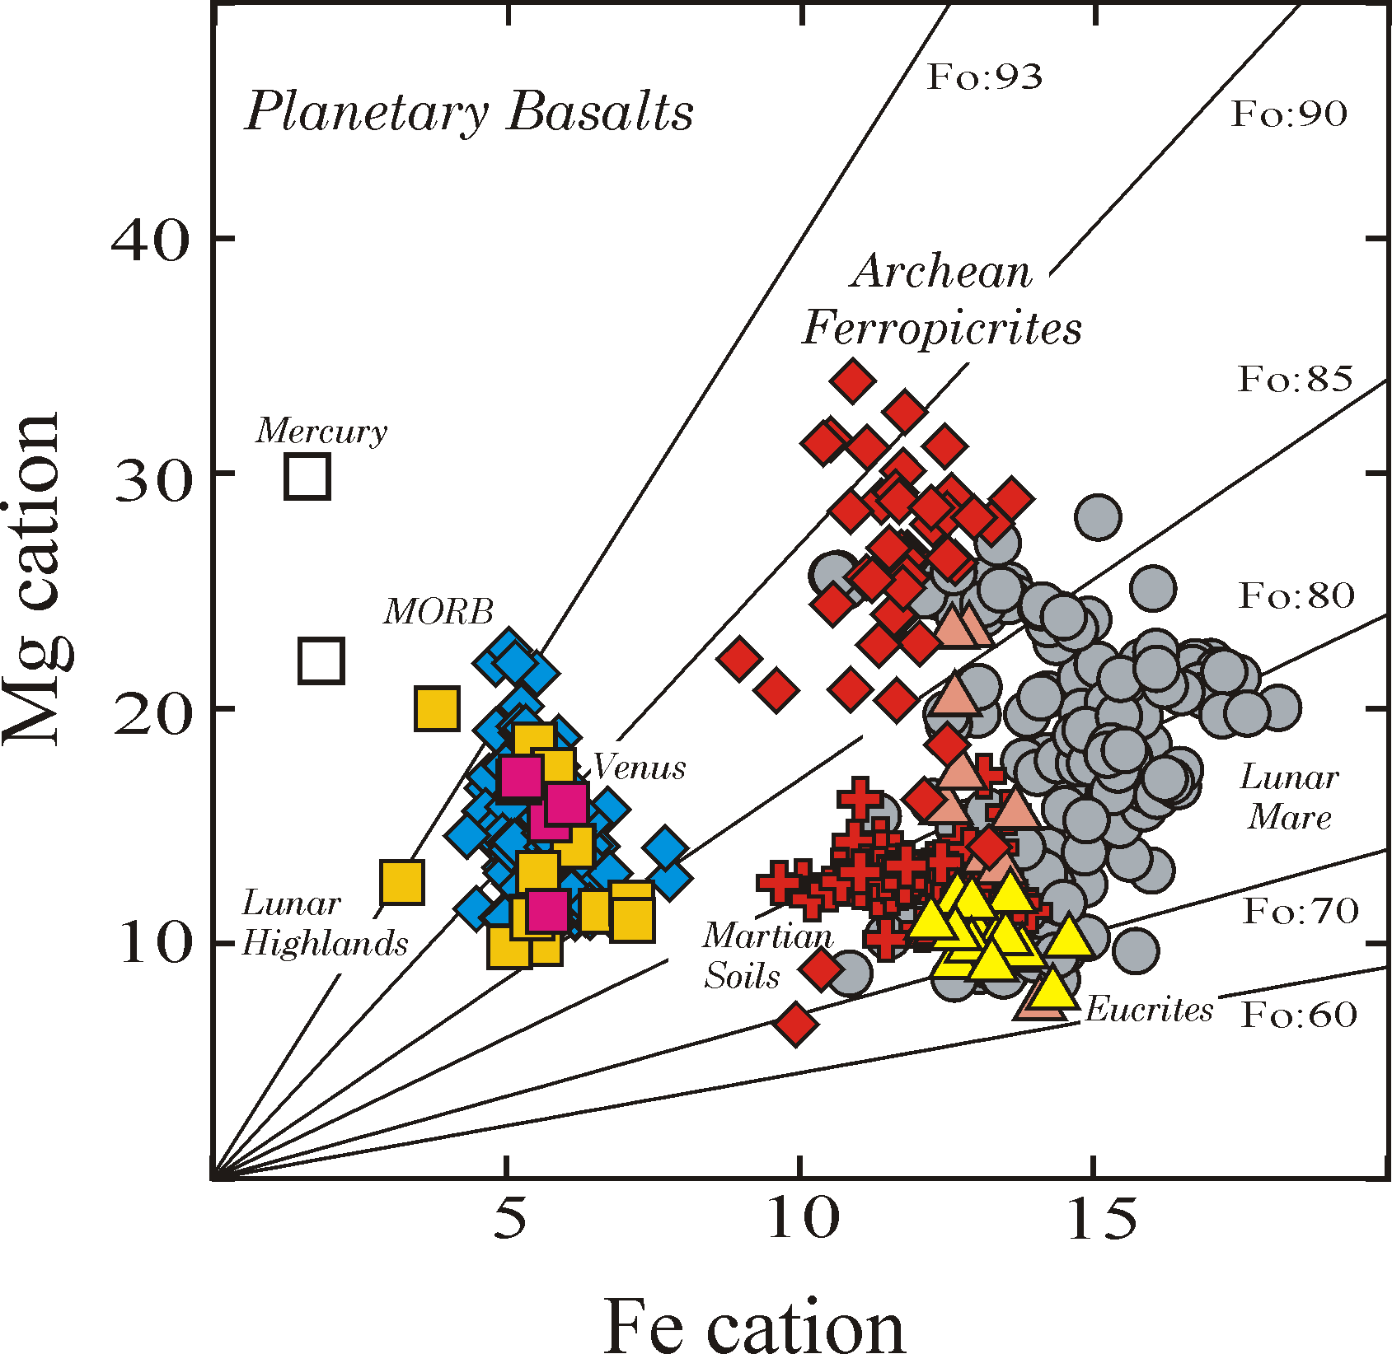
Terrestrial
Archean
Ferropicrites

Slide 29
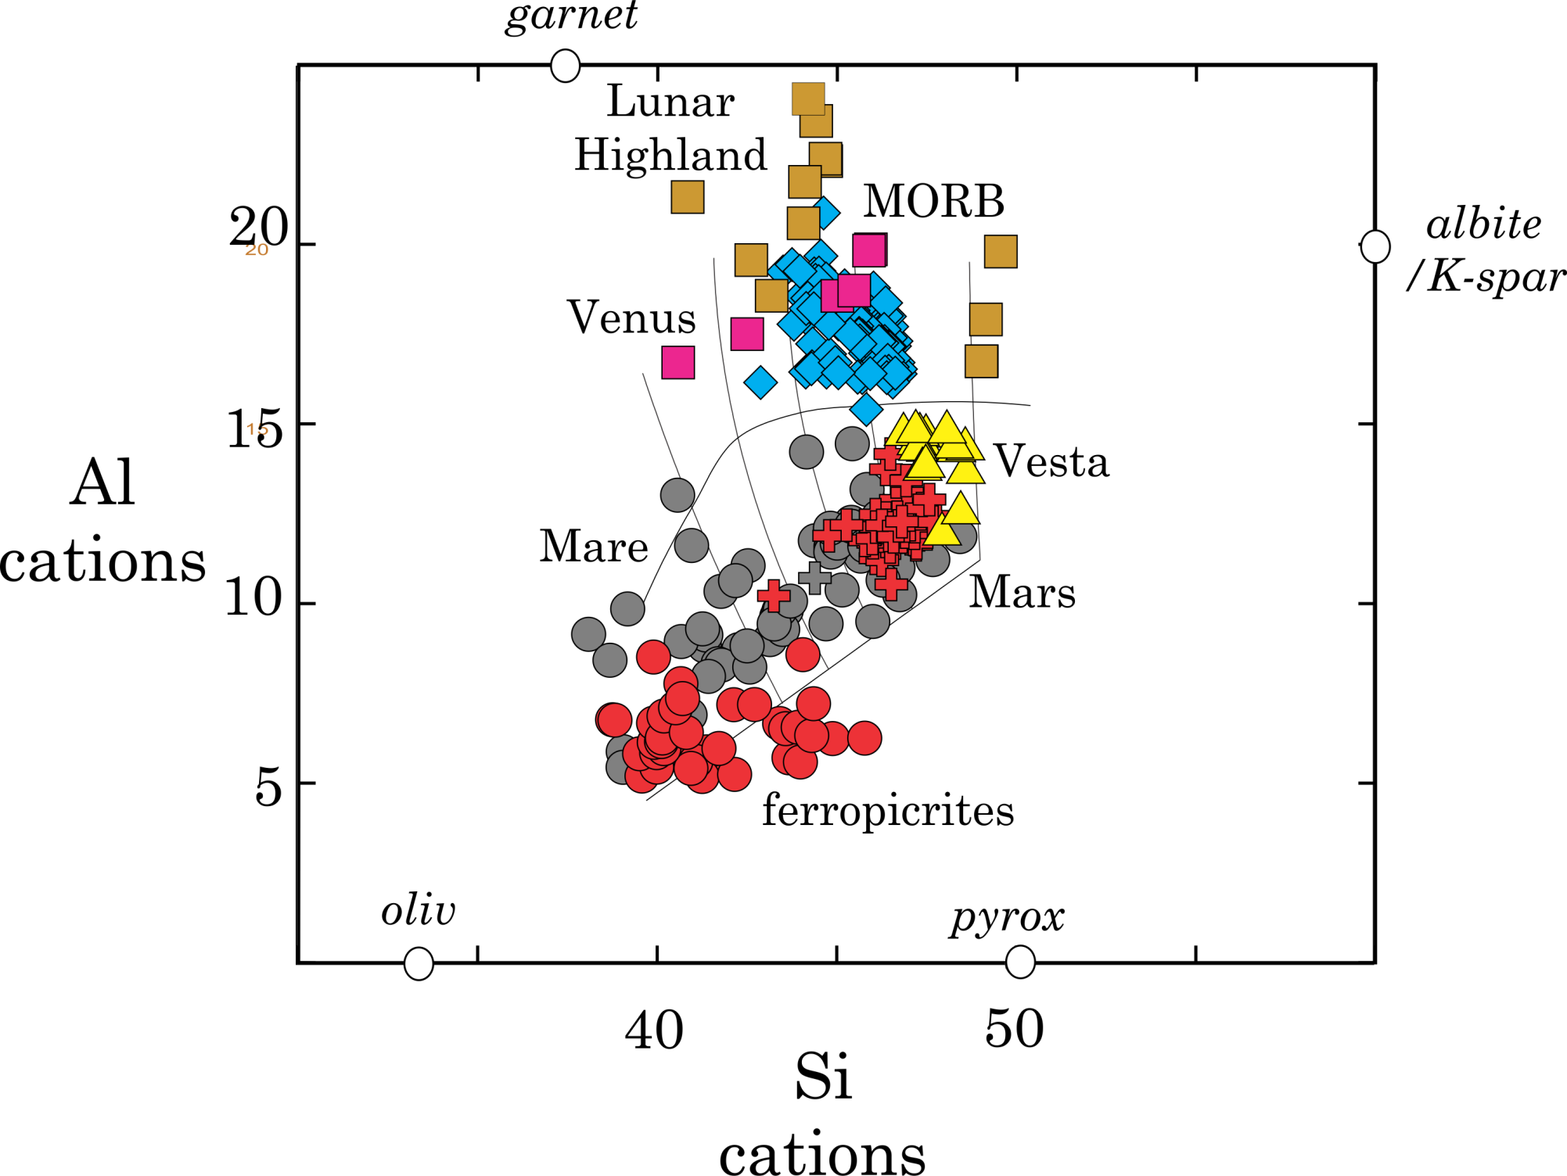

Slide 30
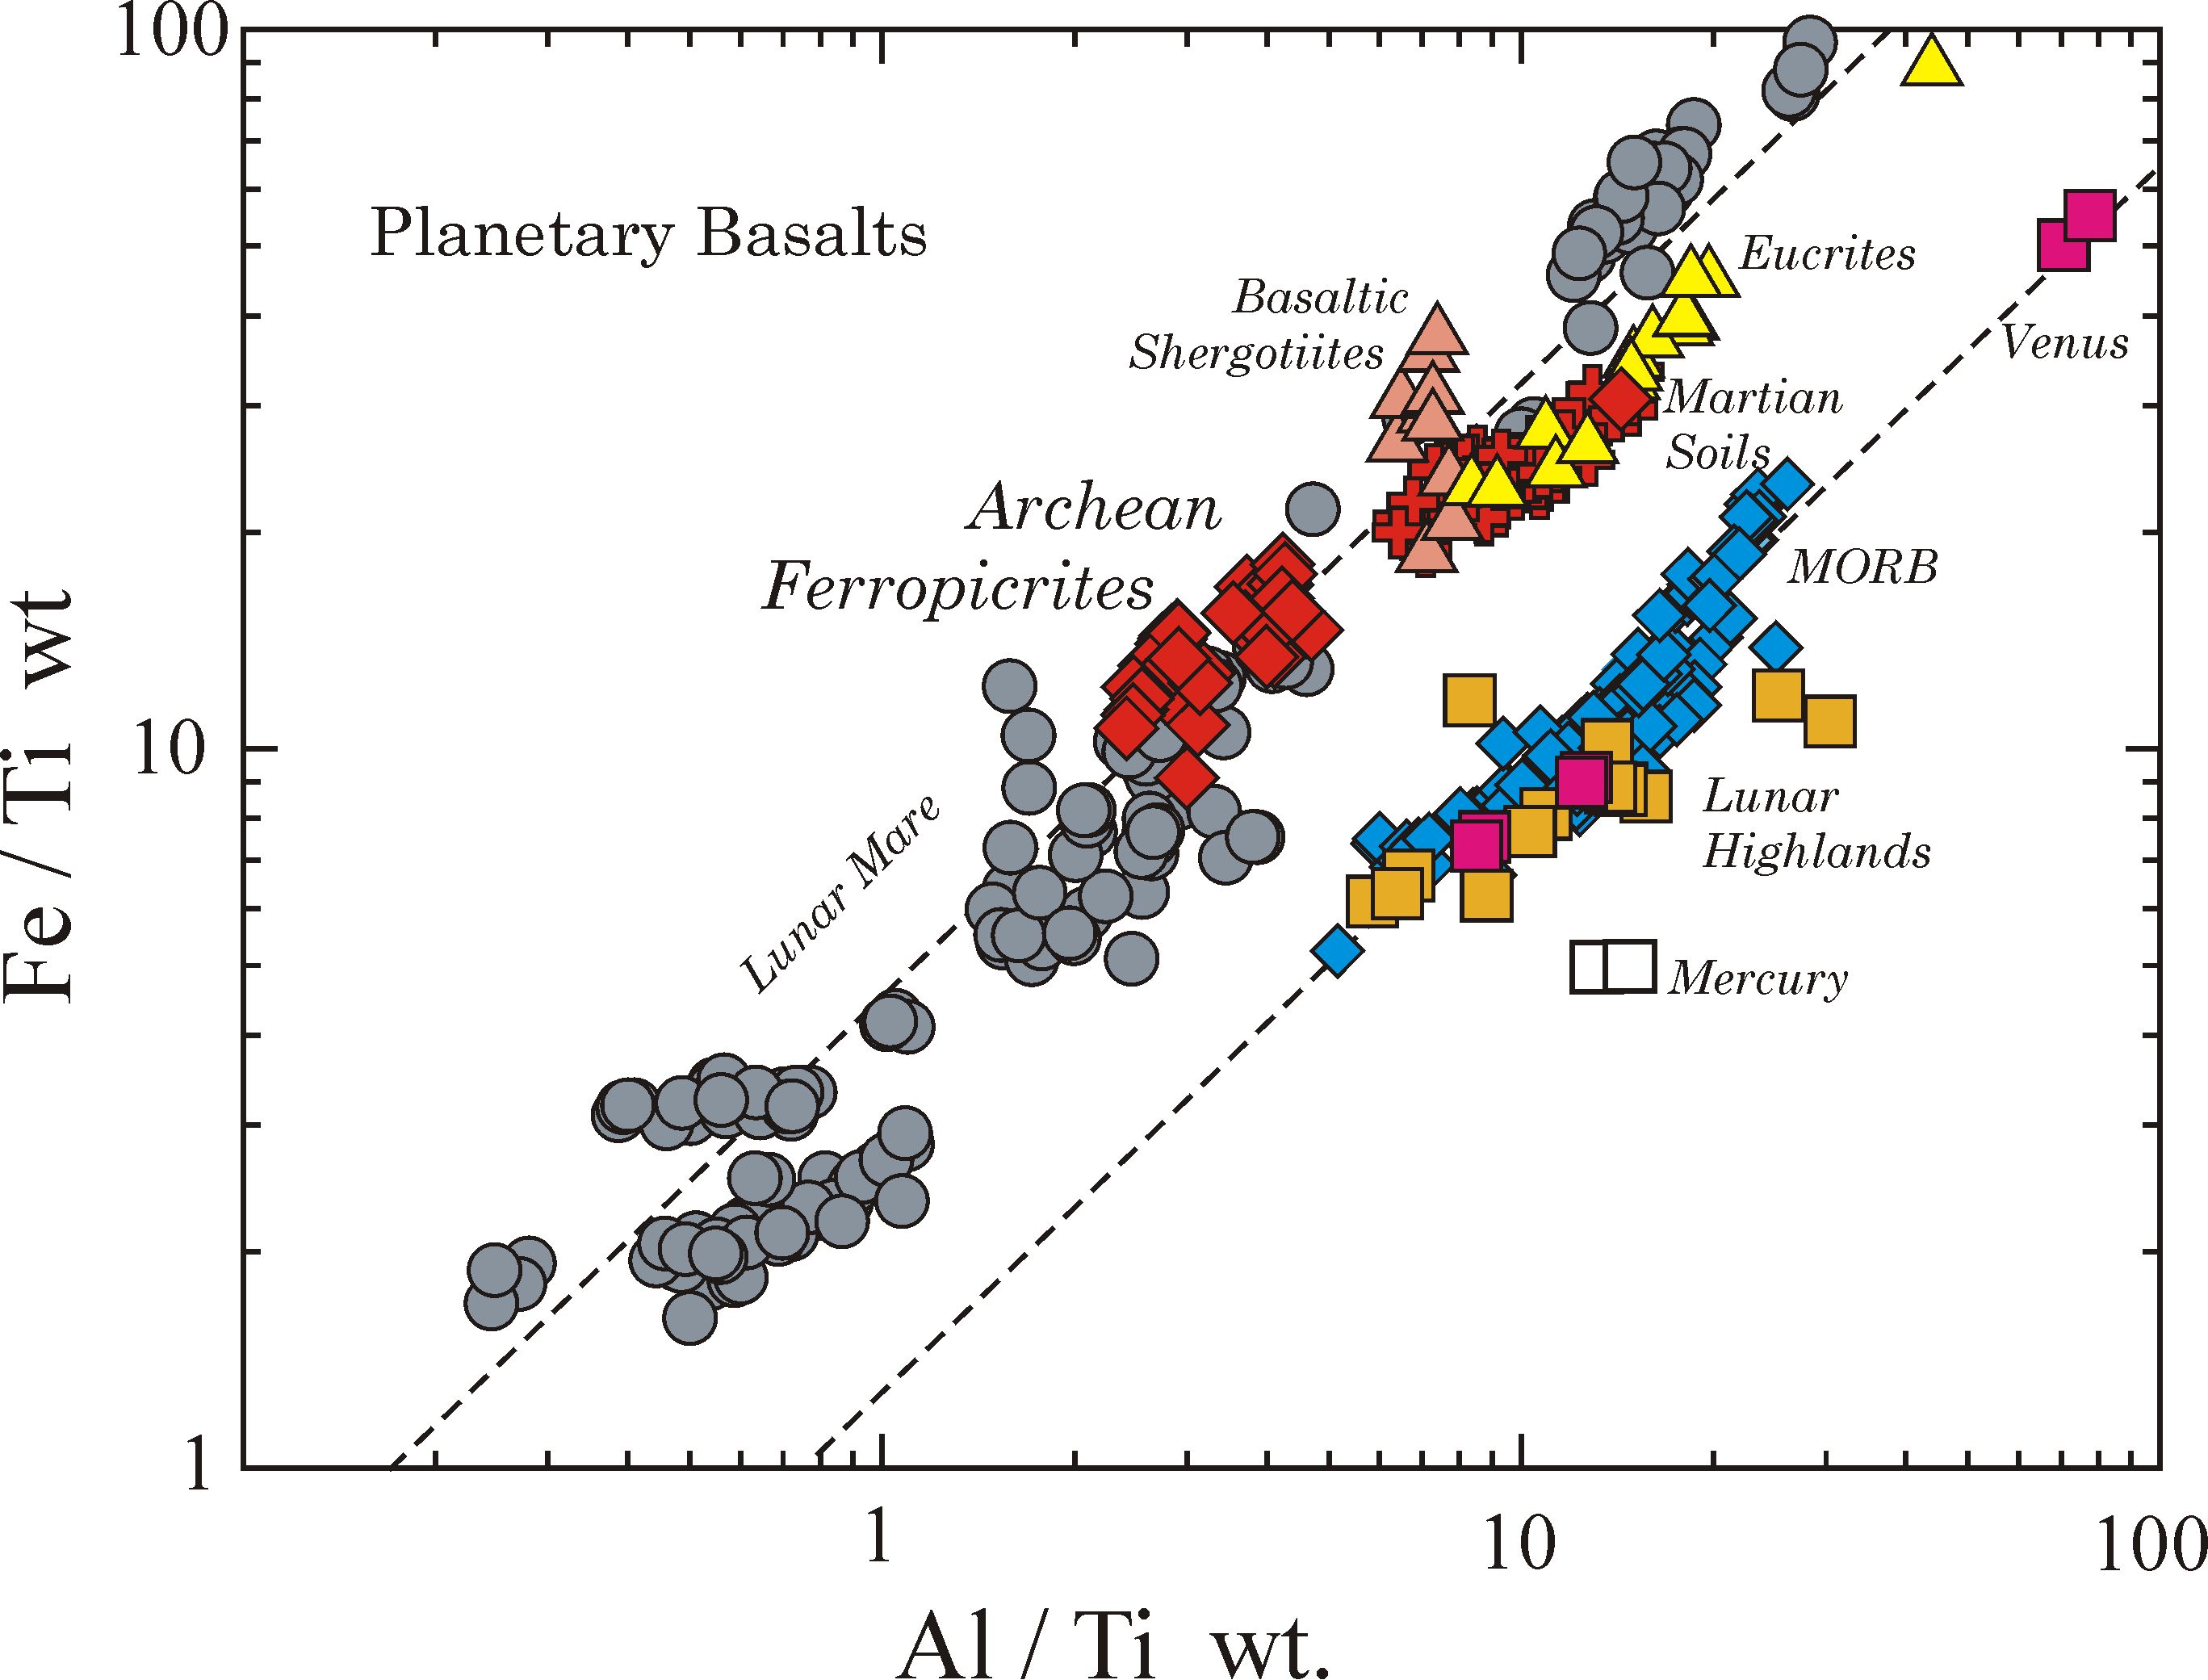

Slide 31
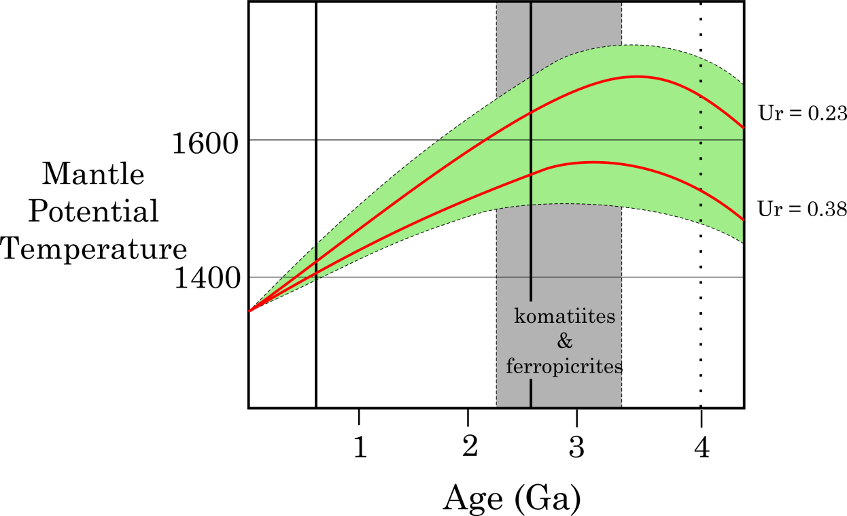
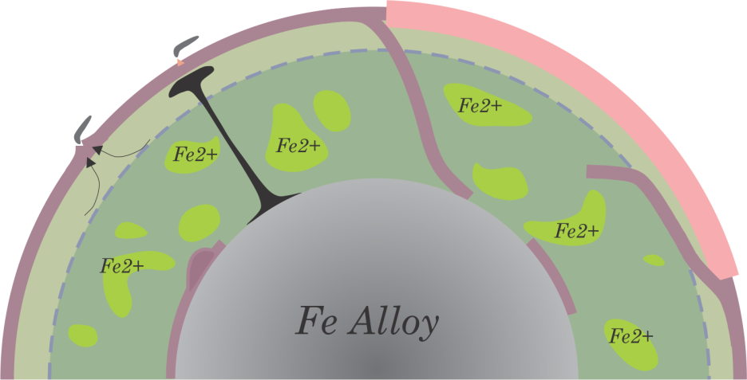
On Earth ?
and so?
Mixing of 2 Planetary Silicate reservoirs in terms of Fe²⁺ ?
after Herzberg & Korenaga

Slide 32
AsteroidBelt
A Cosmogenic Explanation?
Snow Line
A Sulfide Line?
Tar Line
FeS Line?
Ices, C
+
high-T
Metal, Oliv, Opx,
Glass
&
low-T Hydrated
Silicates
Carbonaceous & Low-T
Hydrated Silicates

Slide 33
A Sulfide line near Earth?
Feº_{metal} + S FeS_{sulfide}
Earth
Mars

